Slide 1
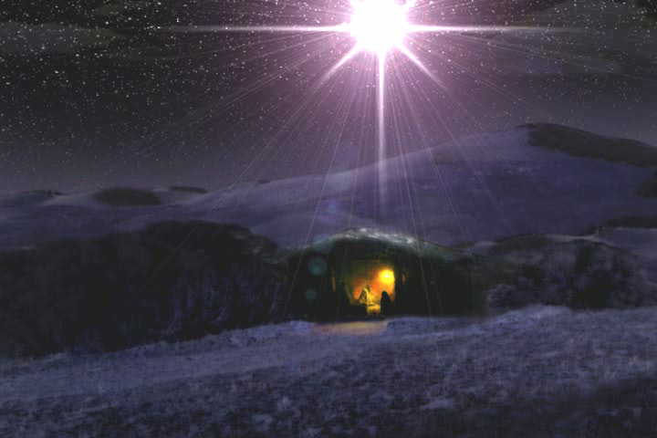
this is a test
Two Kings in Bethlehem
Notes:
There were 2 kings in Bethlehem 2000 year ago - and I think that fact was an a important part of God's plan and the message he was trying to communicate to us through the birth of Jesus the Messiah.

Slide 2
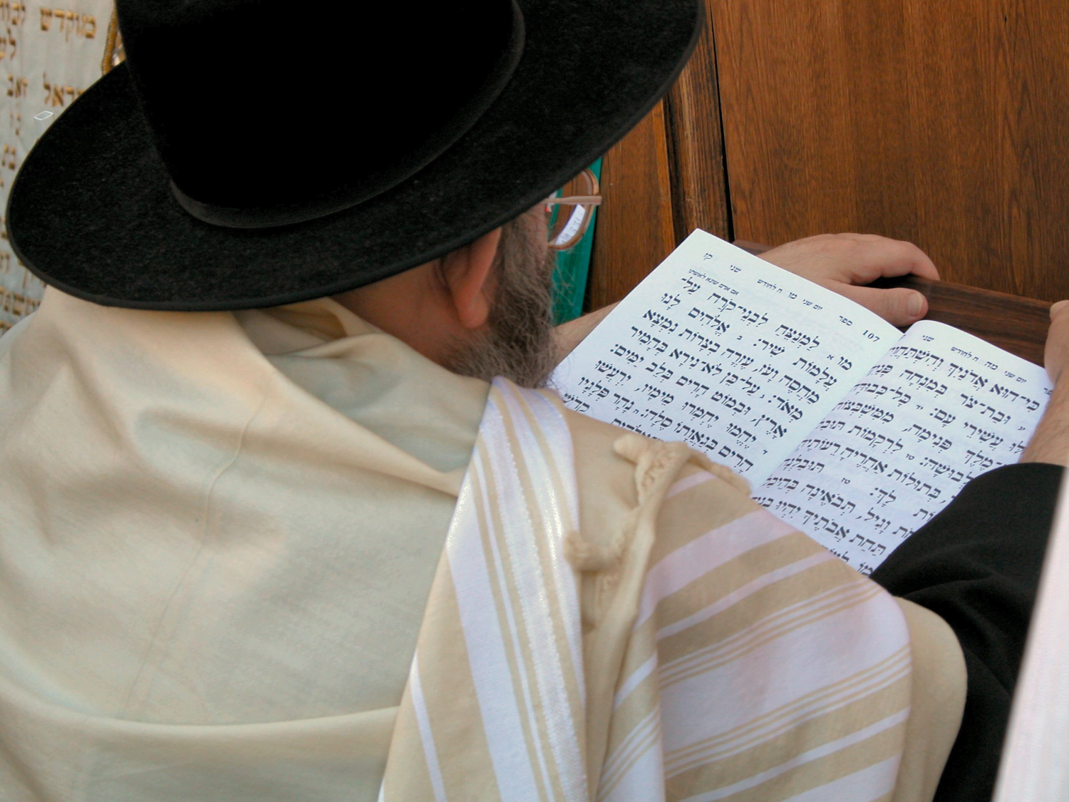
Studying at Scripture in its Context
Time (2000 - 3500 years ago)
Place (Israel, Asia, Egypt…)
Culture (Jewish, Greek, Roman…)
Notes:
Understand scripture in it's original context.

Slide 3
Western vs. Eastern
Abstract Truth
Definitions
Principles
Philosophy
Knowledge
Information
Systematics
Concrete Truth
Experiential
Word Pictures
Parables
Sayings
Practice
Symbolism

Slide 4
Western vs. Eastern
Greek
ISRAEL
Roman
Jewish
USA
Bible

Slide 5
The Bible is Written Primarily From an Eastern Perspective
The Bible is Full of Pictures
and Symbols That Westerners Sometimes Miss
Including Some Aspects of the Birth of Jesus the Messiah

Slide 6
Hosea with Kings
of Judah & Israel
Hosea
(Picture from 13th Century Bible)
Hosea with Gomer
and child
Notes:
One aside -- to show you how important symbolism can be in Scripture, and how God uses it to communicate His message.

Slide 7
Shema
Hosea 1:2-10 (TNIV)
When the Lord began to speak through Hosea, the Lord said to him, “Go, marry a promiscuous woman and have children with her, for like an adulterous wife this land is guilty of unfaithfulness to the Lord.” So he married Gomer daughter of Diblaim, and she conceived and bore him a son.
Then the Lord said to Hosea, “Call him Jezreel, because I will soon punish the house of Jehu for the massacre at Jezreel, and I will put an end to the kingdom of Israel. In that day I will break Israel’s bow in the Valley of Jezreel.”
Gomer conceived again and gave birth to a daughter. Then the Lord said to Hosea, “Call her Lo-Ruhamah (which means “not loved”), for I will no longer show love to the house of Israel, that I should at all forgive them. Yet I will show love to the house of Judah; and I will save them—not by bow, sword or battle, or by horses and horsemen, but by the Lord their God.”
After she had weaned Lo-Ruhamah, Gomer had another son. Then the Lord said, “Call him Lo-Ammi (which means “not my people”), for you are not my people, and I am not your God.
“Yet the Israelites will be like the sand on the seashore, which cannot be measured or counted. In the place where it was said to them, ‘You are not my people,’ they will be called ‘children of the living God.’
Notes:
Very strange to Westerners… God wouldn't do that! In our eyes.
Hosea "Salvation" - names are VERY important. Jewish people can't believe that most of us Christians don't know what names of people and places mean. That's often essential to the story.
buys back his wife, even though she was unfaithful. He lived out the destiny symbolized by his name -- and was her salvation.
Remember this for the very end-- How will salvation come? not by power. I will show love and I will save them. Not thru battle. Not the way you think salvation will come.

Slide 8
God Arranged Hosea's Entire Life (and the lives of his wife and children) as a PICTURE of His Message
Notes:
God's Truth is OFTEN communicated in pictures; in symbols. It's the Eastern way. We have to look for it, and then in minds, it's a real stretch to make any signifiance of it. But to Jewish people, the original audience, they expected to be communicated to in this way. It seem STRANGE to us, but it was NOT to them.
They expected God to communicate his message in Pictures.

Slide 9
this is a test
There is also a PICTURE of God's Message in the Birth of Christ

Slide 10
Shema
Genesis 25:21-26 (NIV)
Isaac prayed to the Lord on behalf of his wife, because she was barren. The Lord answered his prayer, and his wife Rebekah became pregnant. The babies jostled each other within her, and she said, “Why is this happening to me?” So she went to inquire of the Lord.
The Lord said to her,
“Two nations are in your womb,
and two peoples from within you will be separated;
one people will be stronger than the other,
and the older will serve the younger.”
When the time came for her to give birth, there were twin boys in her womb. The first to come out was red, and his whole body was like a hairy garment; so they named him Esau. After this, his brother came out, with his hand grasping Esau’s heel; so he was named Jacob.
Notes:
Esau - hairy
Jacop - the one who follows, the one who supplants (takes the place of)

Slide 11
Shema
Genesis 25:29-30 (NIV)
Once when Jacob was cooking some stew, Esau came in from the open country, famished. He said to Jacob, “Quick, let me have some of that red stew! I’m famished!” (That is why he was also called Edom.)
Genesis 36:8-9 (NIV)
So Esau (that is, Edom) settled in the hill country of Seir. This is the account of Esau the father of the Edomites in the hill country of Seir…
Numbers 24:17-19 (NIV)
A star will come out of Jacob; a scepter will rise out of Israel. He will crush the foreheads of Moab, the skulls of all the sons of Sheth. Edom will be conquered; Seir, his enemy, will be conquered, but Israel will grow strong. A ruler will come out of Jacob and destroy the survivors of the city.”
Notes:
Edom - red, red earth (same root that Adam is derived from)
Seir the area south of Judah - called Idumea in Roman times
REMEMBER "a ruler will come out of Jacob"

Slide 12
Shema
Matthew 1 (NIV)
A record of the genealogy of Jesus Christ the son of David, the son of Abraham: Abraham was the father of Isaac, Isaac the father of Jacob, Jacob the father of Judah… Jesse, the father of King David… Joseph, the husband of Mary, of whom was born Jesus.
Matthew 2 (NIV)
Jesus was born in Bethlehem in Judea, during the time of King Herod. Magi﻿﻿ from the east came to Jerusalem and asked, “Where is the one who has been born king of the Jews? We saw his star in the east﻿﻿ and have come to worship him.” When King Herod heard this he was disturbed, and all Jerusalem with him. When he had called together all the people’s chief priests and teachers of the law, he asked them where the Christ﻿﻿ was to be born. “In Bethlehem in Judea,” they replied, “for this is what the prophet has written:
‘But you, Bethlehem, in the land of Judah,
are by no means least among the rulers of Judah;
for out of you will come a ruler
who will be the shepherd of my people Israel.’” [quoting Micah 5:2]
Notes:
Ch 1 - Genealogy from Abraham and Jacob all the way to Joseph and Jesus.
Jesus - The LORD is Salvation
Ch 2 - starts what we call the Christmas story.
Jesus - ruler coming out of Jacob -- who would destroy Edom.
King Herod -- AN IDOMITE !! ruling over Jews… and I'm sure he knew the prophesy.. that a ruler would come from Jacob and destroy Edom.
What do you know about King Herod? I am willing to bet.. not much!
"during the time of King Herod" invokes emotion similar to "in the days of Adolf Hilter would to a Jew today"

Slide 13
Herod
the Great
Great Wealth
Great Power
Great Builder
Great Cruelty

Slide 14
Herod the Great
------
King of the Jews
Galilee
Nazareth
Judea
Jerusalem
Bethlehem
Idumea
Notes:
This was his Kingdom. Palestine (the name comes from the word Philistine). The land of the Jews. They lived mostly in Judea and Galilee.

Slide 15
Sea of Galilee
Mt. Arbel
Notes:
Jesus chose disciples, taught, did most miracles here, on the North shore of Galilee -- Korazin, Capernaum, and Bethsaida.
In the distance -- Mt Arbel.

Slide 16
Mt. Arbel in Galilee
Notes:
Note caves in circle
Used to be VERY high cliffes here -- landslides and erosions have changed that. Caves used to be a hundred feet or more above the ground. Nearly impossible to climb to.

Slide 17
The Caves of Mt. Arbel
Herod Begins His Reign as King
Notes:
~30 years before Jesus was born, Herod was made of King if Palestine by Rome (Mark Anthony). Before that time Herod was a governor; his father Antipater was called the procurator. But there was an uprising, his father was murdered by the Jewish people, Herod fled to Rome. Rome made Herod the new King, and was given military support to go claim his kingdom. That’s what he did.
He came with a fury, killing and burning towns and villages, and broke the resistance of those Jewish rebels near the Sea of Galilee. There were some that escaped - the remaining rebels and their families hid in these caves in the cliffs along Mount Arbel. Herod was so determined to destroy any opposition that he commanded his troops to make platforms to be let down with ropes to the openings of the caves, and there they lit fires. When the people came out for air they were pulled out with hooks on long poles and dropped down the sheer cliff. Josephus records one man killed his seven children and his wife before leaping to his own death.
Herod with 2 more legions, went on to attack Jerusalem. Many retreated to behind the walls of the temple. But eventually the walls of the temple were breached. The slaughter was beyond description. Women were raped and slaughtered, children were brutally killed, people were tortured and chopped to pieces. And about 30 years before Jesus was born, Herod the Great, King of the Jews, took his throne.

Slide 18
Notes:
Herod had a big family. His family tree is confusing. There are several Herod's (his relatives) in the Bible, so that makes it more confusing.
Blue circle -- Had 10 wives. His second was Miriam, daughter of the Jewish high priest. His favorite wife. He killed her, so no one would lust after her.
He killer her mother too, and her brother. And he killed their 2 sons.
He also killed 45 of the 70 Sanhedrin - ruling Jewish council of elders
On is deathbed, he killed his oldest son, because he was afraid he would take over the reign too soon.
It was said it is safer to be Herod's dog than his friend or family.

Slide 19
Shema
Herod Lived For Power, And Killed Anyone Who Got In His Way.
Matthew 2:16 (NIV)
When Herod realized that he had been outwitted by the Magi, he was furious, and he gave orders to kill all the boys in Bethlehem and its vicinity who were two years old and under, in accordance with the time he had learned from the Magi.
But there was another side to
Herod the Great ---
Master Builder of the Impossible
Notes:
Killing a few dozen babies in Bethlehem was nothing to a man like Herod.

Slide 20
the Jerusalem Temple
Built By Herod
Notes:
Herod rebuilt the temple, to try and gain favor among the Jewish people.
This is a MODEL. Temple wa built on a hillside. Mt Moriah.
Built a HUGE retaining wall and enlarged this whole section of the Temple.
foundation stones 40 ft below gound level
Temple was HUGE!!, by any standards, then or today.

Slide 21
the Temple
in Jesus' Day
Notes:
Look at the relative size of the people, compared to one layer of stone.

Slide 22
Herod's Palace in Jerusalem
Even Bigger than the Temple !
Notes:
Another view of a reconstructed model of old Jerusalem.
The temple in the upper right corner
There was ONE building in Jerusalem even Bigger than the temple.

Slide 23
Herod the Great's Winter Palace at Jericho
Notes:
Herod man-made oasis of a palace in Jericho. Unbelievable luxury, with running water and swimming pools in the middle of the wilderness.

Slide 24
Herod's Jericho Palace
The North Wing
Reception Hall and
Bath Complex

Slide 25
Herod's Great
Man-Made Harbor
At Caesarea
Notes:
Herod was the builder of the impossible. A huge man-made harbor which became the most significant seaport in all the area.

Slide 26
Herod's Masada Fortress
Notes:
His most famous -- Masada fortress.

Slide 27
Herod's Masada Fortress
Hanging Palaces
Notes:
Hanging palaces that almost defy gravity. How could they even be built?
He literally moved mountains to redirect flash flood water to fill his cisterns.

Slide 28
Herod's Kingdom
Major Buildings
Notes:
Magnificant, massive, beautiful buildings, All over his kingdom

Slide 29
The Herodion
Viewed from Jerusalem
Notes:
But there's one more I need to show you. This mountain, seen from near the temple in Jerusalem. Called the Herodion -- Herod named it after himself. Not surprising.

Slide 30
Herod the Great's "Herodion"
Notes:
Looks like a volcano crater - and it looked even more that way when Herod built it.

Slide 31
The Herodion
Notes:
Seen from his swimming pools at the base of the mountain.
This mountain is actually largely a MAN - MADE mountain. Massive amounts of earth moved up ontop of an existing hill.

Slide 32
"The Herodion"
Herod's Palace on his Man-Made Mountain
Notes:
3 stories buried; 4 on top, with the high tower for his family residence.

Slide 33
Herod the Great
------
King of the Jews
Galilee
Nazareth
Judea
Jerusalem
Bethlehem
Herodion
Notes:
And look where it was located.

Slide 34
Bethlehem Today from The Herodion
Notes:
Bethlehem, about a mile away from the Herodian, was almost literally in its shadow.

Slide 35
Bethlehem
pop. ~300
Herodion
Notes:
2000 years ago Bethlehem probably was more this size.
And the Herodian would have been about here, where this hill is.
SO THAT'S THE CONTEXT OF HEROD THE GREAT

Slide 36
Shema
Luke 2:4-7 (NIV)
So Joseph also went up from the town of Nazareth in Galilee to Judea, to Bethlehem, the town of David, because he belonged to the house and line of David. He went there to register with Mary, who was pledged to be married to him and was expecting a child. While they were there, the time came for the baby to be born, and she gave birth to her firstborn, a son. She wrapped him in cloths and placed him in a manger, because there was no room for them in the inn.
Notes:
UP - towards Jerusalem, towards God, always UP
NAZARETH - branch, shoot - Jesus the shoot of Jesse
BETHLEHEM - house of bread -- Jesus the bread of life
TOWN OF DAVID - King David was born here. Small world.
SHEPHERD - probably women or children

Slide 37
Notes:
Typical Christmas scene -- Mary on donkey, Joseph getting refused by the innkeeper, a wooden manger with nicely fluffed straw waiting in background
Remember, Bethlehem ~300 people, like Wyatt… why would they have an Inn?
word = guestroom or inn. people often had a guestroom, often upstairs. This is more likely.

Slide 38
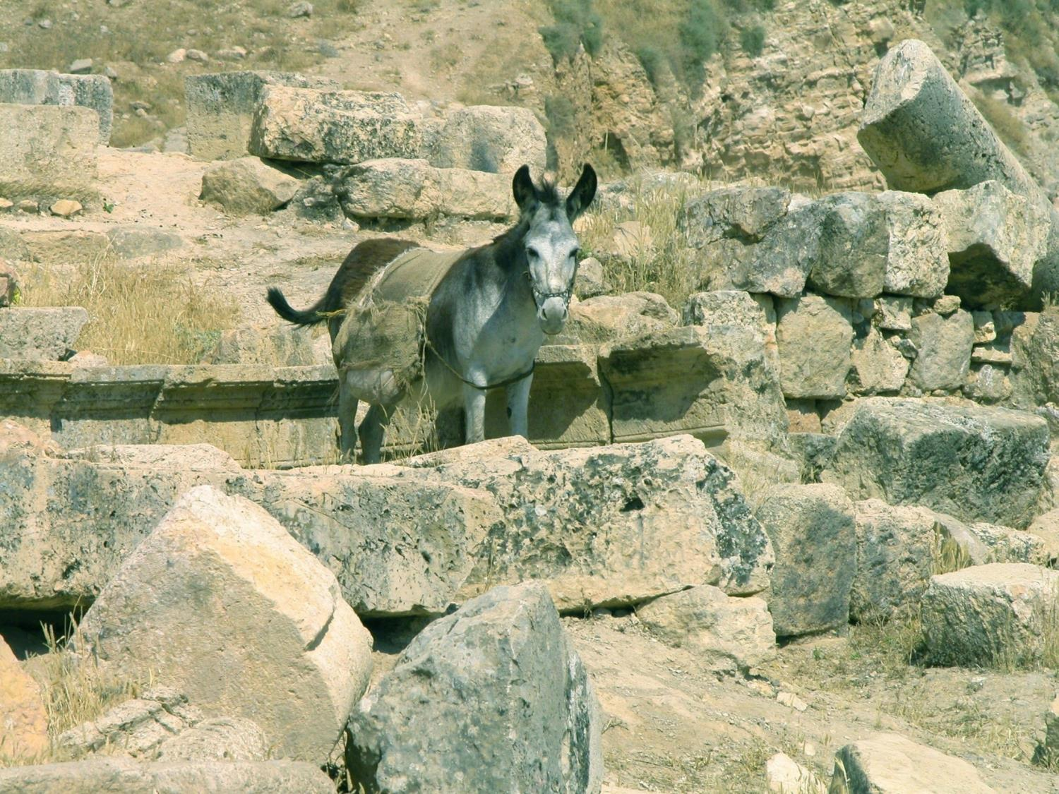
Donkey's were Owned By the Rich

Slide 39
Luke 2:22-24 (NIV)
They brought Him up to Jerusalem to present Him to the Lord… and to offer a sacrifice according to what was said in the Law of the Lord, “﻿﻿A pair of turtledoves or two young pigeons."
Lev 5:7 (NIV)
‘But if ﻿﻿he cannot afford a lamb, then he shall bring to the Lord his guilt offering for that in which he has sinned, two turtledoves or two young pigeons, ﻿﻿one for a sin offering and the other for a burnt offering.
Notes:
Understand this - parents of the messiah, the sacrificial lamb of God, could not even afford to by a lamb for their sacrifice.
But God provided their lamb, didn't he. Just like he provide the lamb for Jacob when he thought he was going to have to sacrifice Isaac his son -- another important message God was teaching through a picture!

Slide 40
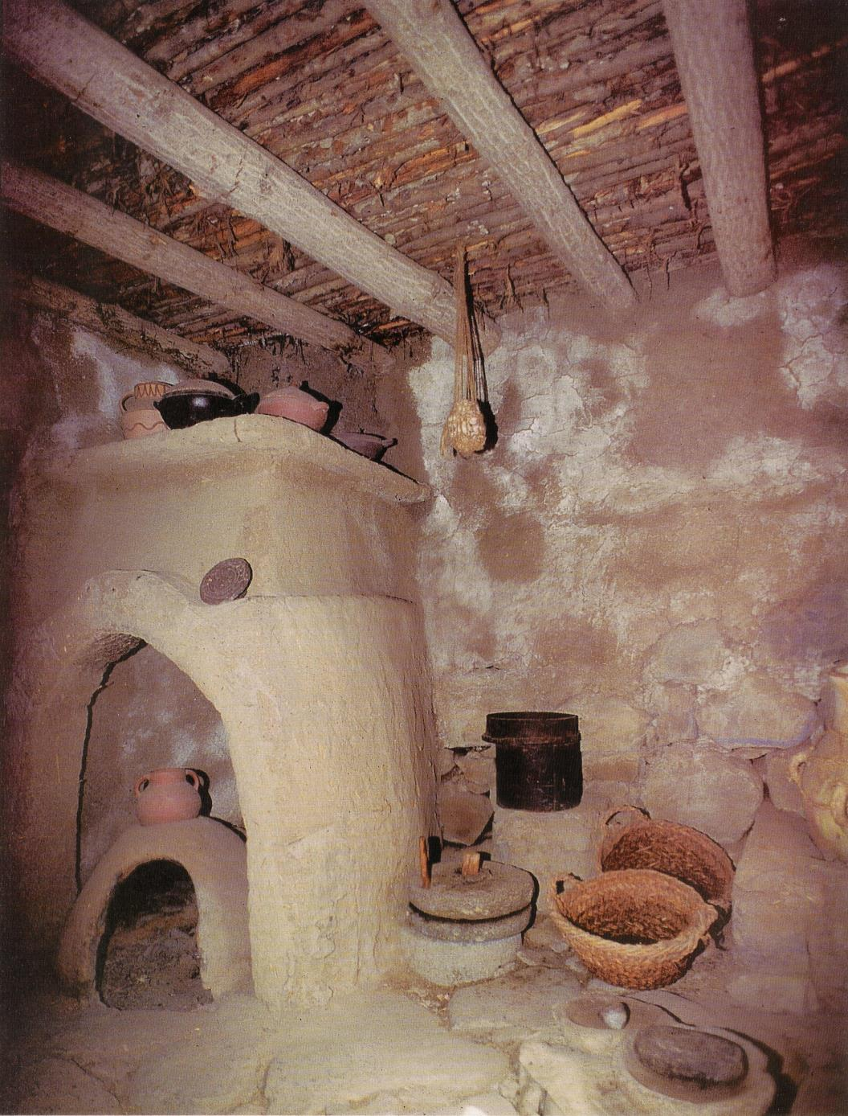
Kitchen
Notes:
They were poor common people. Probably had a simple house with a kitchen like this.

Slide 41
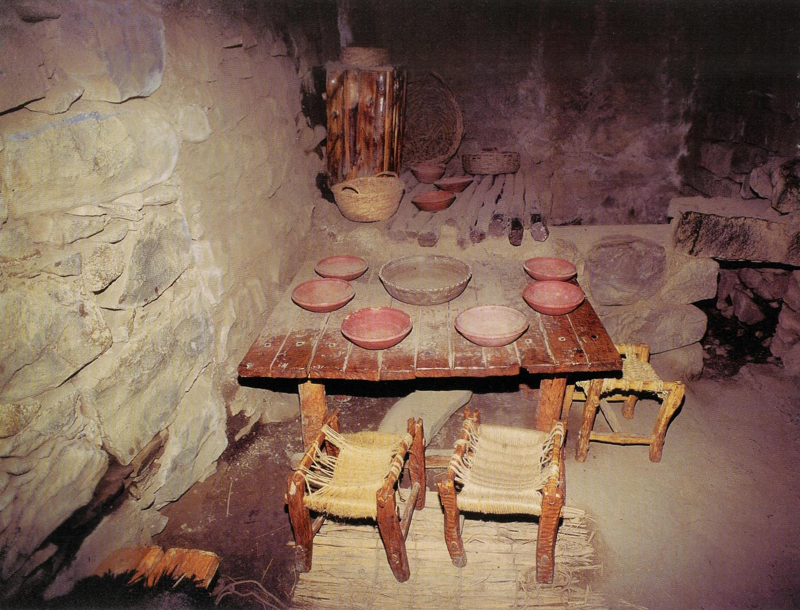
Living Room

Slide 42
A Water Trough for Animals

Slide 43
A Stone Water Trough
Called a "Manger"
Notes:
Wood was expensive, stone was cheap. They built out of stone whenever possible. And stone held water better than wood anyway.
Mangers in the middle east are used for water, not food. The animals grazed, or ate their food on the ground. But the water was most precious. That was handled carefully. It had value. It was kept in the manger for the animals to drink.

Slide 44
Cave Used as Animal Shelter
Notes:
Where were the mangers? In the animal shelter. And usually these were in caves. Easy to dig out caves from the layers of limestone, given the terrain of that area.

Slide 46
Labor and
Delivery room
Notes:
Most likely, something like this would have served as Mary's labor and delivery room.
Sooty walls and ceiling from the decades of fires. Probably, very like, plenty of old manure on the ground. The air filled with smoke from their fire.
No antiseptic hand wash, or clean pampers to use.
Can you imagine given birth in these conditions?

Slide 47
What was Jesus' Birth Really Like?
Notes:
Think about it. How many of you have given birth? How would you like to be in a strange place, far from family and friends, and have to camp out in a dirty smelly cave for sheep, and have your first baby there. All alone.
And that was how God chose to have his Son enter this world.
But we don't really remember it that way.

Slide 48
Herod the Great, King of the Jews:
Born into wealth, power, and luxury
Seemed to be the most powerful man in the country
Killed others that he might live
Sought power at the expense of others
Reigned with terror, cruelty, and fear
Built buildings he hoped would last forever
Jesus the Messiah, King of the Jews:
Born in a dirty animal pen
Seemed weak, poor, and helpless
Died that others might live
Taught that others were more important than himself
Modeled love, peace, compassion
Built a kingdom that really would last forever
Notes:
Let's compare the 2 Kings in Bethlehem:

Slide 49
Can you Imagine the Faith to Believe:
the older would serve the younger?
the star of Jacob would destroy the Edomite?
that Jesus would "supplant" Herod as King?
From a human perspective, nothing could seem more impossible !

Slide 50
Ruins of Herod's Jericho Palace
Notes:
But how did it end? What became of Herod's great Kingdom?

Slide 51
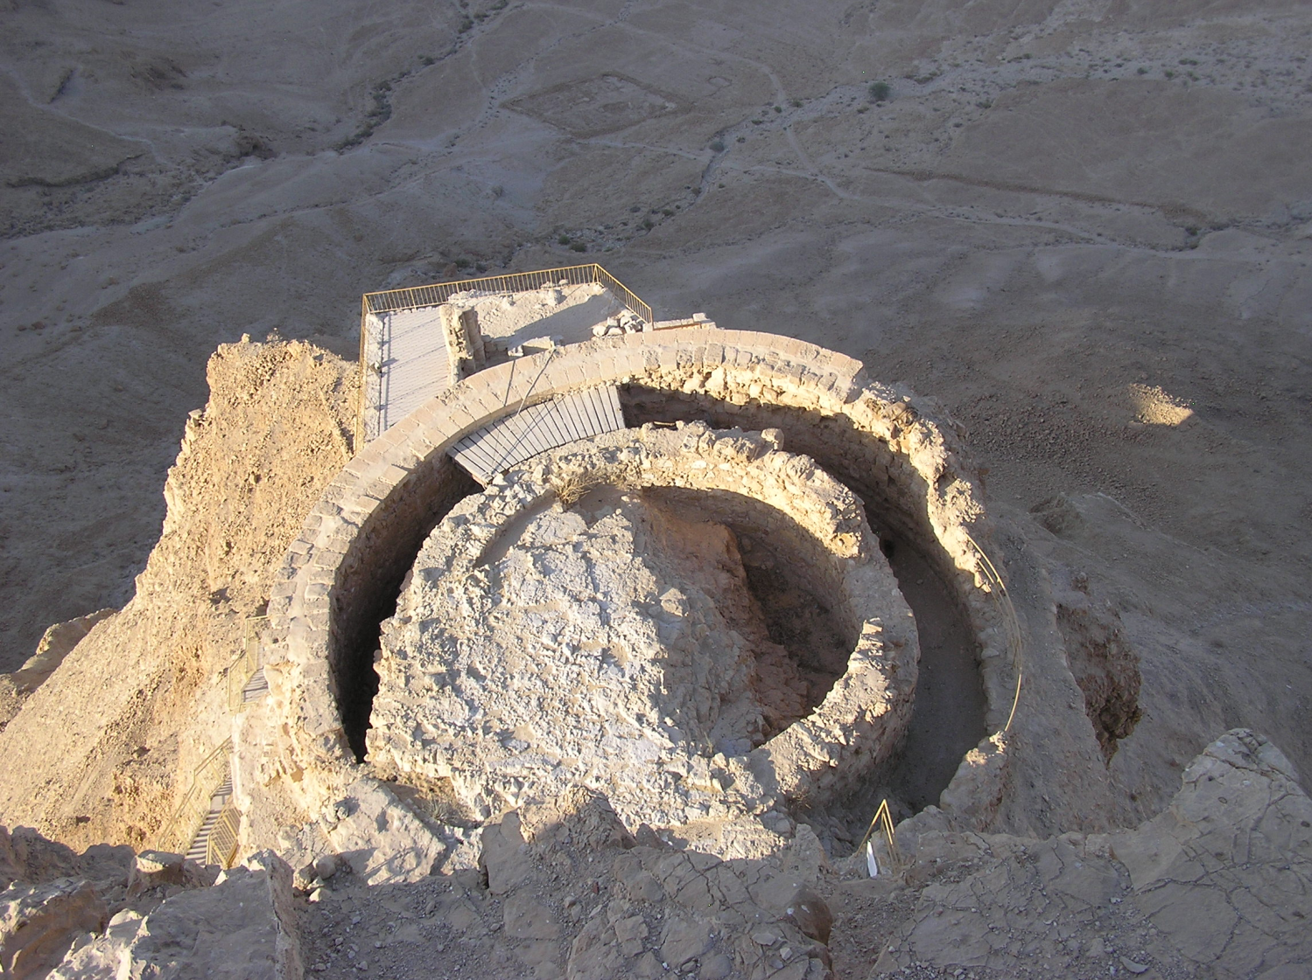
Hanging Palace at Masada

Slide 52
Herod's "Spectacular"
Seaport at Caesarea

Slide 53
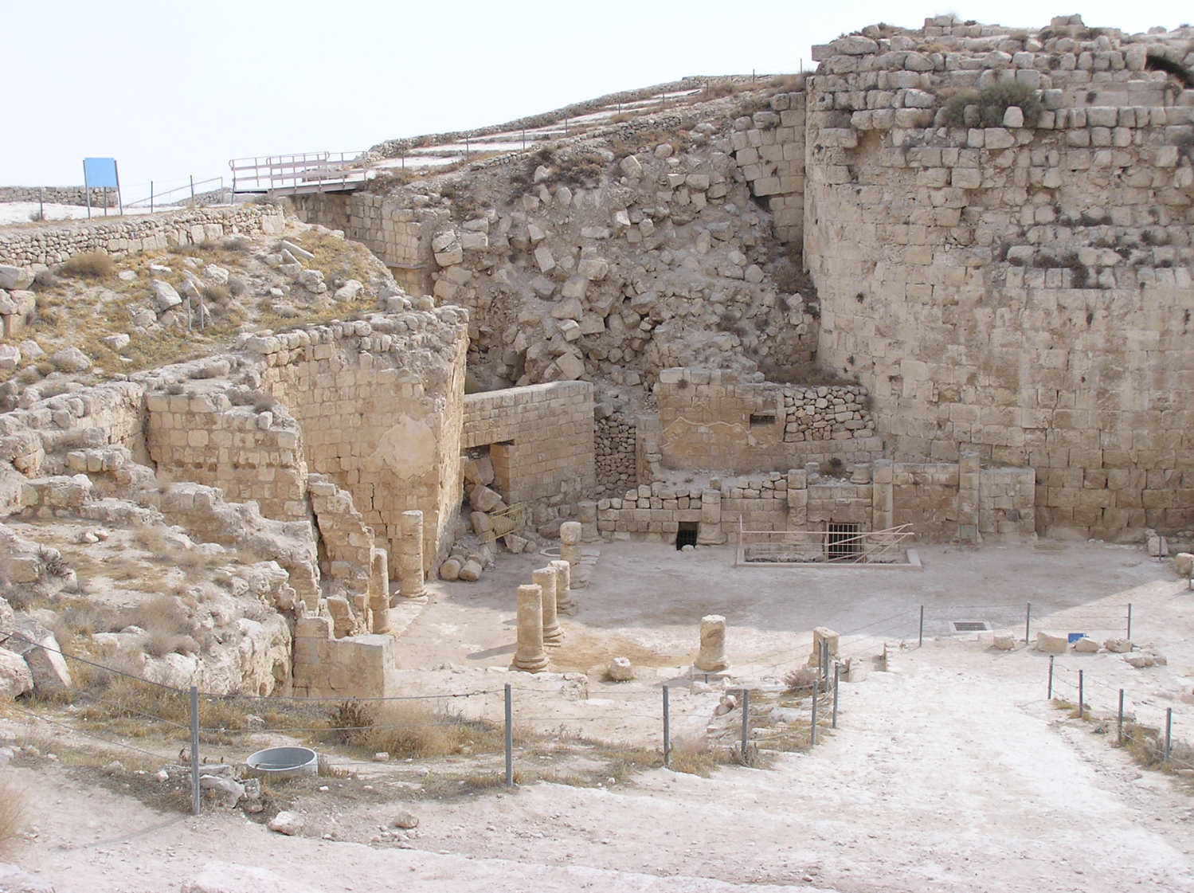
The Herodion
Near Bethlehem

Slide 54
Herod's Kingdom is Gone
What seemed impossible was accomplished…
by God in His time.

Slide 55
Why was Jesus' Born:
in Bethlehem?
in an Animal Shelter?
into a Poor Family?
in the Time of King Herod?

Slide 56
God is Giving Us a Picture
Like Hosea
The Circumstances of Jesus' Birth
Symbolize God's Message
My Ways Are Not Your Ways
My Strength is Shown in Your Weakness
My Kingdom Does Not Come by the Sword

Slide 57
Like God's message thru Hosea:
"I will show love… and I will save them—not by bow, sword or battle, or by horses and horsemen, but by the Lord their God.”
God's Salvation Won't Come Thru Power…
in fact it's just the opposite
Notes:
Jesus - whose name means "The Lord Saves". God's salvation for us. Even his Birth shows he didn't come with power. Just the opposite. The contrast simply could not have been greater.

Slide 58
Matt 5:3-10 (NIV)
Blessed are the poor, in spirit, for theirs is the kingdom of heaven.
Blessed are those who mourn, for they will be comforted.
Blessed are the meek, for they will inherit the earth.
Blessed are those who hunger and thirst for righteousness,
for they will be filled.
Blessed are the merciful, for they will be shown mercy.
Blessed are the pure in heart, for they will see God.
Blessed are the peacemakers, for they will be called sons of God.
Blessed are those who are persecuted because of righteousness,
for theirs is the kingdom of heaven
Notes:
Here, very near the north shore of Galilee, in full view of Mt Arbel where Herod began his reign of power and might, Jesus the Messiah taught these words.
JUST THE OPPOSITE OF HEROD, ISN'T IT ?

Slide 59
The Message of His Life
is seen in the
Picture of His Birth

Slide 60
this is a test
Which King is Yours?

