Slide 2
Sukkot
Rebuilding the Temple
God’s PRESENCE & God’s PROVISION

Slide 3
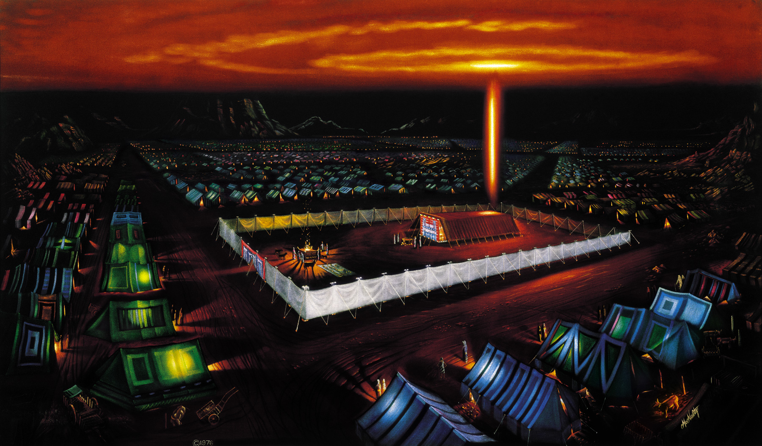
Journey to the Promised Land

Slide 4
Seven Annual Appointed Times of YHWH
Recall PAST events
Have PRESENT applications
Foreshadow FUTURE fulfillments

Slide 5
3 Spring Appointed Times
Passover – Crucifixion
Unleavened Bread – Burial
Firstfruits – Resurrection
First Harvest
Wheat Harvest
Pentecost – Holy Spirit
3 Fall Appointed Times
Trumpets – Messiah returns
Atonement – Judgment Day
Sukkot – Messiah’s reign as King
Final Harvest

Slide 6
Prophesy in Scripture
Future fulfillment of Sukkot
The end times – reign of Messiah
The future temple – His presence
Zechariah 14
Ezekiel & Revelation

Slide 7
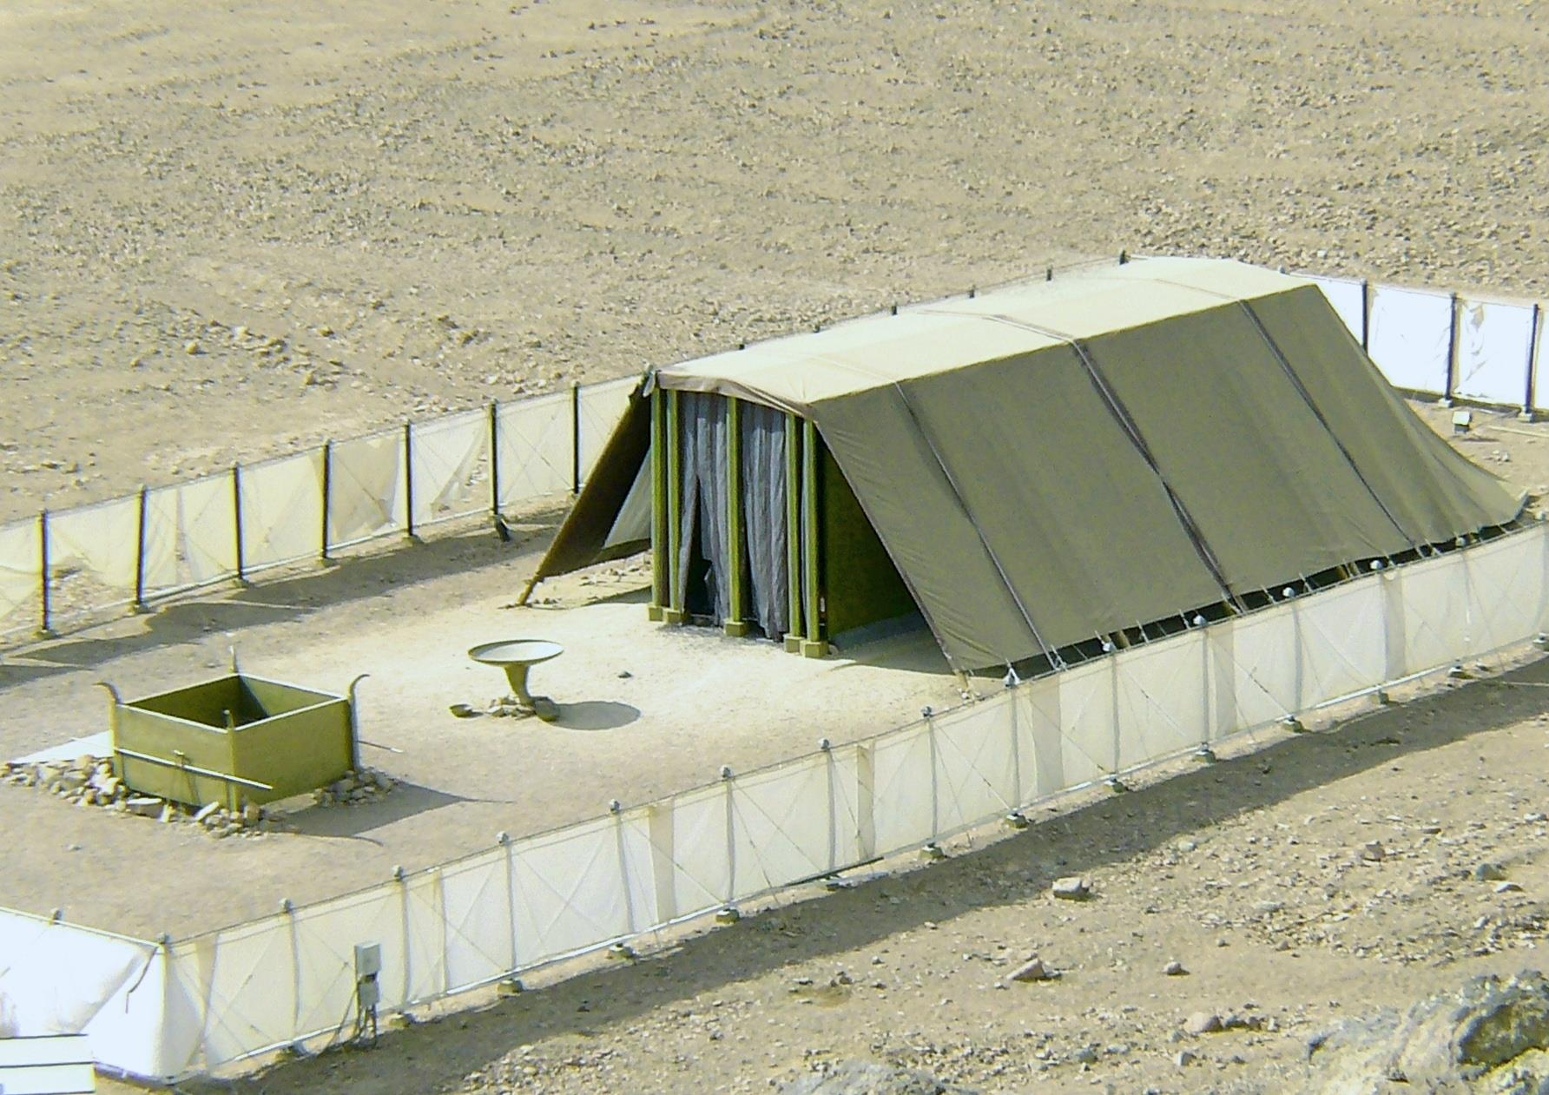
The Tabernacle – YHWH’s Sukkah

Slide 8
God’s PRESENCE in the Holy of Holies
The Tabernacle, 1446 BC -974 BC
1st Temple, 974 BC - 586 BC (The House)

Slide 9
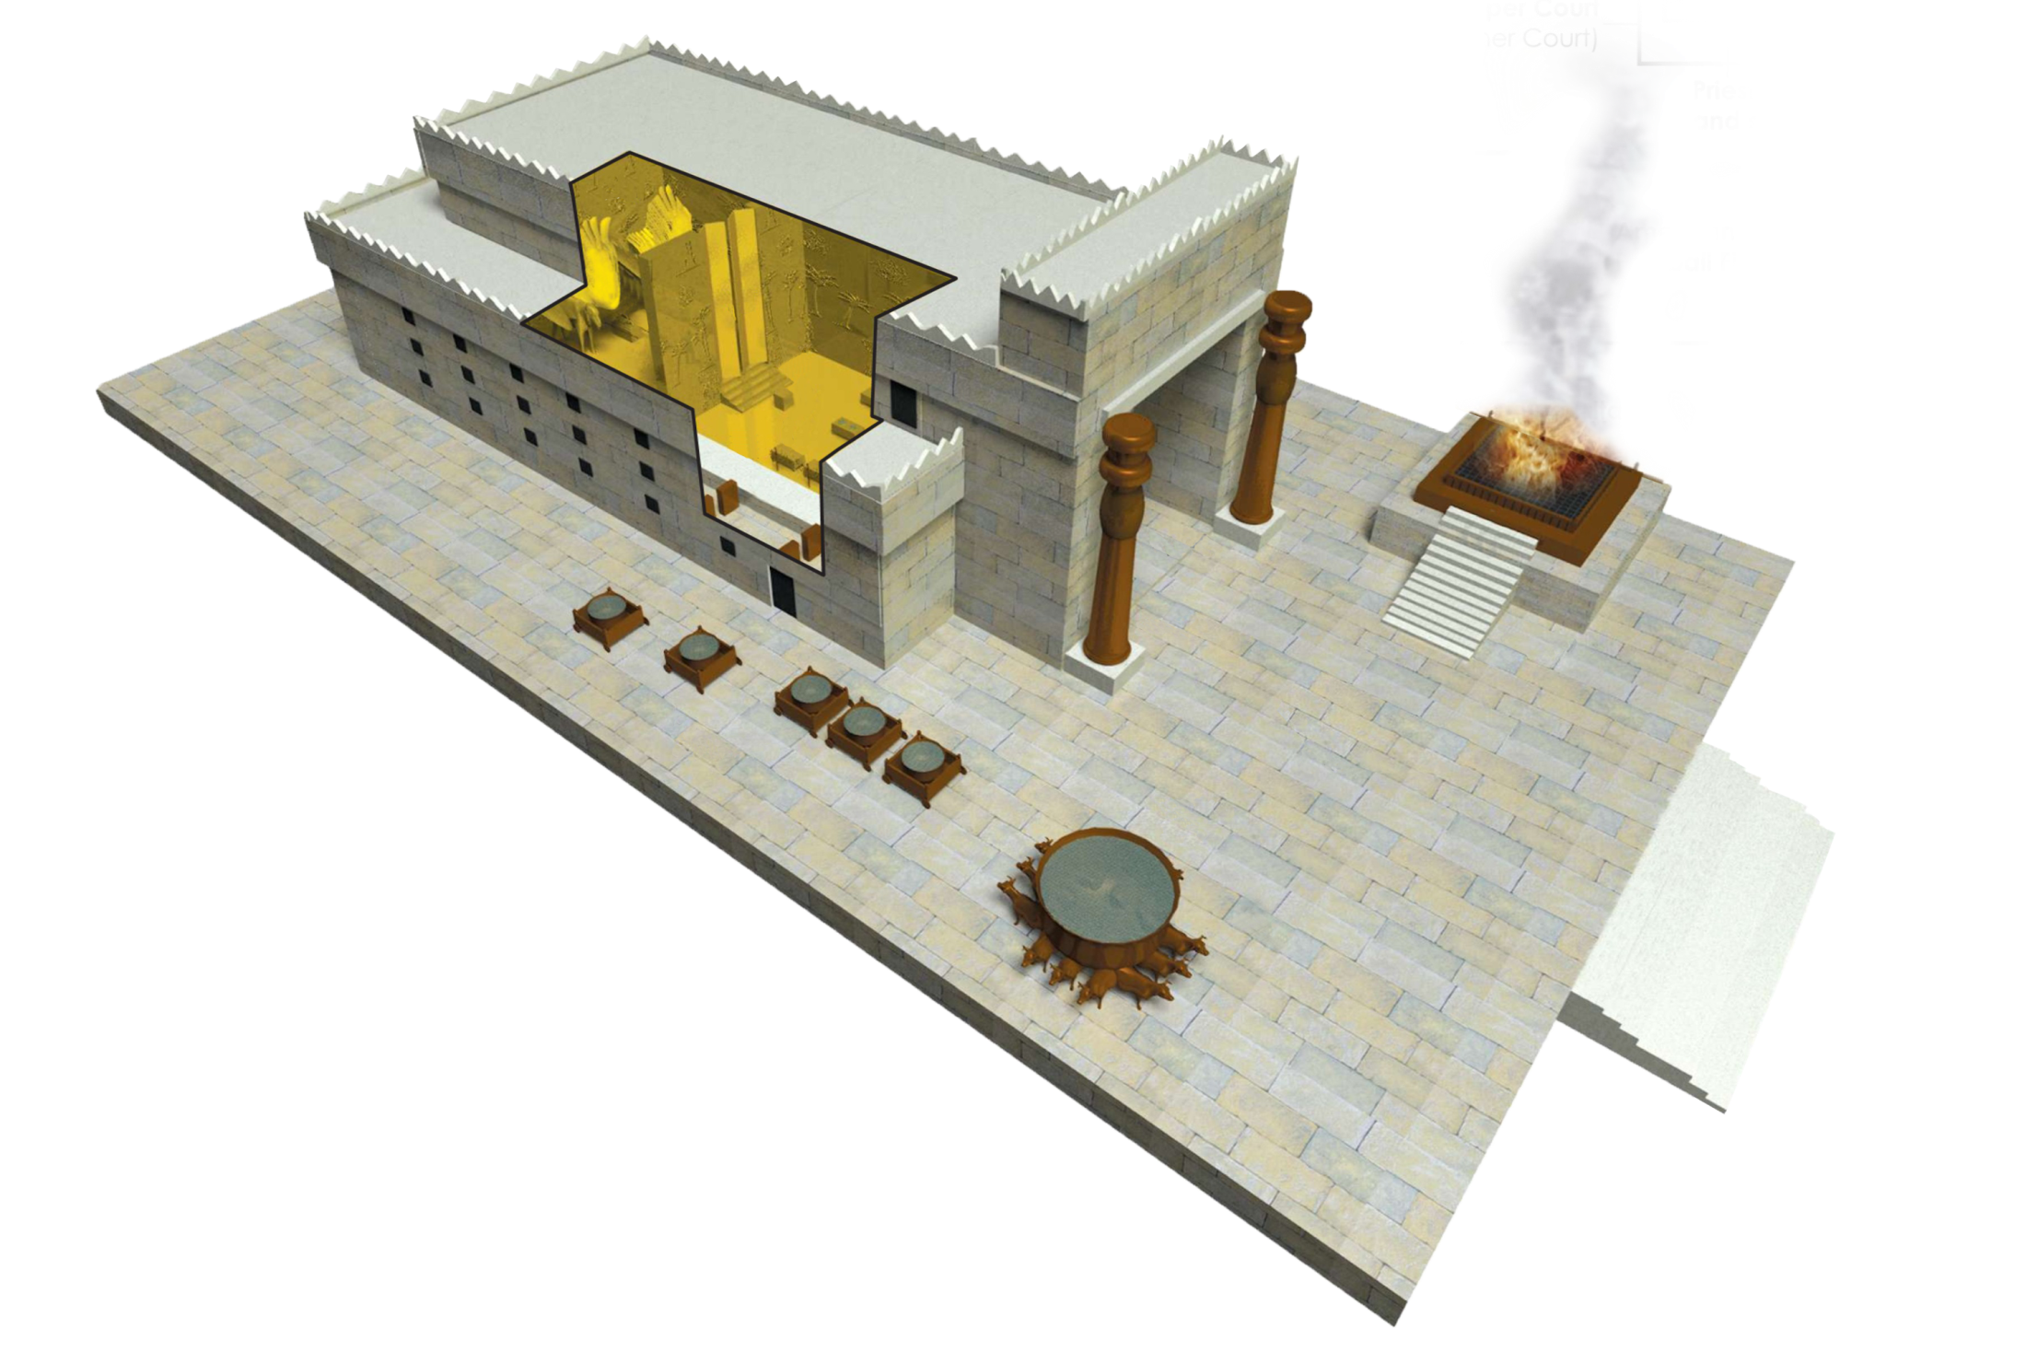

Slide 10
God’s PRESENCE in the Holy of Holies
The Tabernacle, 1446 BC -974 BC
1st Temple, 974 BC - 586 BC
2nd Temple, 515 BC – 70 AD

Slide 11
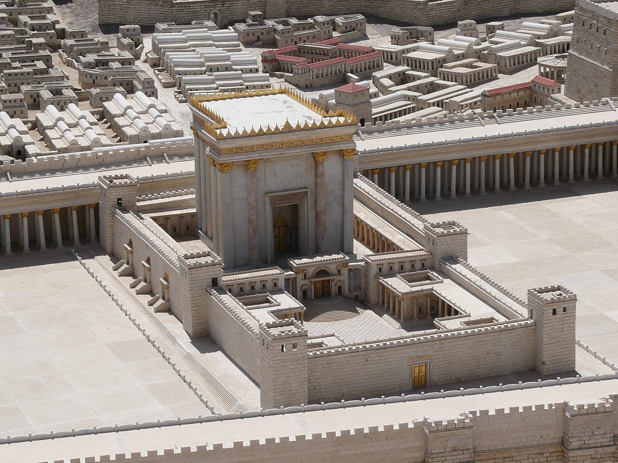

Slide 12
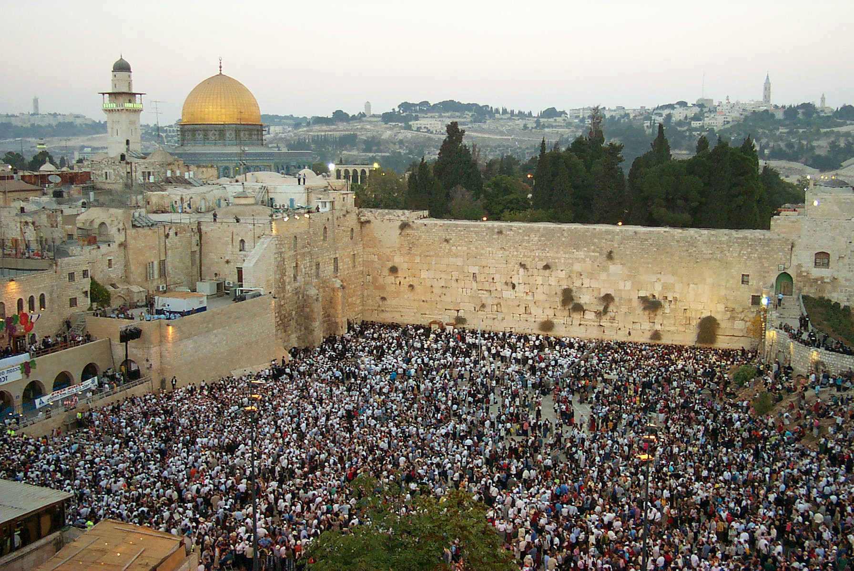
Western Wall on Sukkot

Slide 13
I Corinthians 6:19-20 Or do you not know that your body is a temple of the Holy Spirit within you, whom you have from God? You are not your own, for you were bought with a price. So glorify God in your body.

Slide 14
God’s PRESENCE in the Holy of Holies
The Tabernacle, 1446 BC -974 BC
1st Temple, 974 BC - 586 BC
2nd Temple, 515 BC – 70 AD
His Spirit in our body (now)
3rd Temple (Future)

Slide 15
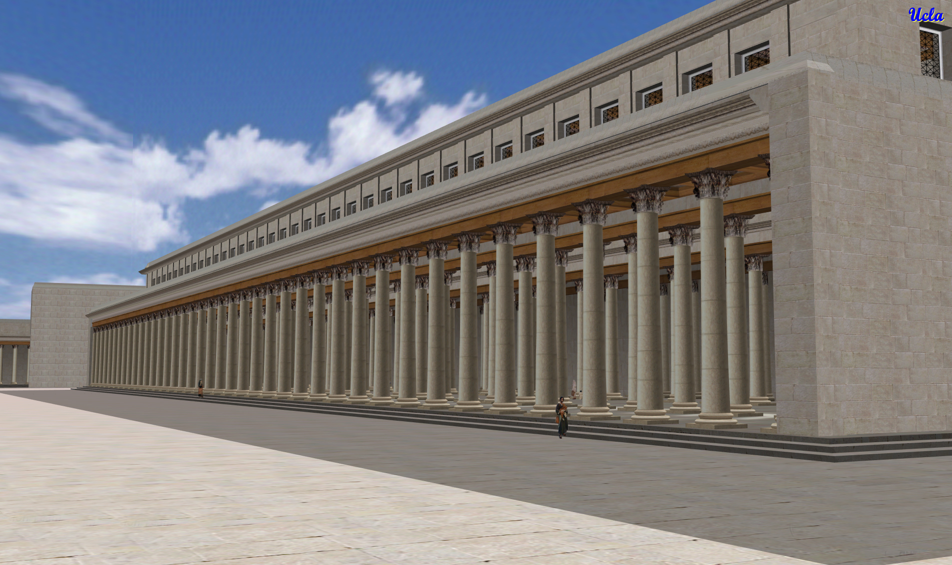

Slide 16
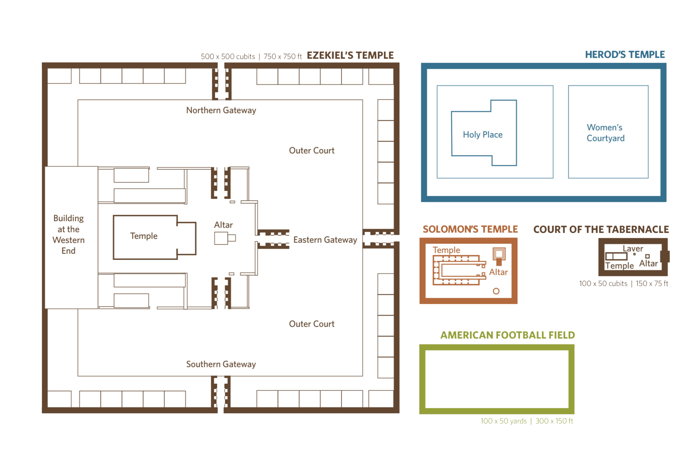

Slide 17
Ezekiel 41:1 And he measured the length of the room, twenty cubits, and its breadth, twenty cubits, across the nave. And he said to me, “This is the Most Holy Place.”

Slide 18
Ezekiel 42:13 Then he said to me, “The north chambers and the south chambers opposite the yard are the holy chambers, where the priests who approach YHWH shall eat the most holy offerings. There they shall put the most holy offerings—the grain offering, the sin offering, and the guilt offering—for the place is holy.

Slide 19
Ezekiel 43:2-3 And behold, the glory of the God of Israel was coming from the east. And the sound of his coming was like the sound of many waters, and the earth shone with his glory... and I fell on my face.

Slide 20
Ezekiel 43:4-5 As the glory of YHWH entered the temple by the gate facing east, the Spirit lifted me up and brought me into the inner court; and behold, the glory of YHWH filled the temple.

Slide 21
Ezekiel 43:6-7 I heard one speaking to me out of the temple, and he said to me, “Son of man, this is the place of my throne and the place of the soles of my feet, where I will dwell in the midst of the people of Israel forever.

Slide 22
Ezekiel 43:12 This is the law of the temple: the whole territory on the top of the mountain all around shall be most holy.

Slide 23
God’s PRESENCE in the Holy of Holies
Ezekiel ~593 BC
1st Temple destroyed 586 BC
Why was the temple destroyed?
Loss of love for God’s Word
Loss of love for YHWH
Disobedience – living for self

Slide 24
God’s PRESENCE in the Holy of Holies
Ezekiel ~593 BC
1st Temple destroyed 586 BC
2nd Temple rebuilt 515 BC
3rd Temple (Future)
Zechariah ~518 BC

Slide 25
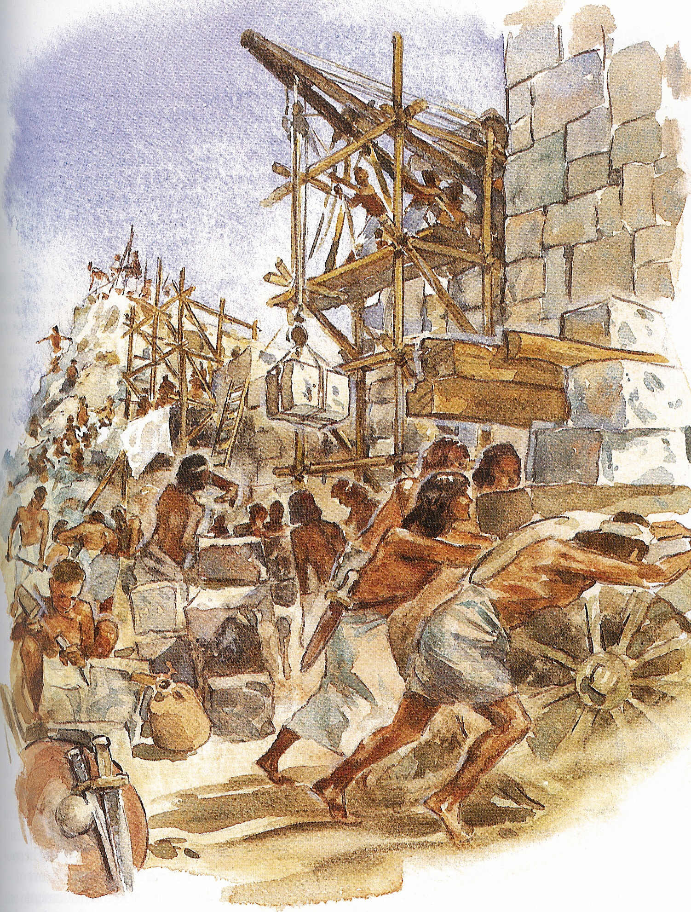
Rebuilding
the Temple

Slide 26
RETURN to God & REBUILD the Temple!
Zechariah 1:3 Return to me, says YHWH of hosts, and I will return to you, says YHWH of hosts.
Prepare my sukkah, and I will sukkah with you again!

Slide 27
How does he encourage them?
He prophesies about the end times... “The day of YHWH”
Two sides – winners and losers!

Slide 28
Zechariah 14:1-2 Behold, a day is coming for YHWH, when the spoil taken from you will be divided in your midst. For I will gather all the nations against Jerusalem to battle, and the city shall be taken and the houses plundered and the women raped. Half of the city shall go out into exile, but the rest of the people shall not be cut off from the city.

Slide 29
Zechariah 14:3-4 Then YHWH will go out and fight against those nations as when he fights on a day of battle. On that day his feet shall stand on the Mount of Olives that lies before Jerusalem on the east, and the Mount of Olives shall be split in two from east to west by a very wide valley, so that one half of the Mount shall move northward, and the other half southward.

Slide 30
Zechariah 14:5 And you shall flee to the valley of my mountains, for the valley of the mountains shall reach to Azal. And you shall flee as you fled from the earthquake in the days of Uzziah king of Judah. Then YHWH my God will come, and all the holy ones with him.

Slide 31
Revelation has a similar picture!
Zechariah 14:6-7 On that day there shall be no light, cold, or frost. And there shall be a unique day, which is known to YHWH, neither day nor night, but at evening time there shall be light.

Slide 32
Revelation 22:5 And night will be no more. They will need no light of lamp or sun, for the Lord God will be their light, and they will reign forever and ever.

Slide 33
Living Water flowing from Jerusalem!
Zechariah 14:8-9 On that day living waters shall flow out from Jerusalem, half of them to the eastern sea and half of them to the western sea. It shall continue in summer as in winter. And YHWH will be king over all the earth.

Slide 34
Ezekiel 47:1 Then he brought me back to the door of the temple, and behold, water was issuing from below the threshold of the temple toward the east (for the temple faced east). The water was flowing down from below the south end of the threshold of the temple, south of the altar.

Slide 35
John 7:38-39 Whoever believes in me, as the Scripture has said, ‘Out of his heart will flow rivers of living water.’ Now this he said about the Spirit.
Ezekiel 47:2-5 The water was trickling out... Going on eastward... it was ankle deep... it was knee deep... it was waist deep... it was deep enough to swim in... it could not be passed through.

Slide 36
Ezekiel 47:8-9 This water flows toward the eastern region and goes down into the Arabah, and enters the sea; when the water flows into the sea, the water will become fresh. And wherever the river goes, every living creature that swarms will live, and there will be very many fish. For this water goes there, that the waters of the sea may become fresh; so everything will live where the river goes.

Slide 37
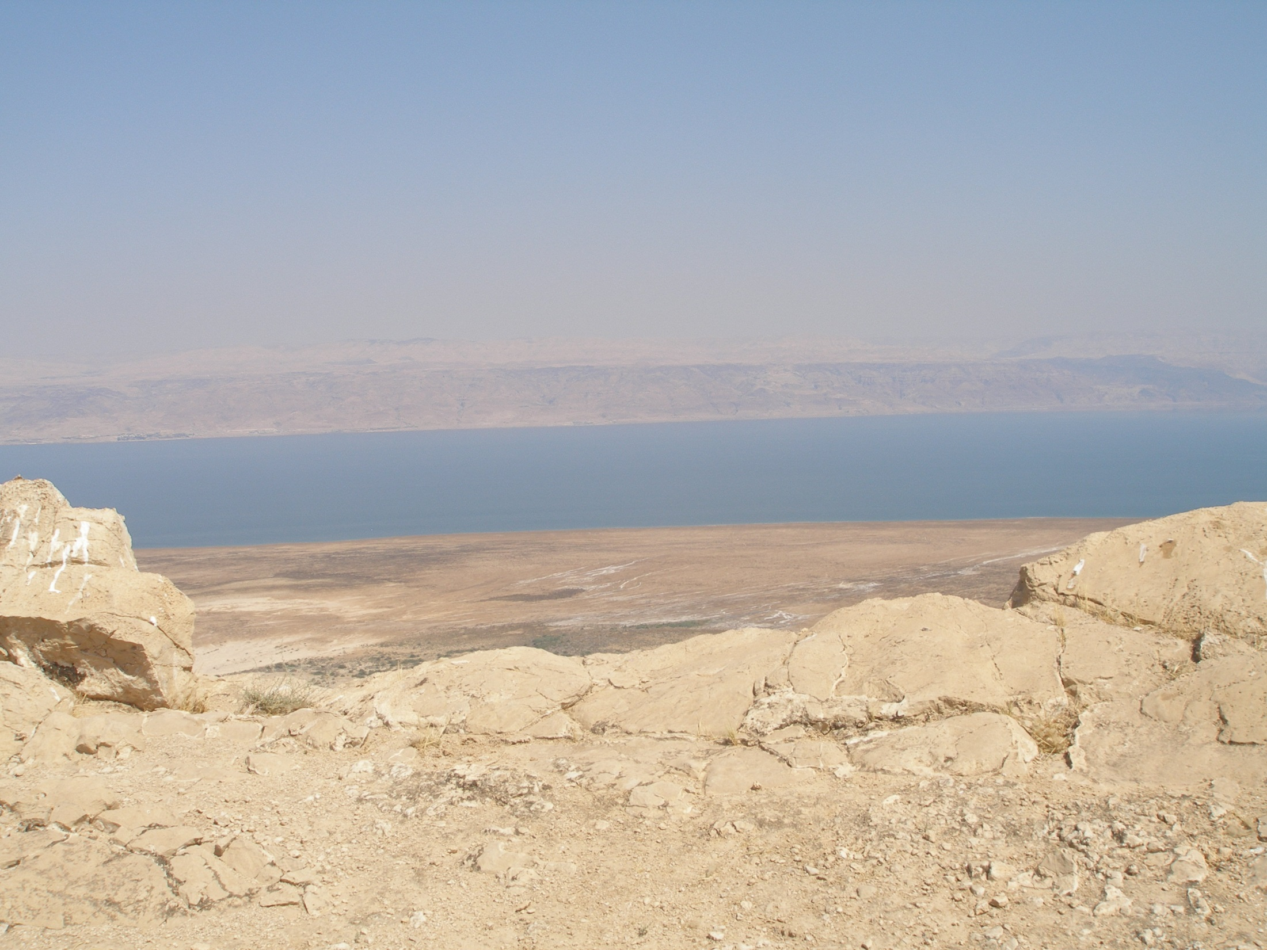
Abundant life in the Dead Sea ?!

Slide 38
Matthew 4:19 And he said to them, “Follow me, and I will make you fishers of men.”
Ezekiel 47:10 Fishermen will stand beside the sea. From Engedi to Eneglaim it will be a place for the spreading of nets. Its fish will be of very many kinds, like the fish of the Great Sea.

Slide 39
Revelation has a similar picture!
Ezekiel 47:12 And on the banks, on both sides of the river, there will grow all kinds of trees for food. Their leaves will not wither, nor their fruit fail, but they will bear fresh fruit every month, because the water for them flows from the sanctuary. Their fruit will be for food, and their leaves for healing.

Slide 40
Revelation 22:1-2 Then the angel showed me the river of the water of life, bright as crystal, flowing from the throne of God and of the Lamb through the middle of the street of the city; also, on either side of the river, the tree of life with its twelve kinds of fruit, yielding its fruit each month. The leaves of the tree were for the healing of the nations.

Slide 41
Zechariah 14:8-9 On that day living waters shall flow out from Jerusalem, half of them to the eastern sea and half of them to the western sea. It shall continue in summer as in winter. And YHWH will be king over all the earth.

Slide 42
Zechariah 14:16 Then everyone who survives of all the nations that have come against Jerusalem shall go up year after year to worship the King, YHWH of hosts, and to keep the Feast of Booths.

Slide 43
Zechariah 14:17 And if any of the families of the earth do not go up to Jerusalem to worship the King, YHWH of hosts, there will be no rain on them.

Slide 44
Zechariah 14:18-19 And if the family of Egypt does not go up and present themselves, then on them there shall be no rain; there shall be the plague with which YHWH afflicts the nations that do not go up to keep the Feast of Booths. This shall be the punishment to Egypt and the punishment to all the nations that do not go up to keep the Feast of Booths.

Slide 45
Return to God!
Remember why the temple was destroyed!
Remember that you walked away from Him!

Slide 46
Rebuild the temple!
He will “sukkah” with you again!
All the nations will worship him
All the nations will keep Sukkot!

Slide 47
RETURN to God & REBUILD the Temple!
Zechariah 1:3 Return to me, says YHWH of hosts, and I will return to you, says YHWH of hosts.
Prepare my sukkah, and I will sukkah with you again!

Slide 48
Does your temple need rebuilding?
I Corinthians 6:19-20 Or do you not know that your body is a temple of the Holy Spirit within you, whom you have from God? You are not your own, for you were bought with a price. So glorify God in your body.

Slide 49
Do you need to return to God?
Why was your temple damaged?
Have you walked away from Him?
Have you neglected to keep His Word?
Have you never made a place for Him?

Slide 50
Will you rebuild your temple?
YHWH wants to sukkah with you!
He wants His glory to fill you!
He wants Living Water to flow through you
He wants your sukkah to bring others to Him

Slide 51
Sukkot
Rebuilding the Temple
God’s PRESENCE & God’s PROVISION

