Slide 2
Sukkot
Living in the Desert
God’s PRESENCE
God’s PROVISION

Slide 3
Seven Annual
Appointed Times of YHWH
Recall PAST events
Have PRESENT applications
Foreshadow FUTURE fulfillments

Slide 4
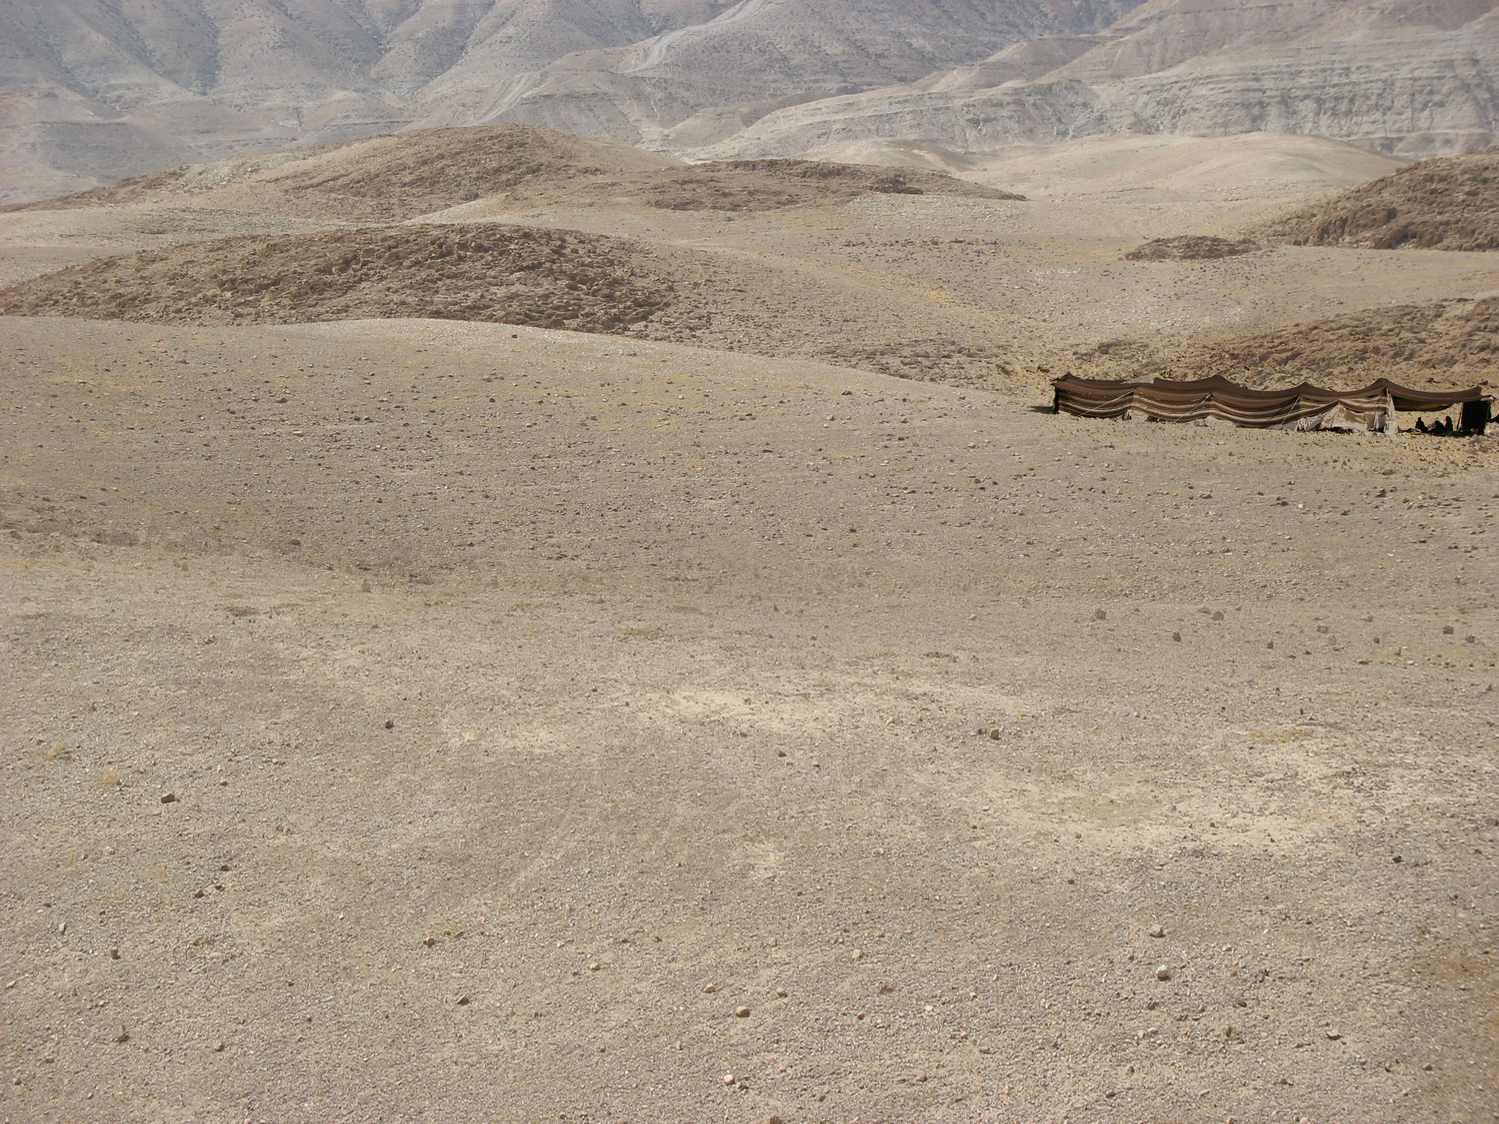
3 Spring Appointed Times
Passover – Crucifixion
Unleavened Bread – Burial
Firstfruits – Resurrection
First
Harvest
Wheat
Harvest
Pentecost – Holy Spirit
3 Fall Appointed Times
Trumpets – The 2nd Coming
Atonement – Judgment Day
Sukkot – Messiah’s reign as King
Final
Harvest

Slide 5
Deut. 16:13-14
You shall keep the Feast of Booths seven days, when you have gathered in the produce from your threshing floor and your winepress. You shall rejoice in your feast, you and your son and your daughter, your male servant and your female servant, the Levite, the sojourner, the fatherless, and the widow who are within your towns.

Slide 6
Leviticus 23:39-41
On the fifteenth day of the seventh month, when you have gathered in the produce of the land, you shall celebrate the feast of YHWH seven days. On the first day shall be a solemn rest, and on the eighth day shall be a solemn rest. And you shall take on the first day the fruit of splendid trees, branches of palm trees and boughs of leafy trees and willows of the brook, and you shall rejoice before YHWH your God seven days.

Slide 7
Leviticus 23:42-43
You shall celebrate it as a feast to YHWH for seven days in the year. It is a statute forever throughout your generations; you shall celebrate it in the seventh month. You shall dwell in booths for seven days. All native Israelites shall dwell in booths, that your generations may know that I made the people of Israel dwell in booths when I brought them out of the land of Egypt: I am YHWH your God.

Slide 8
What is like living the desert?
For Israel, 3500 year ago ??
For YOU, today ??

Slide 9
Numbers 9:15-16
On the day that the tabernacle was set up, the cloud covered the tabernacle, the tent of the testimony. And at evening it was over the tabernacle like the appearance of fire until morning. So it was always: the cloud covered it by day and the appearance of fire by night.

Slide 10
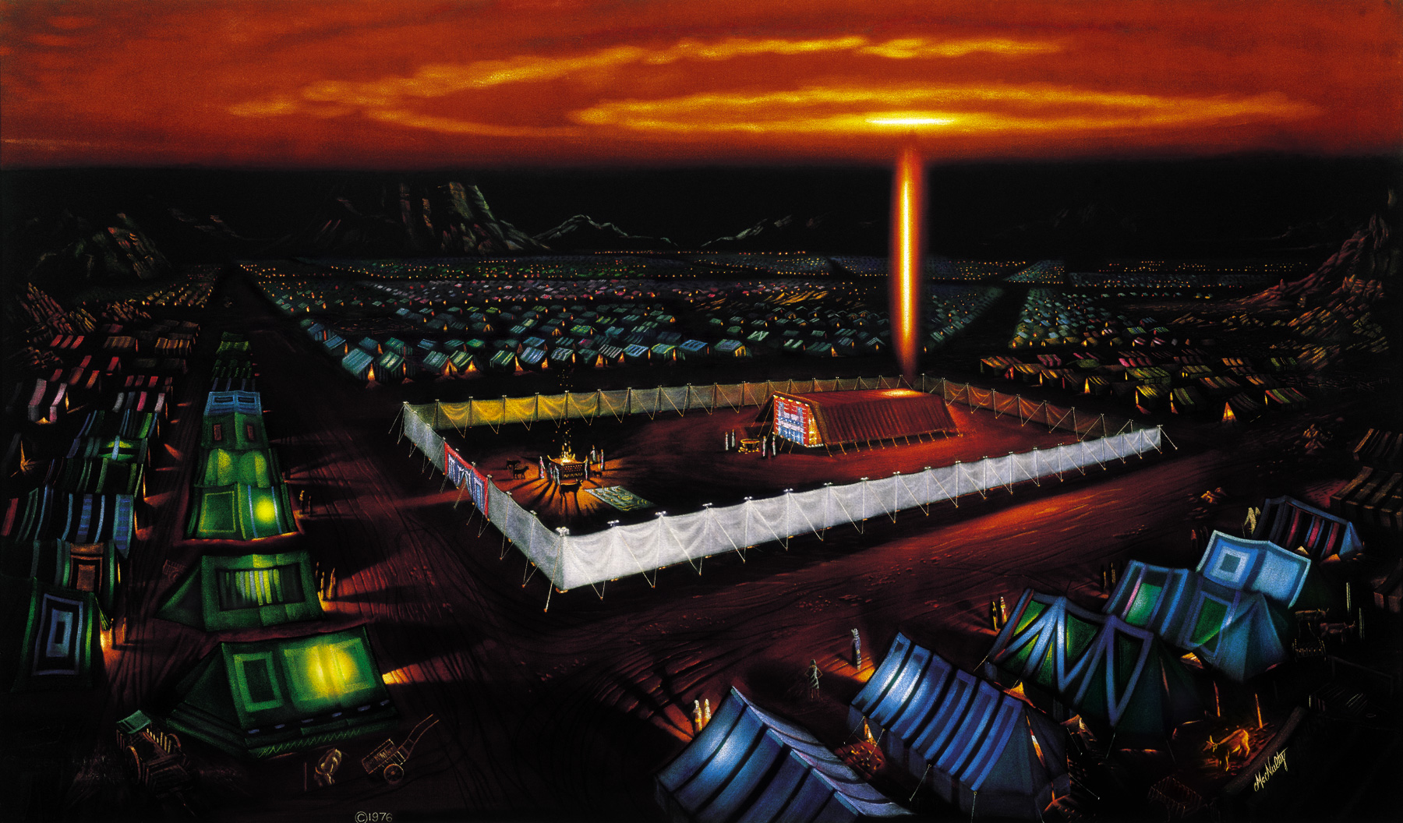

Slide 11
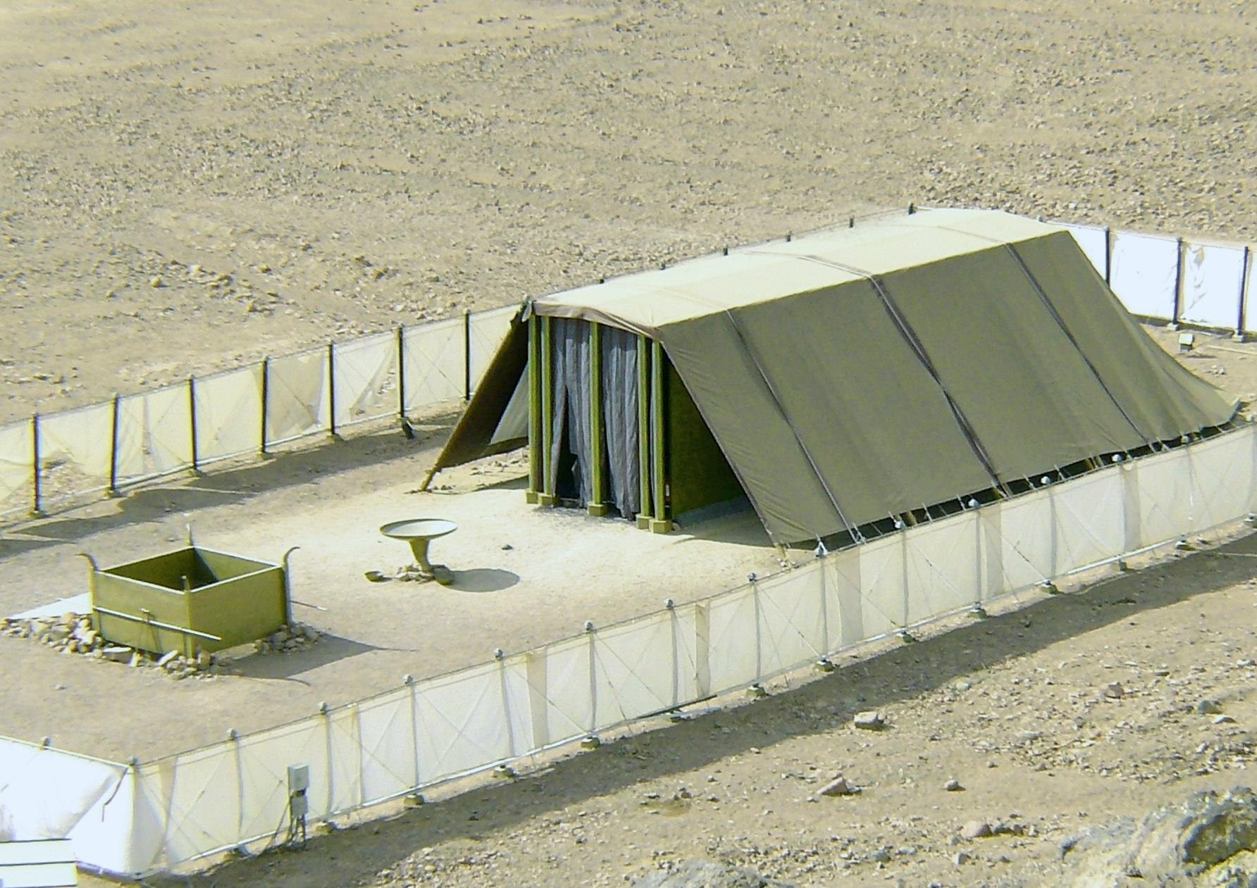

Slide 12
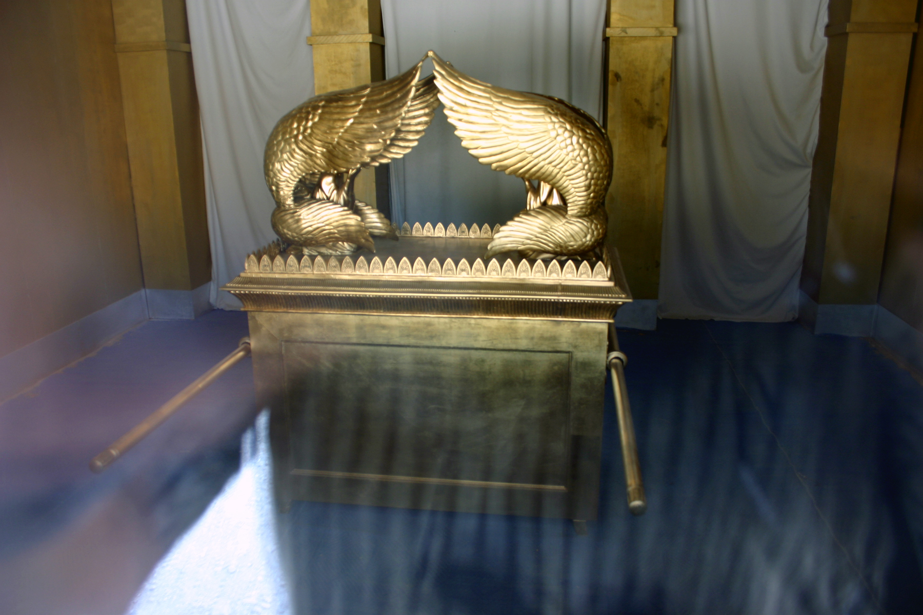

Slide 13
What it was like living the desert?
An awesome, intimate walk with YWHW ?

Slide 14
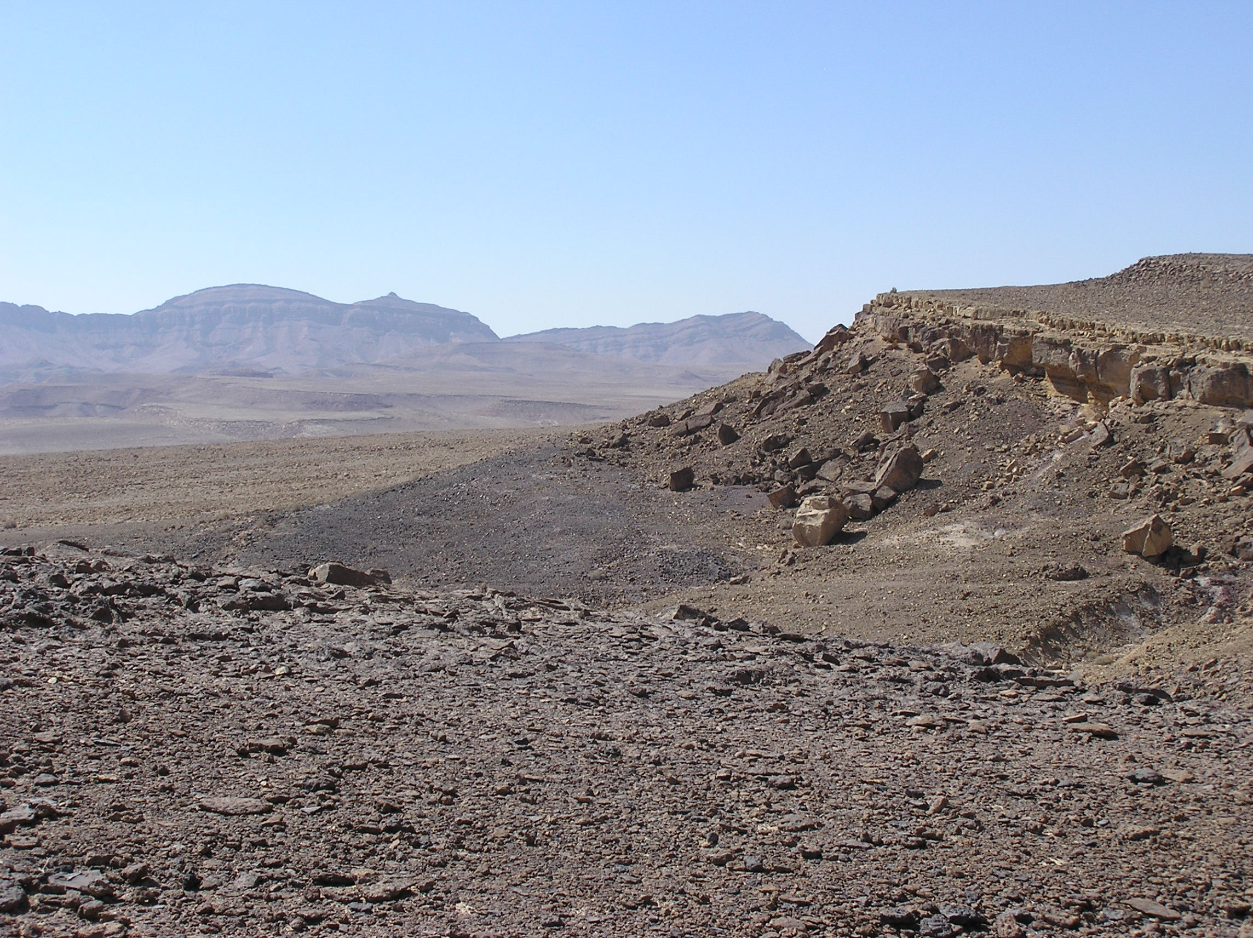
Water??
Food??

Slide 15
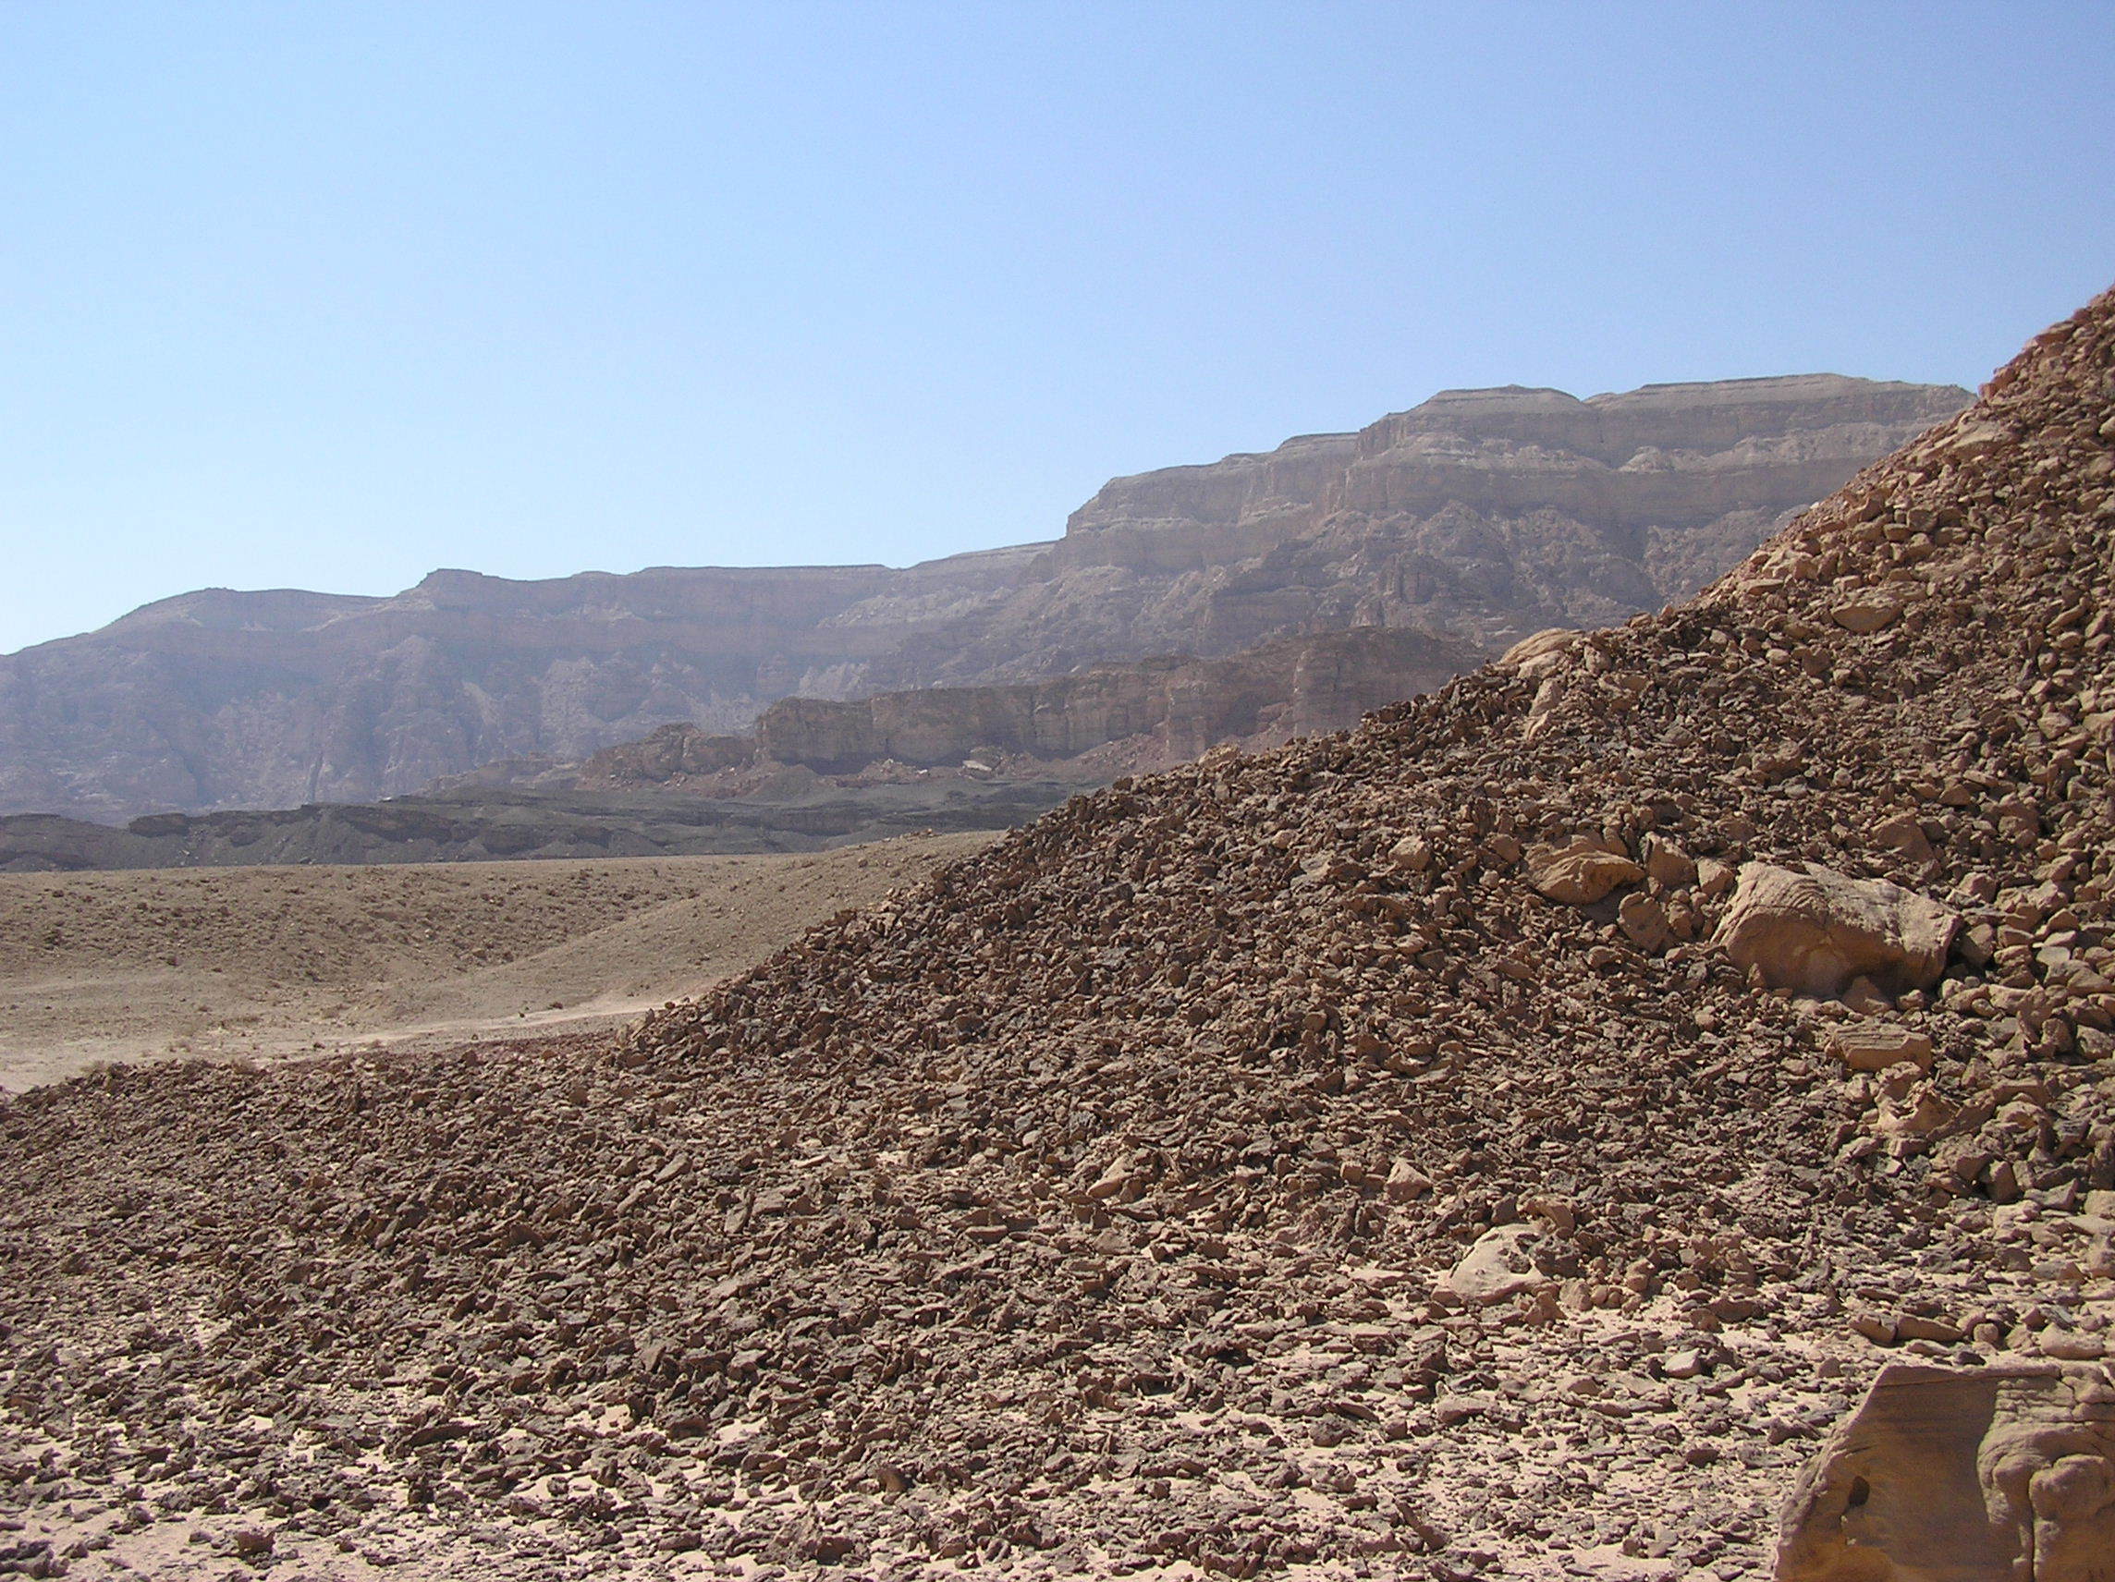
Lost, wandering in the wilderness...

Slide 16
Numbers 9:17-19
And whenever the cloud lifted from over the tent, after that the people of Israel set out, and in the place where the cloud settled down, there the people of Israel camped. At the command of YHWH the people of Israel set out, and at the command of YHWH they camped. As long as the cloud rested over the tabernacle, they remained in camp. Even when the cloud continued over the tabernacle many days, the people of Israel kept the charge of YHWH and did not set out.

Slide 17
Numbers 9:20-21
Sometimes the cloud was a few days over the tabernacle, and according to the command of YHWH they remained in camp; then according to the command of YHWH they set out. And sometimes the cloud remained from evening until morning. And when the cloud lifted in the morning, they set out, or if it continued for a day and a night, when the cloud lifted they set out.

Slide 18
Numbers 9:20-21
Whether it was two days, or a month, or a longer time, that the cloud continued over the tabernacle, abiding there, the people of Israel remained in camp and did not set out, but when it lifted they set out. At the command of YHWH they camped, and at the command of YHWH they set out.

Slide 19
What is like living the desert?
Learning that YWHW is in control
Learning to follow YWHW
Learning total dependency on YHWH

Slide 20
YWHW leads them to the edge of the Promised Land
Moses sends 12 leaders to spy out the land
After 40 days they return with their report.

Slide 21
Numbers 13:25
At the end of forty days they returned from spying out the land. And they came to Moses and Aaron and to all the congregation of the people of Israel in the wilderness of Paran,
at Kadesh.

Slide 22
Numbers 13:27
They brought back word to them and to all the congregation, and showed them the fruit of the land. And they told him, “We came to the land to which you sent us. It flows with milk and honey, and this is its fruit.”

Slide 23
Numbers 13:28-29
However, the people who dwell in the land are strong, and the cities are fortified and very large. And besides, we saw the descendants of Anak there. The Amalekites dwell in the land of the Negeb. The Hittites, the Jebusites, and the Amorites dwell in the hill country. And the Canaanites dwell by the sea, and along the Jordan.

Slide 24
Numbers 13:30
But Caleb quieted the people before Moses and said, “Let us go up at once and occupy it, for we are well able to overcome it.”

Slide 25
How did Caleb know
YHWH was in control ??
Moses & the Burning Bush
10 Plagues in Egypt
Deliverance from Pharoah
Parting of the Red Sea
YHWH speaking on Mt Sinai
Pillar of cloud by day
Pillar of fire by night
Water from a rock
Manna from the sky
Quail for meat

Slide 26
Numbers 13:31-32
Then the men who had gone up with him said, “We are not able to go up against the people, for they are stronger than we are.” So they brought to the people of Israel a bad report of the land that they had spied out, saying, “The land, through which we have gone to spy it out, is a land that devours its inhabitants, and all the people that we saw in it are of great height.”

Slide 27
There were Giants in the Land!
Numbers 13:33
And there we saw the Nephilim (the sons of Anak, who come from the Nephilim), and we seemed to ourselves like grasshoppers, and so we seemed to them.”

Slide 28
So much for God’s provision...
Moses & the Burning Bush
10 Plagues in Egypt
Deliverance from Pharoah
Parting of the Red Sea
YHWH speaking on Mt Sinai
Pillar of cloud by day
Pillar of fire by night
Water from a rock
Manna from the sky
Quail for meat

Slide 29
Numbers 14:1-2
Then all the congregation raised a loud cry, and the people wept that night. And all the people of Israel grumbled against Moses and Aaron. The whole congregation said to them, “Would that we had died in the land of Egypt! Or would that we had died in this wilderness!

Slide 30
Numbers 14:3-4
Why is YHWH bringing us into this land, to fall by the sword? Our wives and our little ones will become a prey. Would it not be better for us to go back to Egypt?” And they said to one another, “Let us choose a leader and go back to Egypt.”

Slide 31
Do you ever feel that way?
Life is too hard...
I don’t believe God’s promises...
I want to go back to my previous life...
I wish I could die...
That’s life in the desert...

Slide 32
When we FALTER in our FAITH,
We need to FALL on our FACE!

Slide 33
Numbers 14:5-7
Then Moses and Aaron fell on their faces before all the assembly of the congregation of the people of Israel. And Joshua the son of Nun and Caleb the son of Jephunneh, who were among those who had spied out the land, tore their clothes and said to all the congregation of the people of Israel:

Slide 34
Numbers 14:8-9
“The land, which we passed through to spy it out, is an exceedingly good land. If YHWH delights in us, he will bring us into this land and give it to us, a land that flows with milk and honey. Only do not rebel against YHWH. And do not fear the people of the land, for they are bread for us. Their protection is removed from them, and YHWH is with us; do not fear them.”

Slide 35
Joshua & Caleb spoke Truth
Numbers 14:10
Then all the congregation said to stone them with stones.
How do you receive Truth?

Slide 36
Numbers 14:10-11
But the glory of YHWH appeared at the tent of meeting to all the people of Israel. And YHWH said to Moses, “How long will this people despise me? And how long will they not believe in me, in spite of all the signs that I have done among them?”

Slide 37
Numbers 14:28
“As I live,” declares YHWH, “what you have said in my hearing I will do to you.”
Would that we had died in this wilderness!

Slide 38
Numbers 14:29-30
Your dead bodies shall fall in this wilderness, and of all your number, listed in the census from twenty years old and upward, who have grumbled against me, not one shall come into the land where I swore that I would make you dwell, except Caleb the son of Jephunneh and Joshua the son of Nun.

Slide 39
Numbers 14:31-33
But your little ones, who you said would become a prey, I will bring in, and they shall know the land that you have rejected. But as for you, your dead bodies shall fall in this wilderness. And your children shall be shepherds in the wilderness forty years and shall suffer for your faithlessness, until the last of your dead bodies lies in the wilderness.

Slide 40
Numbers 14:34
According to the number of the days in which you spied out the land, forty days, a year for each day, you shall bear your iniquity forty years, and you shall know my displeasure.

Slide 41
Living in the desert recalls:
His awesome Presence & Provision
His discipline for disobedience;
the fullness of His blessing taken away
The two sides of Sukkot

Slide 42
YHWH leads them for 40 years...
Learning hard lessons in the desert
Learning trust & obedience
Learning faith & total dependency

Slide 43
Forty years later...
After learning faith lessons of the desert
Again at the edge of the promised land
They are given a second chance!

Slide 44
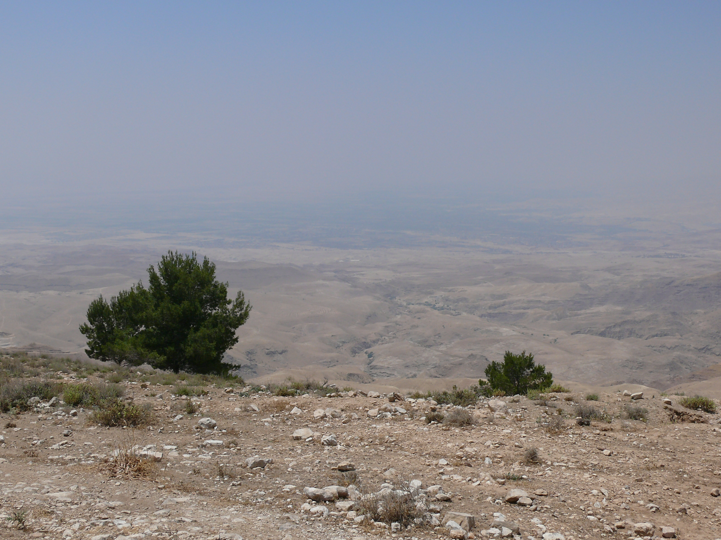
The Promised Land from Mt. Nebo

Slide 45
Deut. 29:2-4
And Moses summoned all Israel and said to them: “You have seen all that YHWH did before your eyes in the land of Egypt, to Pharaoh and to all his servants and to all his land, the great trials that your eyes saw, the signs, and those great wonders. But to this day YHWH has not given you a heart to understand or eyes to see or ears to hear.”

Slide 46
Deut. 29:5-6
I have led you forty years in the wilderness. Your clothes have not worn out on you, and your sandals have not worn off your feet. You have not eaten bread, and you have not drunk wine or strong drink, that you may know that I am YHWH your God.

Slide 47
Deut. 29:7-8
And when you came to this place, Sihon the king of Heshbon and Og the king of Bashan came out against us to battle, but we defeated them. We took their land and gave it for an inheritance to the Reubenites, the Gadites, and the half-tribe of the Manassites.

Slide 48
Deut.29:9-12
Therefore keep the words of this covenant and do them, that you may prosper in all that you do. You are standing today all of you before YHWH your God: the heads of your tribes, your elders, and your officers, all the men of Israel, your little ones, your wives, and the sojourner who is in your camp, from the one who chops your wood to the one who draws your water, so that you may enter into the sworn covenant of YHWH your God, which YHWH your God is making with you today.

Slide 49
Deut. 29:13-15
that he may establish you today as his people, and that he may be your God, as he promised you, and as he swore to your fathers, to Abraham, to Isaac, and to Jacob. It is not with you alone that I am making this sworn covenant, but with whoever is standing here with us today before YHWH our God, and with whoever is not here with us today.

Slide 50
Living in the Desert
A bittersweet experience – good & bad
His presence & provision AND discipline
  We can miss out on his full blessing
  But He continues to provide
He breaks us to teach us & prepare us
He offers opportunity for new commitment

Slide 51
Are You Living in the Desert ?
His presence & provision are still with you
He wants to break you
He wants to teach you
He wants to prepare you
He offers you an opportunity for
a new (or renewed) commitment

Slide 53
Save This

