Slide 1
Sukkot
and The Appointed Times

Slide 2
New Testament:
English Greek Hebrew
Jesus Iesous Yeshua
Old Testament:
English Greek Hebrew
Joshua Iesous Yehoshua or Yeshua

Slide 3
What is Sukkot?
Sukkah – singular Sukkot – plural
Noun: “temporary dwelling, like a tent, lean-to, shack, shelter, cave”
Feast of Tabernacles, Booths, Shelters
Verb: “to dwell, to tabernacle”

Slide 4
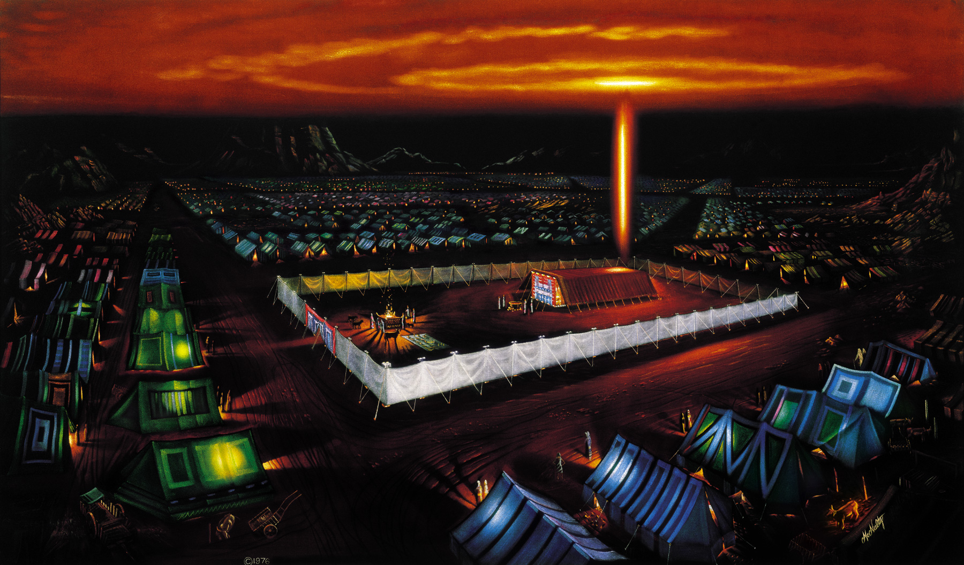

Slide 5
His Presence
God dwelling with his people – desert
Yeshua dwelling on earth – 1st coming
God’s Holy Spirit dwelling within us
Yeshua’s return and reign – 2nd coming

Slide 6
His Provision
He provided water & manna in the desert
He provided the annual harvest
Feast of the Ingathering
He provided His Son to save us
He provided His Spirit to indwell us

Slide 7
Sukkot
God’s PRESENCE
and
God’s PROVISION
The 7th Holy Day of the year

Slide 8
Leviticus 23:1–2 The LORD spoke to Moses, saying, “Speak to the people of Israel and say to them, These are the appointed feasts of the LORD that you shall proclaim as holy convocations; they are my appointed feasts.”.
The LORD = YHWH
“Yahweh” ?
“Yahuah” ?

Slide 9
Exodus 3:15
Say this to the people of Israel, “YHWH, the God of your fathers, the God of Abraham, the God of Isaac, and the God of Jacob, has sent me to you.” This is my name forever, and thus I am to be remembered throughout all generations.

Slide 10
Leviticus 23:1–2 YHWH spoke to Moses, saying, “Speak to the people of Israel and say to them, These are the appointed feasts of YHWH that you shall proclaim as holy convocations; they are my appointed feasts.”.
appointed feasts = mo’edim
“set times”
“appointed times”

Slide 11
Leviticus 23:1–2 YHWH spoke to Moses, saying, “Speak to the people of Israel and say to them, These are the appointed feasts of YHWH that you shall proclaim as holy convocations; they are my appointed feasts.”.
holy convocation =
“holy assembly”
“holy gathering”

Slide 12
Leviticus 23:3
Six days shall work be done, but on the seventh day is a Sabbath of solemn rest, a holy convocation. You shall do no work. It is a Sabbath to YHWH in all your dwelling places.

Slide 13
Genesis 2:2-3
And on the seventh day God finished his work that he had done, and he rested on the seventh day from all his work that he had done. So God blessed the seventh day and made it holy.

Slide 14
Appointed Times of YHWH
1 weekly appointment
(the Sabbath)
7 annual appointments

Slide 15
Leviticus 23:4-5
These are the appointed feasts of YHWH, the holy convocations, which you shall proclaim at the time appointed for them. In the first month, on the fourteenth day of the month at twilight, is YHWH’s Passover.

Slide 16
Passover
Recalls the passing over of the destroyer - death to every household not covered by the blood of the sacrificed lamb
Looks forward to the sacrifice of Yeshua on the very same day, when he was crucified as our sacrificial Lamb

Slide 17
Leviticus 23:6-7
And on the fifteenth day of the same month is the feast of Unleavened Bread to YHWH; for seven days you shall eat unleavened bread. On the first day you shall have a holy convocation; you shall not do any ordinary work.

Slide 18
Unleavened Bread
Recalls their quick deliverance from Egypt, the beginning of their path to new life
Unleavened bread = sinless Messiah Yeshua = Bread of Life
His body buried on the very same day, like seed planted to raise up new life

Slide 19
Leviticus 23:9-11
And YHWH spoke to Moses, saying, “Speak to the people of Israel and say to them, When you come into the land that I give you and reap its harvest, you shall bring the sheaf of the firstfruits of your harvest to the priest, and he shall wave the sheaf
before YHWH, so that you may be accepted. On the day after the Sabbath the priest shall wave it.

Slide 20
Firstfruits = Resurrection Day
Offering the firstfruits of the first harvest
Yeshua was resurrected on the very same day, becoming the Firstfruits of the spiritual harvest of the earth
1 Corinthians 15:20
But in fact Christ has been raised from the dead, the firstfruits of those who have fallen asleep.

Slide 21
Leviticus 23:15-16, 21
You shall count seven full weeks from the day after the Sabbath, from the day that you brought the sheaf of the wave offering. You shall count fifty days to the day after the seventh Sabbath. Then you shall present a grain offering of new grain to YHWH…
You shall hold a holy convocation. You shall not do any ordinary work. It is a statute forever in all your dwelling places throughout your generations.

Slide 22
Shavuot (Pentecost)
Initiated the wheat harvest – new grain
Recalls giving of Torah on tablets of stone
God gave His Spirit on the very same day, when He wrote his Torah on our hearts
Sign of the new covenant initiating a new spiritual harvest

Slide 23
3 Spring Appointed Times
Passover – Crucifixion
Unleavened Bread – Burial
Firstfruits – Resurrection
Shavuot (Pentecost) – Holy Spirit
3 Fall Appointed Times
Trumpets – ??
Atonement – ??
Sukkot – ??

Slide 24
Leviticus 23:24-25
Speak to the people of Israel, saying, In the seventh month, on the first day of the month, you shall observe a day of solemn rest, a memorial proclaimed with blast of trumpets, a holy convocation. You shall not do any ordinary work, and you shall present a food offering to YHWH.

Slide 25
Day of Trumpets
Gathering people for Appointed Time
Gathering people for battle
For the crowning of a king
For the anointing of a High Priest
For the arrival of the bridegroom
Looks forward to Yeshua’s 2nd coming, on the very same day ??

Slide 26
Leviticus 23:27-31
Now on the tenth day of this seventh month is the Day of Atonement. It shall be for you a time of holy convocation, and you shall afflict yourselves and present a food offering to YHWH. And you shall not do any work on that very day, for it is a Day of Atonement, to make atonement for you before YHWH your God… It is a statute forever throughout your generations in all your dwelling places.

Slide 27
Day of Atonement
Recalls High Priest going into the Holy of Holies to stand in God’s presence
The High Priest would either live or die in God’s presence
Symbolizes Judgment Day, when on the very same day?? we will stand before God to either live or die in His presence

Slide 28
Leviticus 23:39-41
On the fifteenth day of the seventh month, when you have gathered in the produce of the land, you shall celebrate the feast of YHWH seven days. On the first day shall be a solemn rest, and on the eighth day shall be a solemn rest. And you shall take on the first day the fruit of splendid trees, branches of palm trees and boughs of leafy trees and willows of the brook, and you shall rejoice before YHWH your God seven days.

Slide 29
Leviticus 23:42-43
You shall celebrate it as a feast to YHWH for seven days in the year. It is a statute forever throughout your generations; you shall celebrate it in the seventh month. You shall dwell in booths for seven days. All native Israelites shall dwell in booths, that your generations may know that I made the people of Israel dwell in booths when I brought them out of the land of Egypt: I am YHWH your God.

Slide 31
Sukkot
God and his people sukkah’ing together His PRESENCE His PROVISION
The end of the final harvest THANKSGIVING
Symbolizes Messiah’s reign as King The Millennium – 1000 year reign starting on this very same day??

Slide 32
3 Spring Appointed Times
Passover – Crucifixion
Unleavened Bread – Burial
Firstfruits – Resurrection
First Harvest
Shavuot (Pentecost) – Holy Spirit
Wheat Harvest
3 Fall Appointed Times
Trumpets – The 2nd Coming
Atonement – Judgment Day
Sukkot – Messiah’s reign as King
Final Harvest

Slide 33
Next Steps for Today
Commit to CELEBRATING Sukkot
Enjoy the fire, food & fellowship
Consider camping out with us
Read / study the Scripture portions
Come back tomorrow

Slide 35
Save This

