Slide 2
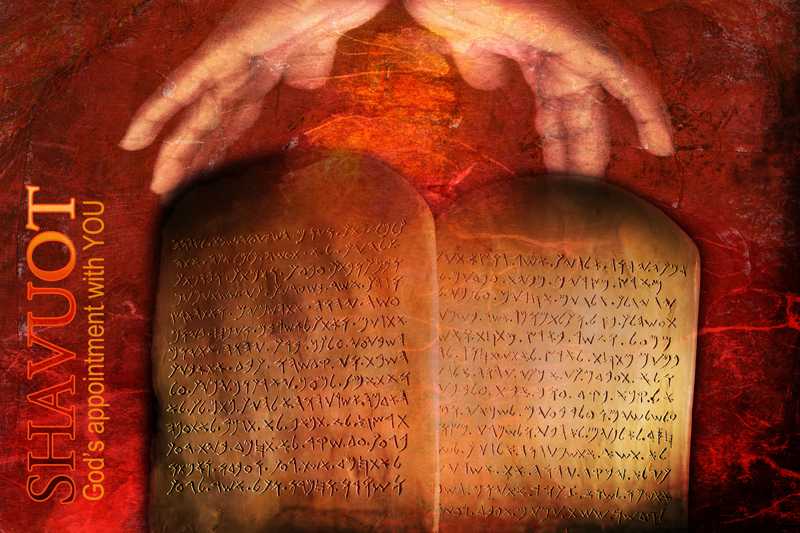
Shavuot
“Weeks”

Slide 3
Leviticus 23:1–2
The LORD spoke to Moses, saying, “Speak to the people of Israel and say to them, These are the appointed feasts of the LORD that you shall proclaim as holy convocations; they are my appointed feasts.”.

Slide 4
Leviticus 23:1–2
The LORD spoke to Moses, saying, “Speak to the people of Israel and say to them, These are the appointed feasts of the LORD that you shall proclaim as holy convocations; they are my appointed feasts.”.
The LORD = YHWH
“Yahweh” ?
“Yahuah” ?

Slide 5
Exodus 3:15
Say this to the people of Israel, “YHWH, the God of your fathers, the God of Abraham, the God of Isaac, and the God of Jacob, has sent me to you.” This is my name forever, and thus I am to be remembered throughout all generations.

Slide 6
Leviticus 23:1–2
YHWH spoke to Moses, saying, “Speak to the people of Israel and say to them, These are the appointed feasts of YHWH that you shall proclaim as holy convocations; they are my appointed feasts.”.
appointed feasts = mo’edim
“set times”
“appointed times”
“appointments”

Slide 7
Leviticus 23:3
Six days shall work be done, but on the seventh day is a Sabbath of solemn rest, a holy convocation. You shall do no work. It is a Sabbath to YHWH in all your dwelling places.

Slide 8
Genesis 2:2-3
And on the seventh day God finished his work that he had done, and he rested on the seventh day from all his work that he had done. So God blessed the seventh day and made it holy, because on it God rested from all his work that he had done in creation.

Slide 9
Leviticus 23:3
Six days shall work be done, but on the seventh day is a Sabbath of solemn rest, a holy convocation. You shall do no work. It is a Sabbath to YHWH in all your dwelling places.

Slide 10
Appointed Times of YHWH
1 weekly (the Sabbath)
7 annual appointments

Slide 11
Leviticus 23:4-5
These are the appointed feasts of YHWH, the holy convocations, which you shall proclaim at the time appointed for them. In the first month, on the fourteenth day of the month at twilight, is YHWH’s Passover.

Slide 12
Leviticus 23:6-7
And on the fifteenth day of the same month is the feast of Unleavened Bread to YHWH; for seven days you shall eat unleavened bread. On the first day you shall have a holy convocation; you shall not do any ordinary work.

Slide 13
Leviticus 23:9-11
And YHWH spoke to Moses, saying, “Speak to the people of Israel and say to them, When you come into the land that I give you and reap its harvest, you shall bring the sheaf of the firstfruits of your harvest to the priest, and he shall wave the sheaf
before YHWH, so that you may be accepted. On the day after the Sabbath the priest shall wave it.

Slide 14
1 Corinthians 15:20
But in fact Christ has been raised from the dead, the firstfruits of those who have fallen asleep.
Firstfruits = Resurrection Day

Slide 15
3 Spring Appointed Times
Passover – the crucifixion
Unleavened Bread – death & burial
Firstfruits – the resurrection
3 Fall Appointed Times
future events symbolic
of the second coming

Slide 16
Trumpets – Leviticus 23:23-25
the second coming, gathering his people
Atonement – Leviticus 23:26-32
judgment day, standing before His throne
Tabernacles – Leviticus 23:33-43
the millennial reign,
living in His presence

Slide 17
Leviticus 23:21
It is a statute forever in all your dwelling places throughout your generations.

Slide 18
3 Spring Appointed Times
Passover
Unleavened Bread
Firstfruits
Shavuot = “weeks”
3 Fall Appointed Times
Trumpets
Atonement
Tabernacles

Slide 19
Leviticus 23:15-16, 21
You shall count seven full weeks from the day after the Sabbath, from the day that you brought the sheaf of the wave offering. You shall count fifty days to the day after the seventh Sabbath. Then you shall present a grain offering of new grain to YHWH…
You shall hold a holy convocation. You shall not do any ordinary
work. It is a statute forever
in all your dwelling places
throughout your generations.

Slide 21
Exodus 19:1
On the third new moon after the people of Israel had gone out of the land of Egypt, on that day they came into the wilderness of Sinai.

Slide 22
Day 1. Arrive at Sinai
Day 2. Moses up & down mountain

Slide 23
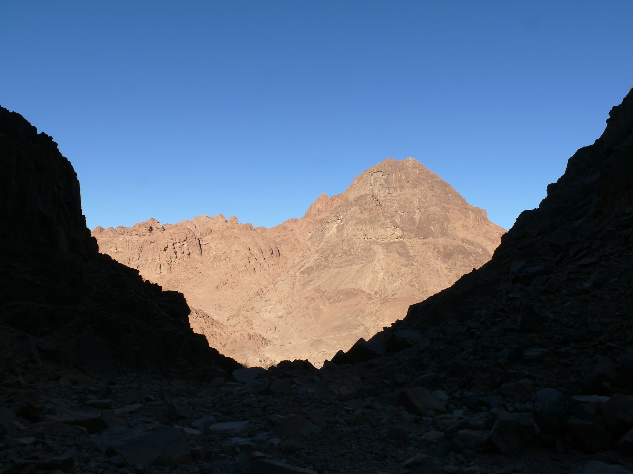
Mt. Sinai (traditional location)

Slide 24
Day 1. Arrive at Sinai
Day 2. Moses up & down mountain
Day 3. Moses up & down mountain
1st day of preparation
Day 4. 2nd day of preparation
Day 5. 3nd day of preparation
Moses up & down mt.
Day 6. Moses & Aaron go up
YHWH speaks

Slide 25
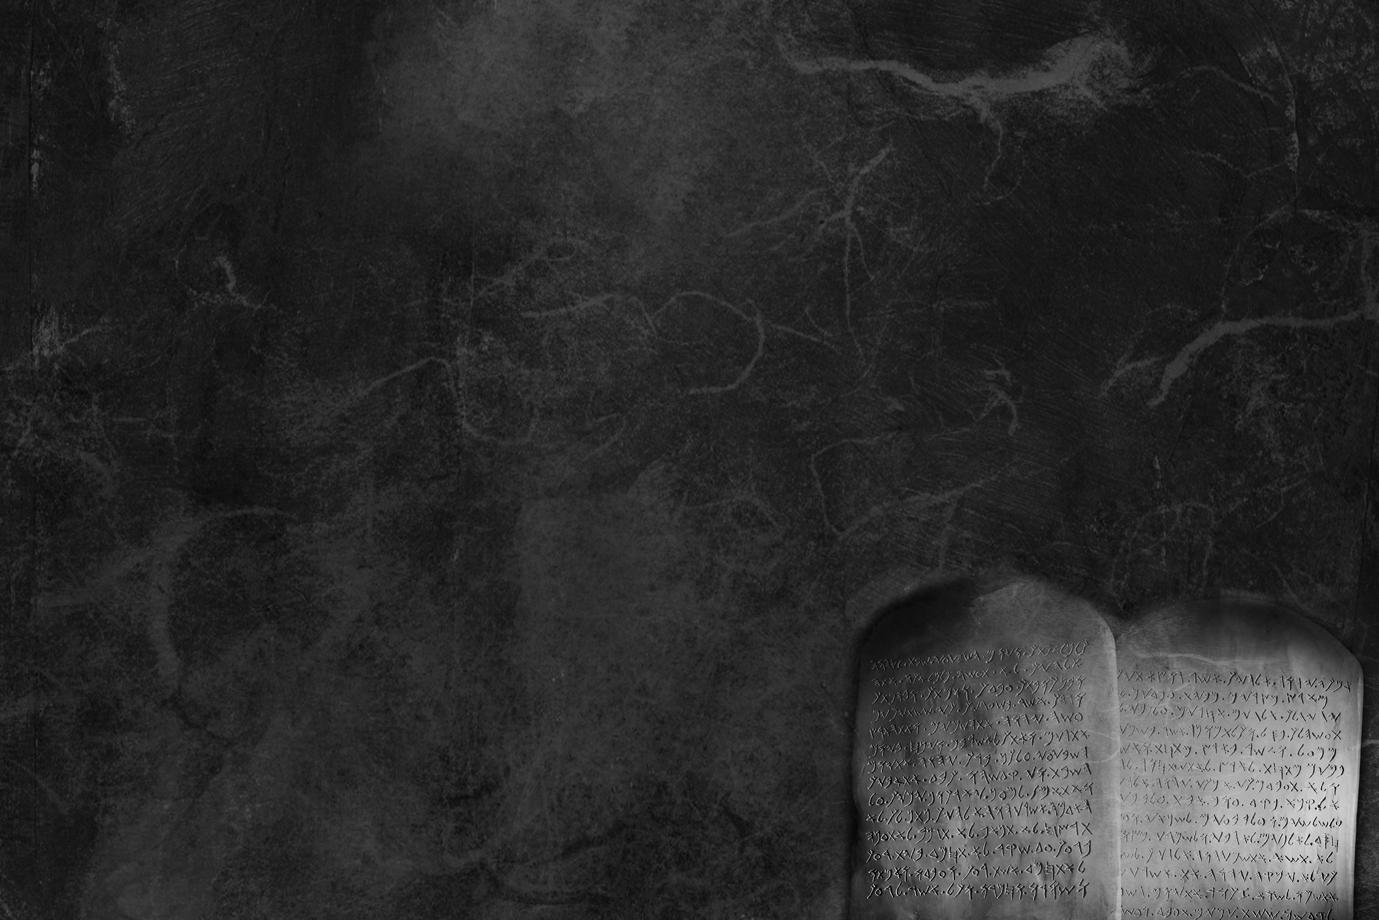
Timing of Shavuot & the Ten Words

Slide 26
Timing of Shavuot & the Ten Words

Slide 27
Timing of Shavuot & the Ten Words

Slide 28
Ex 20:2
I am YHWH your God, who brought you out of the land of Egypt.
Ex 20:3
You shall have no other gods before me.
Ex 20:7
You shall not take the name of YHWH your God in vain.

Slide 29
Ex 20:8
Remember the Sabbath day, to keep it holy. Six days you shall labor, and do all your work, but the seventh day is a Sabbath to YHWH your God. On it you shall not do any work.
Ex 20:12
Honor your father and your mother.
Ex 20:13
You shall not murder.

Slide 30
Ex 20:14
You shall not commit adultery.
Ex 20:15
You shall not steal.
Ex 20:16
You shall not bear false witness against your neighbor.
Ex 20:17
You shall not covet.

Slide 31
Exodus 20:18
Now when all the people saw the thunder and the flashes of lightning and the sound of the trumpet and the mountain smoking, the people were afraid and trembled, and they stood far off.
Exodus 20:22
And YHWH said to Moses... “You have seen for yourselves that I have talked with you from heaven.”

Slide 33
Ezekiel 1:1
In the thirtieth year, in the fourth month, on the fifth day of the month, as I was among the exiles by the Chebar canal, the heavens were opened, and I saw visions of God.

Slide 34
Ezekiel 1:4
As I looked, behold, a stormy wind came out of the north, and a great cloud, with brightness around it, and fire flashing forth continually, and in the midst of the fire, as it were gleaming metal.

Slide 35
Ezekiel 1:13-14
As for the likeness of the living creatures, their appearance was like burning coals of fire, like the appearance of torches moving to and fro among the living creatures. And the fire was bright, and out of the fire went forth lightning.

Slide 36
Ezekiel 1:24
And when they went, I heard the sound of their wings like the sound of many waters, like the sound of the Almighty, a sound of tumult like the sound of an army.

Slide 37
Ezekiel 2:1-2
And he said to me, “Son of man, stand on your feet, and I will speak with you.” And as he spoke to me, the Spirit entered into me and set me on my feet, and I heard him speaking to me.

Slide 39
Acts 2:1
When the day of Pentecost arrived, they were all together in one place.
Pentecost = Shavuot
Hebrew: shavuot “weeks”
counting 7 full weeks
Greek: pentecoste “fiftieth”
counting 50 days

Slide 40
Acts 2:1-4
When the day of Pentecost arrived, they were all together in one place. And suddenly there came from heaven a sound like a mighty rushing wind, and it filled the entire house where they were sitting. And divided tongues as of fire appeared to them and rested on each one of them.
And they were all filled with the
Holy Spirit and began to speak
in other tongues as the Spirit
gave them utterance.

Slide 42
Next Steps for Today
1. Make today a day of rest.
2. Celebrate His Word and His Spirit
3. Make plans to keep YHWH’s appointments
4. Treat His Word as holy; as your
most precious possession
5. Commit your life to
the God of Israel

Slide 43

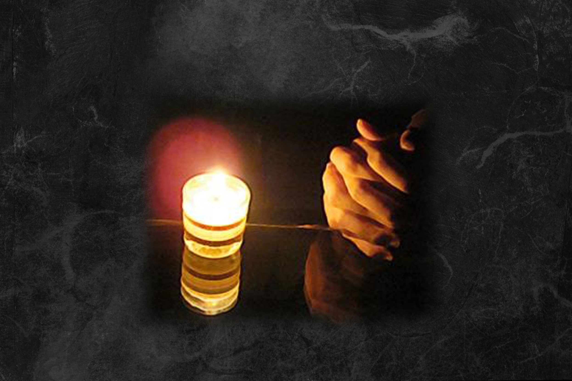
Prayer Room - 208

Slide 44
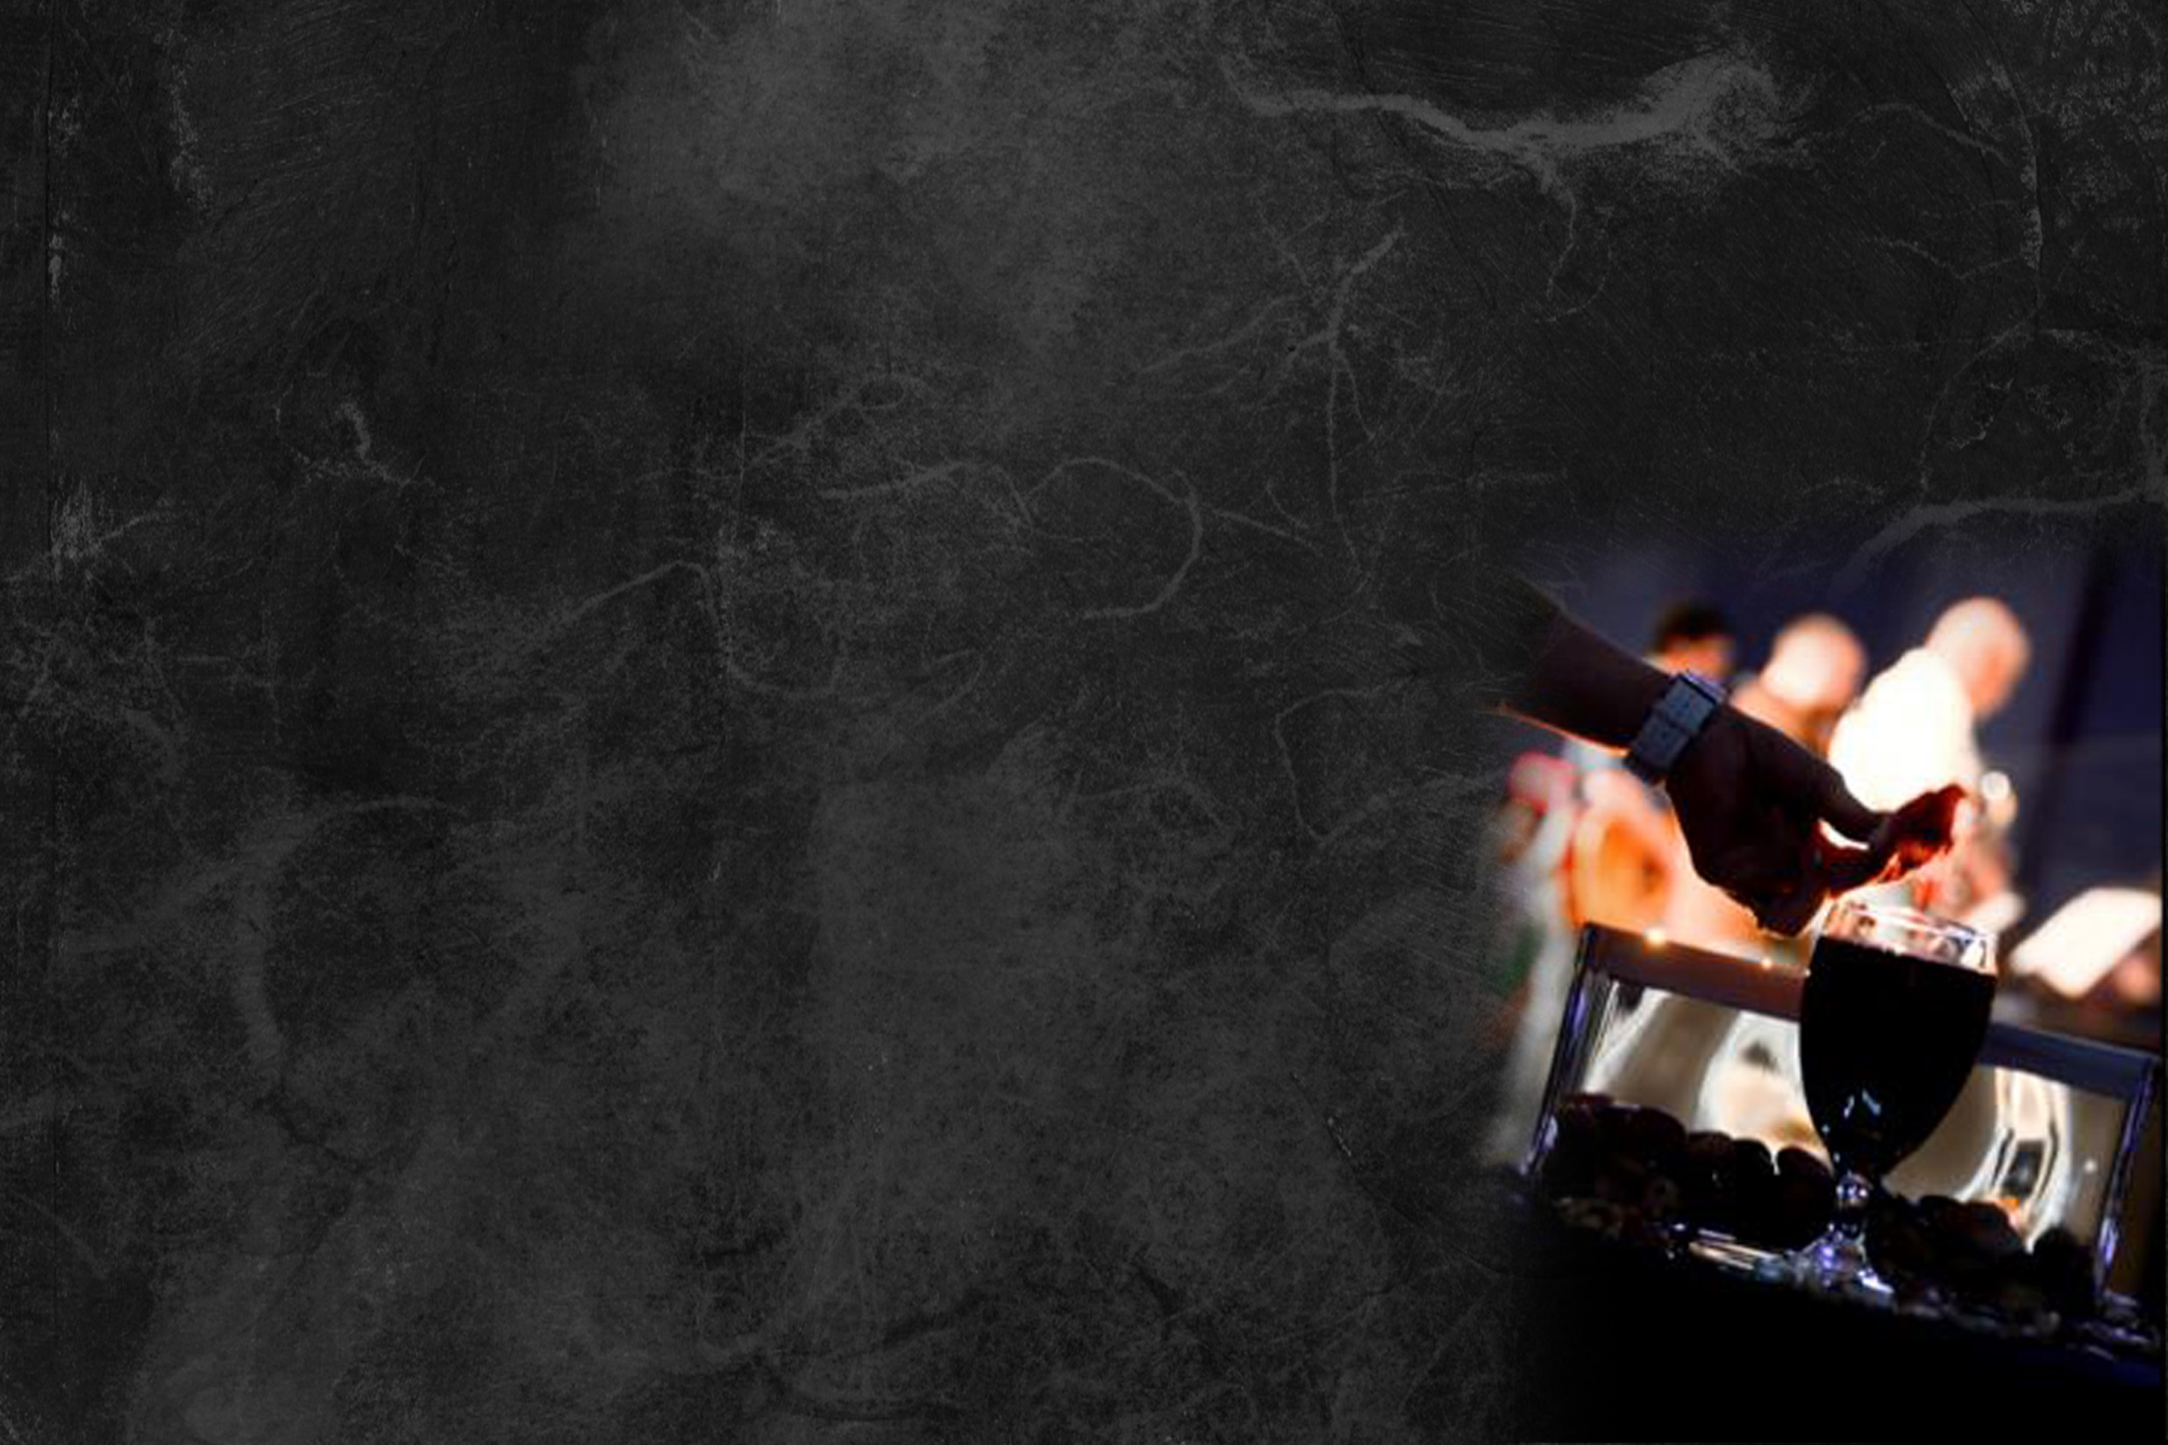
1 Corinthians 11:23–26
For I received from the Lord what I also delivered to you, that the Lord Jesus on the night when he was betrayed took bread, and when he had given thanks, he broke it, and said, “This is my body which is for you. Do this in remembrance of me.” In the same way also he took the
cup, after supper, saying, “This cup
is the new covenant in my blood.
Do this, as often as you drink it, in
remembrance of me.” For as often
as you eat this bread and drink the
cup, you proclaim the Lord’s death
until he comes.

