Slide 1
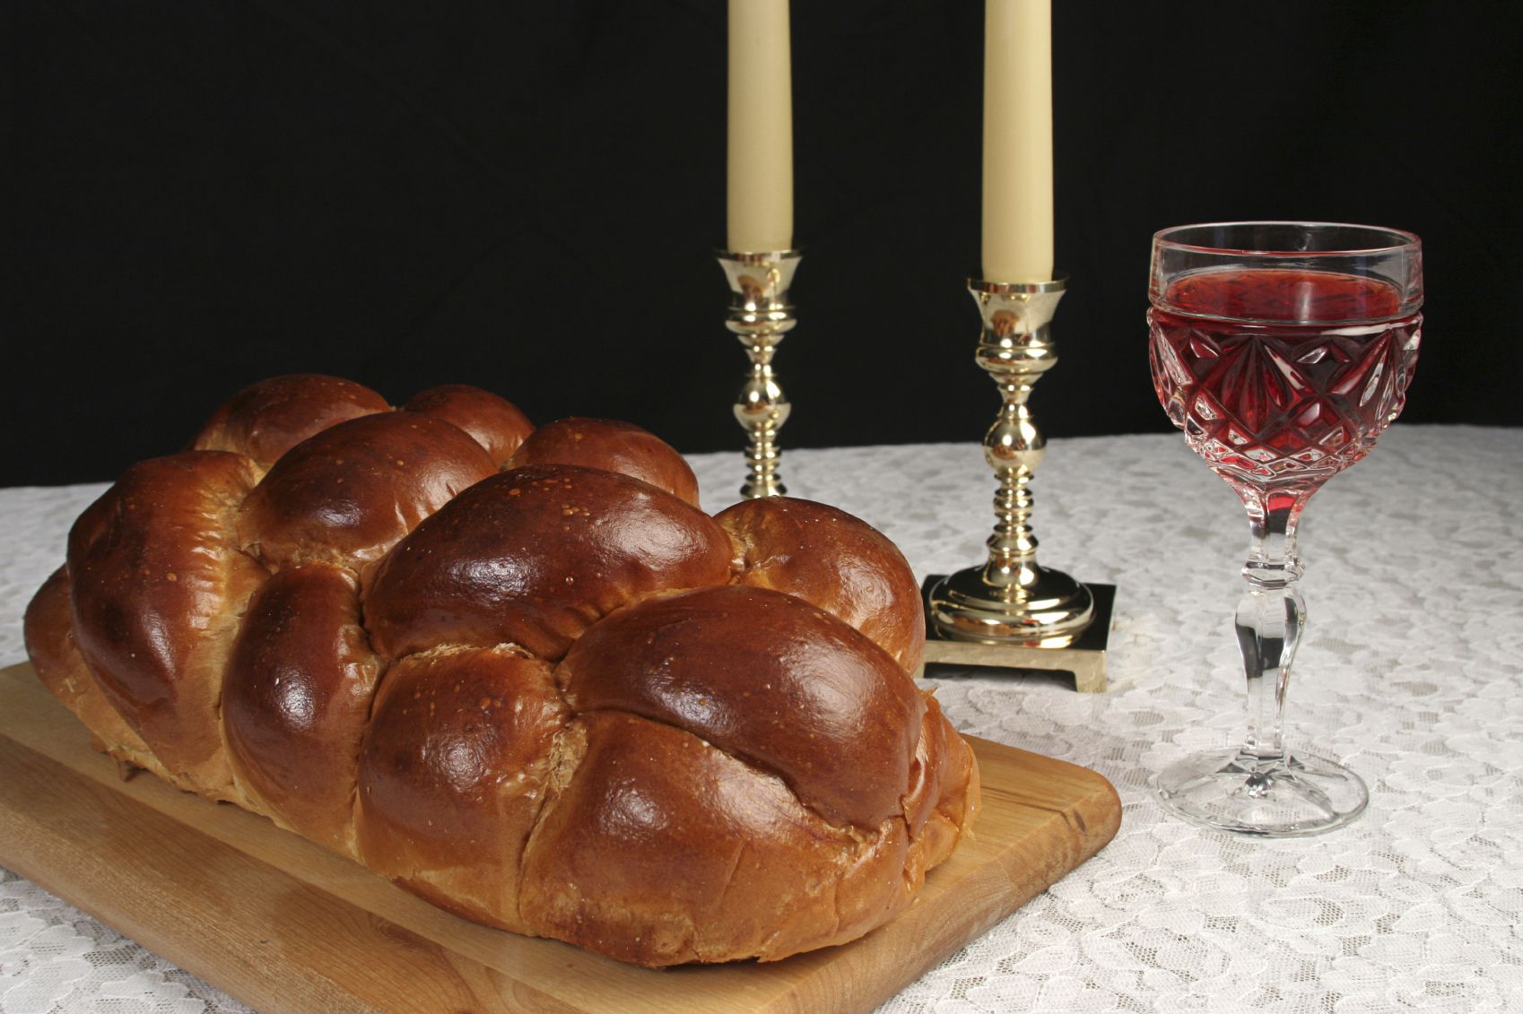
Sabbath

Slide 2
Mark 7:1–4
Now when the Pharisees gathered to him, with some of the scribes who had come from Jerusalem, they saw that some of his disciples ate with hands that were defiled, that is, unwashed. (For the Pharisees and all the Jews do not eat unless they wash their hands properly, holding to the tradition of the elders, and when they come from the marketplace, they do not eat unless they wash. And there are many other traditions that they observe, such as the washing of cups and pots and copper vessels and dining couches.)

Slide 3
Mark 7:5–8
And the Pharisees and the scribes asked him, “Why do your disciples not walk according to the tradition of the elders, but eat with defiled hands?” And he said to them, “Well did Isaiah prophesy of you hypocrites, as it is written, “ ‘This people honors me with their lips, but their heart is far from me; in vain do they worship me, teaching as doctrines the commandments of men.’ You leave the commandment of God and hold to the tradition of men.”

Slide 4
Mark 7:9–11
You have a fine way of rejecting the commandment of God in order to establish your tradition! For Moses said, ‘Honor your father and your mother’; and, ‘Whoever reviles father or mother must surely die.’ But you say, ‘If a man tells his father or his mother, “Whatever you would have gained from me is Corban” ’ (that is, given to God) - then you no longer permit him to do
anything for his father or mother.

Slide 5
And many such things WE do ??
Mark 7:12–13
Thus making void the word of God by your tradition that you have handed down.
And many such things you do.

Slide 6
The First of the Appointed Times
The Sabbath
Leviticus 23:3
Six days shall work be done, but on the seventh day is a Sabbath of solemn rest, a holy convocation. You shall do no work. It is a Sabbath to YHWH in all your dwelling places.

Slide 7
Set apart from the very beginning:
Genesis 2:2-3
And on the seventh day God finished his work that he had done, and he rested on the seventh day from all his work that he had done. So God blessed the seventh day and made it holy.
holy = set apart (for YHWH)

Slide 8
Manna, before the Torah was given:
Exodus 16:21–23
Morning by morning they gathered it, each as much as he could eat; but when the sun grew hot, it melted. On the sixth day they gathered twice as much bread, two omers each. And when all the leaders of the congregation came and told Moses, he said to them, “This is what YHWH has commanded: ‘Tomorrow is a day
of solemn rest, a holy Sabbath
to YHWH.’

Slide 9
Exodus 16:23–25
“Bake what you will bake and boil what you will boil, and all that is left over lay aside to be kept till the morning.” So they laid it aside till the morning, as Moses commanded them, and it did not stink, and there were no worms in it. Moses said, “Eat it today, for today is a Sabbath to YHWH; today you will not find it in
the field.

Slide 10
Exodus 16:26–28
“Six days you shall gather it, but on the seventh day, which is a Sabbath, there will be none.” On the seventh day some of the people went out to gather, but they found none. And YHWH said to Moses, “How long will you refuse to keep my commandments and my laws? See! YHWH has given you the Sabbath; therefore on the sixth day he gives
you bread for two days.”

Slide 11
The 4th Commandment:
Exodus 20:8–10
Remember the Sabbath day, to keep it holy. Six days you shall labor, and do all your work, but the seventh day is a Sabbath to YHWH your God. On it you shall not do any work, you, or your son, or your daughter, your male servant, or your female servant, or your livestock, or the sojourner who is within your gates.

Slide 12
And what is the reason?
Exodus 20:11
For in six days YHWH made heaven and earth, the sea, and all that is in them, and rested on the seventh day. Therefore YHWH blessed the Sabbath day and made it holy.

Slide 13
And after the Torah is given:
Exodus 31:13–14
You are to speak to the people of Israel and say, “Above all you shall keep my Sabbaths, for this is a sign between me and you throughout your generations, that you may know that I, YHWH, sanctify you. You shall keep the Sabbath, because it is holy for you. Everyone who profanes it shall be put to death. Whoever does
any work on it, that soul shall be
cut off from among his people.”

Slide 14
Exodus 31:15–16
Six days shall work be done, but the seventh day is a Sabbath of solemn rest, holy to YHWH. Whoever does any work on the Sabbath day shall be put to death. Therefore the people of Israel shall keep the Sabbath, observing the Sabbath throughout their generations, as a covenant forever.

Slide 15
The Sabbath is for Gentiles too:
Isaiah 56:6–7
And the foreigners who join themselves to YHWH, to minister to him, to love the name of YHWH, and to be his servants, everyone who keeps the Sabbath and does not profane it, and holds fast my covenant -- these I will bring to my holy mountain, and make them joyful in my house of prayer; their burnt offerings and their sacrifices will
be accepted on my altar; for my
house shall be called a house of
prayer for all peoples.

Slide 16
The Sabbath is our Blessing:
Isaiah 58:13–14
If you turn back your foot from the Sabbath, from doing your pleasure on my holy day, and call the Sabbath a delight and the holy day of YHWH honorable; if you honor it, not going your own ways, or seeking your own pleasure, or talking idly; then you shall take delight in YHWH, and I will make you
ride on the heights of the earth.

Slide 17
A sign that we are set apart:
Ezekiel 20:12
Moreover, I gave them my Sabbaths, as a sign between me and them, that they might know that I am YHWH who sanctifies them.

Slide 18
An Appointed Time of YHWH
The Sabbath is a Picture
Recalls a PAST even
Has a PRESENT application
Foreshadows a FUTURE fulfillment

Slide 19
Seven = a complete cycle
Seven days for creation
Seven days in a weekly cycle
Seven appointed times in a year
Seven weeks after Firstfruits to Shavuot
Seven years in sabbatical cycle
Seven sabbaticals (49 yrs) in jubilee cycle
Seven “1000-years” in this era
(according to Jewish tradition)

Slide 20
Seven days of creation
One day = 1000 years
Psalm 90:4
For a thousand years in your sight are but as yesterday when it is past, or as a watch in the night.
2 Peter 3:8
But do not overlook this one fact, beloved, that with the Lord one day is as a thousand
years, and a thousand years
as one day.

Slide 21
Seven days of creation
One day = 1000 years
Man was created on day 6
So 6 is the number of man
(666 – the mark of the beast)
The first 6000 years = reign of man
Day 7 = God set apart, made holy
The last 1000 years = reign of Messiah
Weekly Sabbath foreshadows this
Revelation:
Messiah reigns 1000 years

Slide 22
The Sabbath Rest of Hebrews 4
Hebrews 4:9–10
So then, there remains a Sabbath rest for the people of God, for whoever has entered God’s rest has also rested from his works as God did from his.
Entering the promised land = REST
The Sabbath = REST
With Messiah = REST
ALL foreshadows the Millennium

Slide 23
The Sabbath
Sabbath is the 7th day of the week &
Sukkot is the 7th Appointed Time
Sukkot & Sabbath picture the millennium
King Messiah dwells with His people
Satan is bound and we rest in Messiah
The Bridegroom & the bride
begin married life together

Slide 24
Did Yeshua break the Sabbath?
If he broke Torah
he could not be sinless!
“Prioritizing” commands of Torah
Shammai vs. Hillel

Slide 25
Shammai
Love YHWH with all your heart
Keep the Sabbath holy
Love your neighbor as yourself
Hillel
Love YHWH with all your heart
Love your neighbor as yourself
Keep the Sabbath holy

Slide 26
Doing good on the Sabbath
Matthew 12:11–12
He said to them, “Which one of you who has a sheep, if it falls into a pit on the Sabbath, will not take hold of it and lift it out? Of how much more value is a man than a sheep! So it is lawful to do good on the Sabbath.”

Slide 27
Plucking grain to eat on Sabbath
Mark 2:25–27
“Have you never read what David did, when he was in need and was hungry, he and those who were with him: how he entered the house of God, in the time of Abiathar the high priest, and ate the bread of the Presence, which it is not lawful for any but the priests to eat, and also gave it to those who were with him?” And he said to them,
“The Sabbath was made for man,
not man for the Sabbath.”

Slide 28
Yeshua is lord of the Sabbath
Matthew 12:5–8
Or have you not read in the Law how on the Sabbath the priests in the temple profane the Sabbath and are guiltless? I tell you, something greater than the temple is here. And if you had known what this means, ‘I desire mercy, and not sacrifice,’ you would not have condemned the guiltless.
For the Son of Man is lord of
the Sabbath.

Slide 29
Doing good “work” on the Sabbath
John 5:15–18
The man went away and told the Jews it was Yeshua who healed him. And this was why the Jews were persecuting Yeshua, because he was doing these things on the Sabbath. But Yeshua answered them, “My Father is working until now, and I am working.” This was why the Jews were seeking all the more to kill him, because not only was he breaking the
Sabbath, but he was even calling
God his own Father, making
himself equal with God.

Slide 30
Did Yeshua break the Sabbath?
If he broke Torah he could not be sinless!
He was accused of breaking the Sabbath
Yeshua broke the Sabbath
according to Jewish teaching
but not according to Torah
Yeshua never broke Torah!

Slide 31
Yeshua’s followers kept Sabbath
Luke 23:55–24:1
The women who had come with him from Galilee followed and saw the tomb and how his body was laid. Then they returned and prepared spices and ointments. On the Sabbath they rested according to the commandment. But on the first day of the week, at early dawn, they went to the tomb, taking the spices they had
prepared.

Slide 32
Gentile believers were expected to meet on the Sabbath:
Acts 15:21
For from ancient generations Moses has had in every city those who proclaim him, for he is read every Sabbath in the synagogues.

Slide 33
Paul taught on the Sabbath
Acts 13:42–44
As they went out, the people begged that these things might be told them the next Sabbath… The next Sabbath almost the whole city gathered to hear the word of the Lord.

Slide 34
It was his custom…
Acts 17:1–2
They came to Thessalonica, where there was a synagogue of the Jews. And Paul went in, as was his custom, and on three Sabbath days he reasoned with them from the Scriptures,

Slide 35
Did they ever meet on Sunday??
Acts 20:7
On the first day of the week, when we were gathered together to break bread, Paul talked with them, intending to depart on the next day, and he prolonged his speech until midnight.

Slide 36
Saving “firstfruits” each week:
1 Corinthians 16:1–2
Now concerning the collection for the saints: as I directed the churches of Galatia, so you also are to do. On the first day of every week, each of you is to put something aside and store it up, as he may prosper, so that there will be no collecting when I come.

Slide 37
Paul… Study the context!
Colossians 2:16–17
Therefore let no one pass judgment on you in questions of food and drink, or with regard to a festival or a new moon or a Sabbath. These are a shadow of the things to come, but and the substance belongs to Christ.

Slide 38
So what happened?
Nothing in Scripture indicates
the Sabbath (4th commandment)
was ever changed!

Slide 39
Jewish – Christian Separation
So what happened?
Sabbath fasting vs feasting
Sun worship influence from Rome
Meetings Sabbaths + Sundays
Gradual focus on Sundays

Slide 40
Ignatius (~100AD), Syria:
Let us therefore no longer keep the Sabbath after the Jewish manner, and rejoice in days of idleness...But let every one of you keep the Sabbath in a spiritual manner...not in relaxation, not in eating things prepared the day before, not in finding delight in dancing and clapping which have no sense in them.

Slide 41
Justin Martyr (~150AD), Rome:
And on the day called Sunday, all who live in cities or in the country gather together to one place, and the memoirs of the apostles or the writings of the prophets are read, as long as time permits; then, when the reader has ceased, the president verbally instructs, and exhorts to the imitation of these good things. Then we all rise together and pray, and, as we before said, when our prayer is
ended, bread and wine and water
are brought…

Slide 42
Justin Martyr (~150AD), Rome:
But Sunday is the day on which we all hold our common assembly, because it is the first day on which God, having wrought a change in the darkness and matter, made the world; and Jesus Christ our Savior on the same day rose from the dead. For He was crucified on the day before that of Saturn; and on the day after that of Saturn, which is the day of the Sun, having appeared to His apostles
and disciples…

Slide 43
Origin (~300 AD):
Forsaking the Judaic Sabbath observance, let us see what kind of Sabbath observance is expected of the Christian. On the Sabbath day, nothing of worldly activity should be done. If therefore desisting from all worldly works and doing nothing mundane but being free for spiritual works, you come to the church, listen to divine readings and discussions and think of heavenly things… disregard present and visible things in favor of the invisible
and future, this is the observance
of the Christian Sabbath.

Slide 44
Apostle’s Constitution (4th Century):
Thou shalt observe the Sabbath, on account of Him who ceased from His work of creation, but ceased not from His work of providence: it is a rest for meditation of the law, not for idleness of the hands.

Slide 45
Apostle’s Constitution (4th Century):
But keep the Sabbath, and the Lord’s day festival; because the former is the memorial of the creation, and the latter of the resurrection. But there is one only Sabbath to be observed by you in the whole year, which is that of our Lord’s burial, on which men ought to keep a fast, but not a festival.

Slide 46
Constantine (~321AD):
On the venerable Day of the Sun let the magistrates and people residing in cities rest, and let all workshops be closed. In the country, however, persons engaged in agriculture may freely and lawfully continue their pursuits; because it often happens that another day is not so suitable for grain-sowing or for vine-planting; lest by
neglecting the proper moment for
such operations the bounty of
heaven should be lost.

Slide 47
Eusebius (~339 AD):
[Constantine] enjoined on all the subjects of the Roman empire to observe the Lord's day, as a day of rest, and also to honor the day which precedes the Sabbath; in memory, I suppose, of what the Savior of mankind is recorded to have achieved on that day.

Slide 48
Eusebius (~339 AD):
Quotes Constantine’s letter to the churches:
“Let us then have nothing in common with the detestable Jewish crowd…
…that we might have nothing in common with that nation of parricides who slew
their Lord.”

Slide 49
Council of Laodicea (~364 AD):
Christians shall not Judaize and be idle on Saturday but shall work on that day; but the Lord's day they shall especially honor, and, as being Christians, shall, if possible, do no work on that day. If, however, they are found Judaizing, they shall be shut out from Christ.

Slide 50
Pope Innocent (~416 AD):
A very clear reason shows why one should
fast on the Sabbath. For if we celebrate the Diem Dominicum to show reverence for the resurrection of our Lord Jesus Christ not only on the day of Easter, but indeed also from one weekly cycle to another one, if we assemble together for the commemoration of that very day, and fast on the sixth holiday, we must
not omit the Sabbath, which comes
between the sadness and the joy
of that period.

Slide 51
Socrates Scholasticus (~439 AD):
At Rome they fast every Saturday.

Slide 52
Socrates Scholasticus (~439 AD):
Nor is there less variation in regard to religious assemblies. For although almost all churches throughout the world celebrate the sacred mysteries on the sabbath of every week, yet the Christians of Alexandria and at Rome, on account of some ancient tradition, have ceased to do this.

Slide 53
Sozomen (~443 AD):
The people of Constantinople, and almost everywhere, assemble together on the Sabbath, as well as on the first day of the week, which custom is never observed at Rome or at Alexandria.

Slide 54
Jewish – Christian Separation
So what happened?
Sabbath fasting vs feasting
Sun worship influence from Rome
Meetings Sabbaths + Sundays
Gradual focus on Sundays
Man’s tradition replaced
God’s command

Slide 55
Many such things??
Mark 7:9–13
You have a fine way of rejecting the commandment of God in order to establish your tradition… making void the word of God by your tradition that you have handed down.
And many such things you do.

Slide 56
Do you want to thrive in ministry?
In life??
Keep the Sabbath -
you will be blessed!
Keep the Appointed Times -
you will be even more blessed!
Re-examine your traditions
in the light of Scripture
Learn the Text, Live the Text,
Die the Text

Slide 57
Steps on the journey toward
Intimacy with YHWH
Israel
“Struggle with God”

