Slide 1
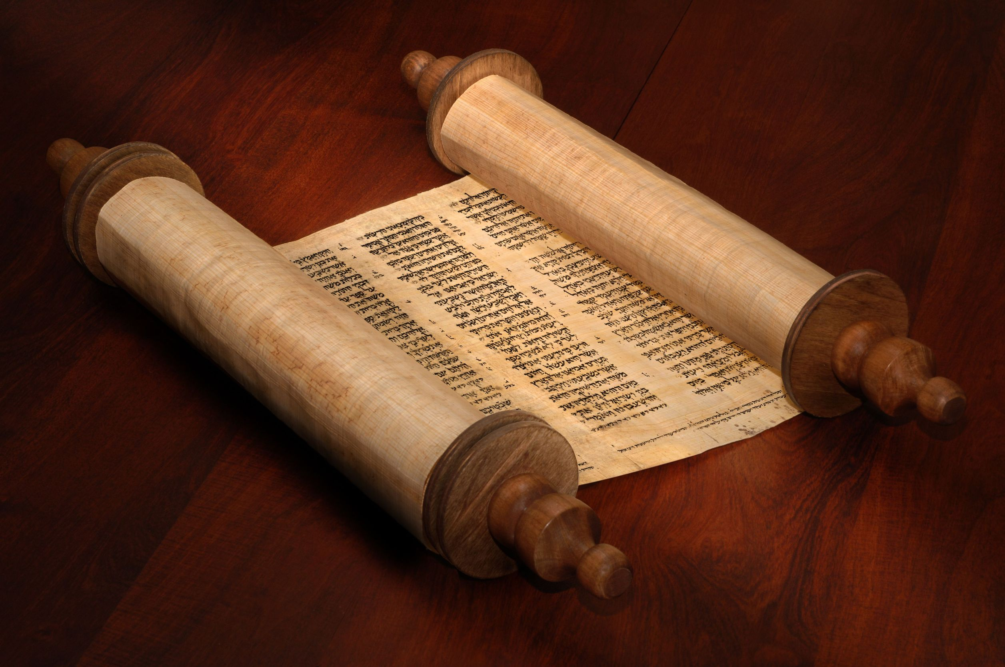
Struggling with Scripture

Slide 2
Names have meaning. They often indicate purpose or destiny.
Israel = “struggle with God”
We are Gentiles “grafted in” to the olive tree of Israel.
We are sojourners / foreigners who are attached to Israel.

Slide 3
We are supposed to be struggling with God! It is how we fulfill our purpose, our destiny.
How do we apply the Scriptures?
What is the role of the Old Testament?
How does the Torah apply to us today?

Slide 4
Matthew 5:17–19 Do not think that I have come to abolish the Law or the Prophets; I have not come to abolish them but to fulfill them. For truly, I say to you, until heaven and earth pass away, not an iota, not a dot, will pass from the Law until all is accomplished. Therefore whoever relaxes one of the least of these commandments and teaches others to do the same will be called least in the kingdom of heaven, but whoever does them and teaches them will be called great in the kingdom of heaven.

Slide 5
2 Timothy 3:16
All Scripture is breathed out by God and profitable for teaching, for reproof, for correction, and for training in righteousness.
Deuteronomy 6:25 And it will be righteousness for us, if we are careful to do all this commandment before YHWH our God, as he has commanded us.

Slide 6
Romans 3:28-31 We hold that one is justified by faith apart from works of the law…
Do we then overthrow the law by this faith? By no means! On the contrary, we uphold the law.

Slide 7
What did it mean for Yeshua to never sin?
How is sin defined?
Hebrews 4:15 For we do not have a high priest who is unable to sympathize with our weaknesses, but one who in every respect has been tempted as we are, yet without sin.

Slide 8
1 John 3:4–7 Everyone who makes a practice of sinning also practices lawlessness; sin is lawlessness. You know that he appeared in order to take away sins, and in him there is no sin. No one who abides in him keeps on sinning; no one who keeps on sinning has either seen him or known him. Little children, let no one deceive you. Whoever practices righteousness is righteous, as he is righteous.

Slide 9
1 Peter 2:21–22 For to this you have been called, because Christ also suffered for you, leaving you an example, so that you might follow in his steps. He committed no sin, neither was deceit found in his mouth.

Slide 10
What does it mean that Yeshua is our example?
1 Corinthians 11:1
Be imitators of me, as I am of Christ.
How did Yeshua live?
According to Torah!

Slide 11
What traditions do we keep that are contrary to the commands of God?
Mark 7:6–7 And he said to them, “Well did Isaiah prophesy of you hypocrites, as it is written, “ ‘This people honors me with their lips, but their heart is far from me; in vain do they worship me, teaching as doctrines the commandments of men.’ ”

Slide 12
Yeshua speaks to the Pharisees – the conservative guardians of His Word!
Mark 7:8–9 “You leave the commandment of God and hold to the tradition of men.” And he said to them, “You have a fine way of rejecting the commandment of God in order to establish your tradition!

Slide 13
Mark 7:10-13 For Moses said, ‘Honor your father and your mother’; and, ‘Whoever reviles father or mother must surely die.’ But you say, ‘If a man tells his father or his mother, “Whatever you would have gained from me is Corban” ’ (that is, given to God) — then you no longer permit him to do anything for his father or mother, thus making void the word of God by your tradition that you have handed down. And many such things you do.

Slide 14
Were Yeshua’s expectation for Gentiles different than for the Jews?
Matthew 28:19–20 Go therefore and make disciples of all nations, baptizing them in the name of the Father and of the Son and of the Holy Spirit, teaching them to observe all that I have commanded you.

Slide 15
Are the commands of Yeshua different than the commands of God?
John 14:15 If you love me, you will keep my commandments.
Was Yeshua giving us new and different commands or was he teaching how to properly obey the commands of God?

Slide 16
John 15:10–13
If you keep my commandments, you will abide in my love, just as I have kept my Father’s commandments and abide in his love. These things I have spoken to you, that my joy may be in you, and that your joy may be full. This is my commandment, that you love one another as I have loved you. Greater love has no one than this, that someone lay down his life for his friends.

Slide 17
Lev 19:18
You shall love your neighbor as yourself. I am YHWH.
Yeshua: “This is my commandment, that you love one another as I have loved you. Greater love has no one than this, that someone lay down his life for his friends.”

Slide 18
1 John 3:21–22 Beloved, if our heart does not condemn us, we have confidence before God; and whatever we ask we receive from him, because we keep his [Gods] commandments and do what pleases him.

Slide 19
1 John 5:2-3 By this we know that we love the children of God, when we love God and obey his commandments. For this is the love of God, that we keep his [Gods] commandments. And his commandments are not burdensome.

Slide 20
Should we eat “clean” or did Yeshua do away with all that?
Mark 7:18–20 And he said to them, “Then are you also without understanding? Do you not see that whatever goes into a person from outside cannot defile him, since it enters not his heart but his stomach, and is expelled?” (Thus he declared all foods clean.) And he said, “What comes out of a person is what defiles him.

Slide 21
According to the Mishnah, excrement is not ritually impure though it may be offensive. This surprising judgment may be the key to Jesus’ argument. With a droll twist Jesus argues that if food defiles a person, why is it not regarded as impure when it winds up in the latrine—at least according to the tradition of the Pharisees? (NIV Appl Commentary)

Slide 22
Acts 10:13–16 And there came a voice to him: “Rise, Peter; kill and eat.” But Peter said, “By no means, Lord; for I have never eaten anything that is common or unclean.” And the voice came to him again a second time, “What God has made clean, do not call common.” This happened three times, and the thing was taken up at once to heaven.

Slide 23
Acts 10:28 And he said to them, “You yourselves know how unlawful it is for a Jew to associate with or to visit anyone of another nation, but God has shown me that I should not call any person common or unclean.
Acts 11:12 And the Spirit told me to go with them, making no distinction.

Slide 24
Acts 10:44–47 While Peter was still saying these things, the Holy Spirit fell on all who heard the word. And the believers from among the circumcised who had come with Peter were amazed, because the gift of the Holy Spirit was poured out even on the Gentiles. For they were hearing them speaking in tongues and extolling God. Then Peter declared, “Can anyone withhold water for baptizing these people, who have received the Holy Spirit just as we have?”

Slide 25
Acts 11:16–18 And I remembered the word of the Lord, how he said, ‘John baptized with water, but you will be baptized with the Holy Spirit.’ If then God gave the same gift to them as he gave to us when we believed in the Lord Jesus Christ, who was I that I could stand in God’s way?” When they heard these things they fell silent. And they glorified God, saying, “Then to the Gentiles also God has granted repentance that leads to life.”

Slide 26
Israel = “struggle with God”
We are supposed to be struggling with God! It is how we fulfill our purpose, our destiny.

Slide 27
Do you want to thrive in ministry?
In life??
Re-examine your traditions in the light of Scripture
Struggle with Scripture!
Learn the Text, Live the Text, Die the Text

Slide 28
Steps on the journey toward Intimacy with YHWH
Israel “Struggle with God”

Slide 29
1 John 5:2–3 (ESV)
2 By this we know that we love the children of God, when we love God and obey his commandments. 3 For this is the love of God, that we keep his commandments. And his commandments are not burdensome.

