Slide 1
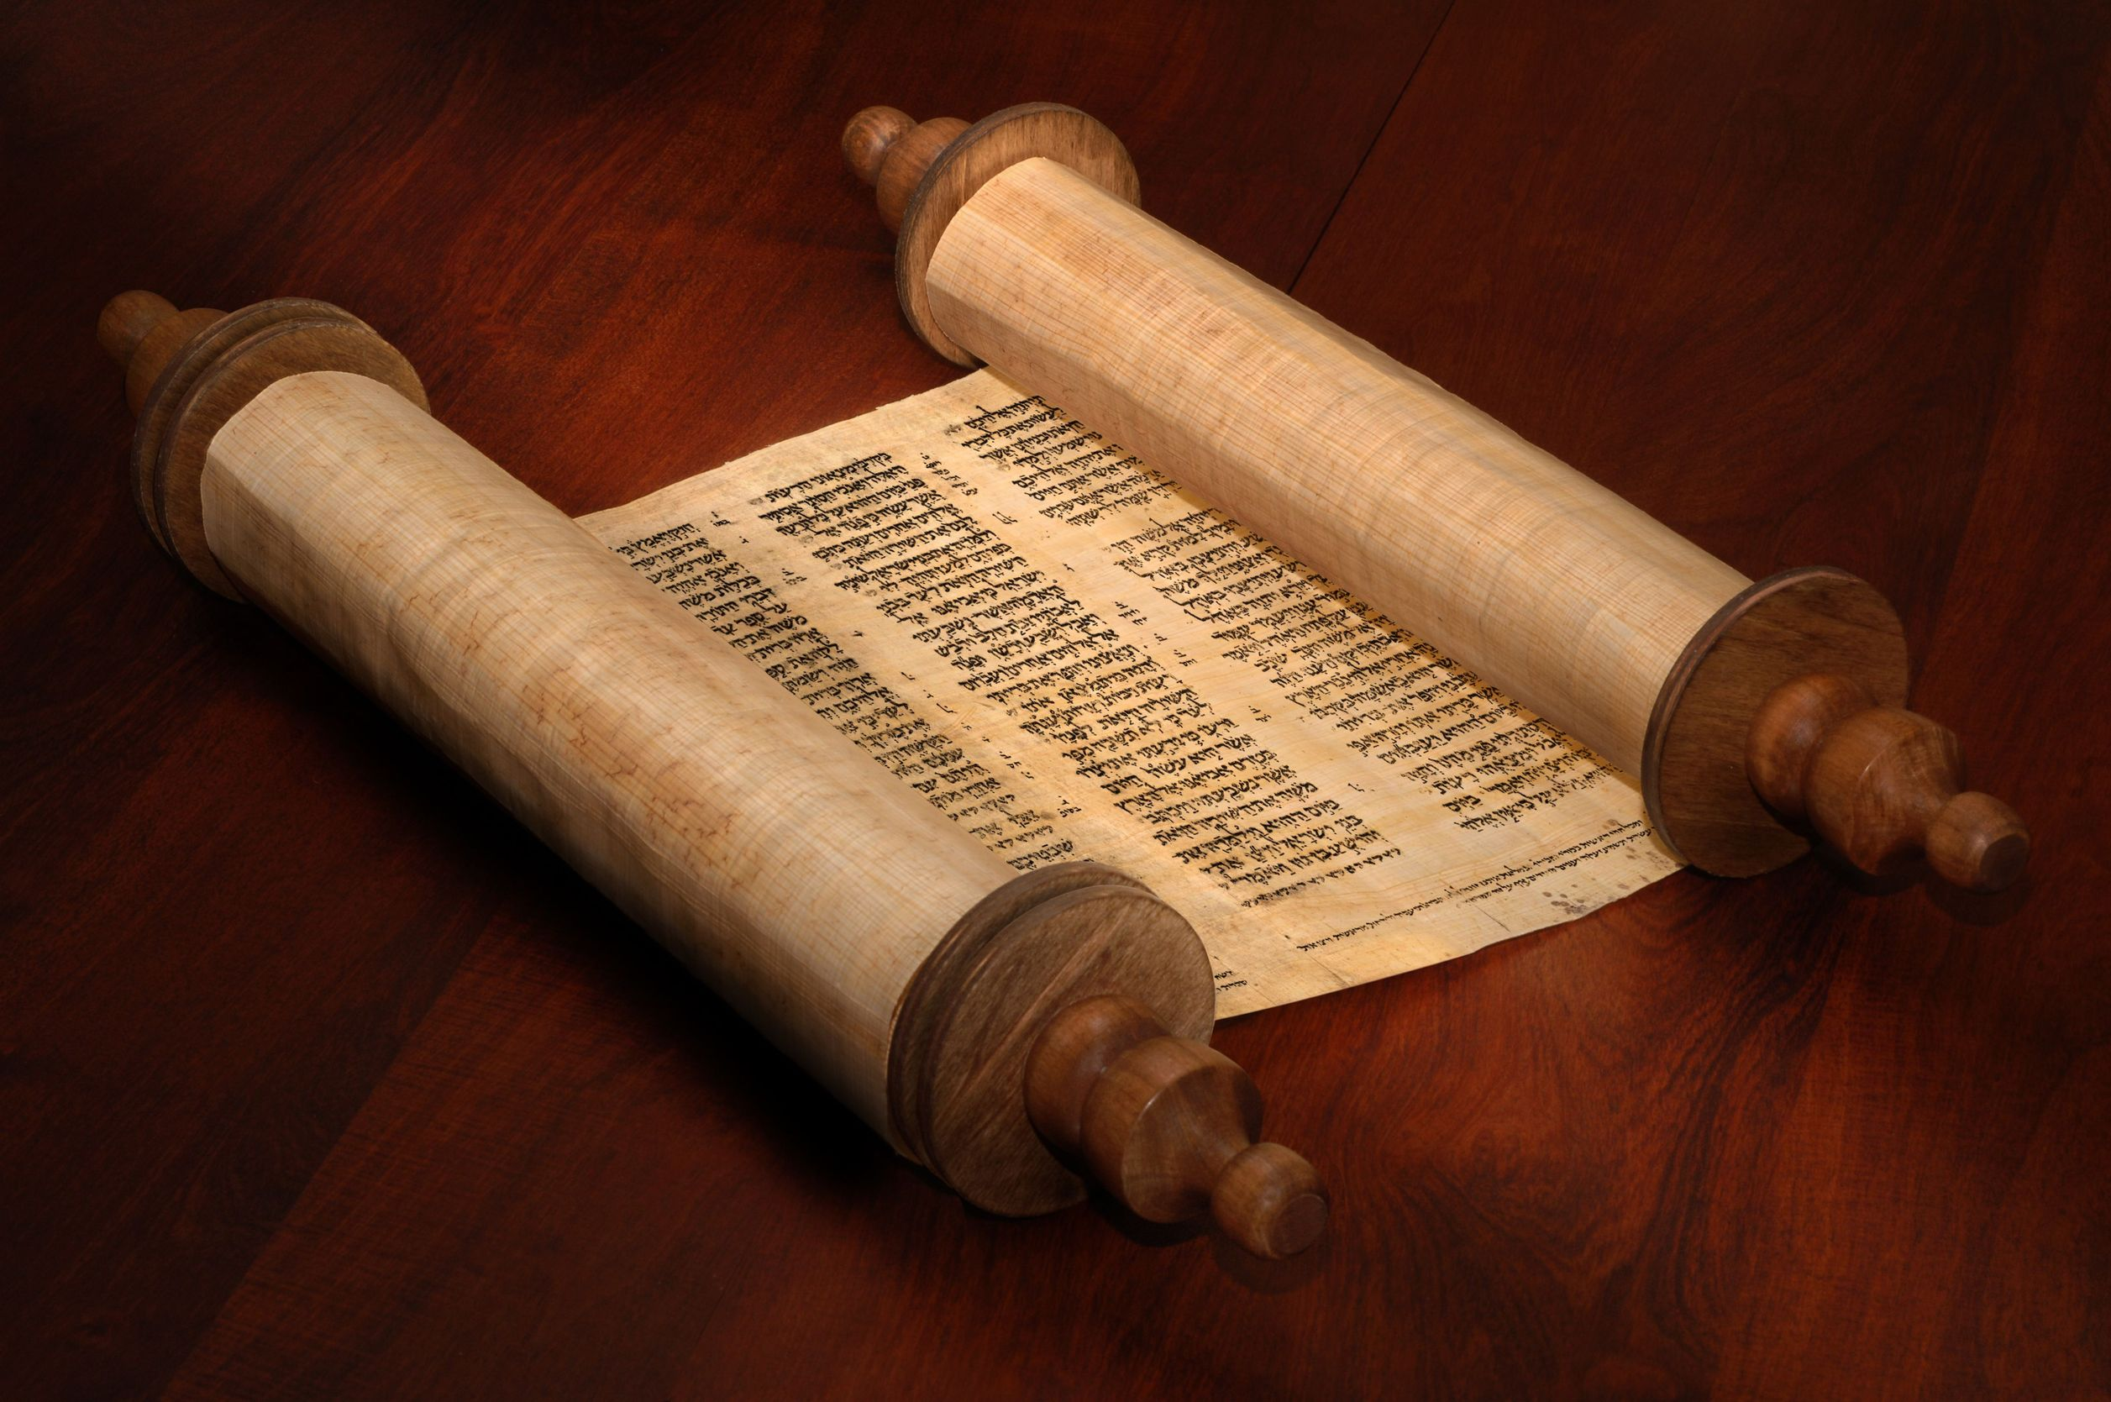
Old & New
Covenants

Slide 2
Old Testament = Old Covenant; Jewish
New Testament = New Covenant; Christian
OLD
replaced / superseded by
NEW

Slide 3
The “Old Testament” describes various covenants including the New Covenant.
The “New Testament” refers to the New Covenant described in the Old Testament.
Hebrew Scriptures (OT)
Apostolic Scriptures (NT)

Slide 4
Covenant = promise or agreement
between two parties
Both parties make promises to each other.
Each side had obligations and responsibilities.

Slide 5
God’s covenant with Abraham:
Not a one-time event
A series of promises
Made over many years
With increasing definition
To Abraham & his offspring

Slide 6
YHWH calls Abram out of Haran & tells him to move away to the land of Canaan.
Genesis 12:1
Now YHWH said to Abram, “Go from your country and your kindred and your father’s house to the land that I will show you.

Slide 7
YHWH makes a series of promises to Abram.
Genesis 12:2–3 And I will make of you a great nation, and I will bless you and make your name great, so that you will be a blessing. I will bless those who bless you, and him who dishonors you I will curse, and in you all the families of the earth shall be blessed.

Slide 8
Abram goes to Canaan in obedience to YHWH and gets another promise.
Genesis 12:6–7 Abram passed through the land to the place at Shechem, to the oak of Moreh. At that time the Canaanites were in the land. Then YHWH appeared to Abram and said, “To your offspring I will give this land.” So he built there an altar to YHWH, who had appeared to him.

Slide 9
The SAME or DIFFERENT ??
First promise: I will bless you and make you a great nation.
Second promise: I will give this specific land to your offspring.
The second gives more detail to the first.

Slide 10
Years later we get more definition to “this land” and “your offspring” through another promise.
Genesis 13:14–16
YHWH said to Abram, after Lot had separated from him, “Lift up your eyes and look from the place where you are, northward and southward and eastward and westward, for all the land that you see I will give to you and to your offspring forever. I will make your offspring as the dust of the earth, so that if one can count the dust of the earth, your offspring also can be counted.”

Slide 11
Problem: Abram has no children!
Genesis 15:3–5 And Abram said, “Behold, you have given me no offspring, and a member of my household will be my heir.” And behold, the word of YHWH came to him: “This man shall not be your heir; your very own son shall be your heir… Look toward heaven, and number the stars, if you are able to number them… So shall your offspring be.”

Slide 12
More definition – through your natural offspring
And next, there is that traditional covenant ceremony… where the animals are cut in half and the blood drained into the trench between the 2 halves.

Slide 13
And here Abram is given more information:
Genesis 15:13–14 Then YHWH said to Abram, “Know for certain that your offspring will be sojourners in a land that is not theirs and will be servants there, and they will be afflicted for four hundred years. But I will bring judgment on the nation that they serve, and afterward they shall come out with great possessions.”

Slide 14
Genesis 15:17–21
When the sun had gone down and it was dark, behold, a smoking fire pot and a flaming torch passed between these pieces. On that day YHWH made a covenant with Abram, saying, “To your offspring I give this land, from the river of Egypt to the great river, the river Euphrates, the land of the Kenites, the Kenizzites, the Kadmonites, the Hittites, the Perizzites, the Rephaim, the Amorites, the Canaanites, the Girgashites and the Jebusites.”

Slide 15
Was this another covenant?
Or was it just further definition in the line of prior promises?
We now have the boundaries of the land specified, as well as the information that this process will take hundreds of years, and his offspring will first be slaves in another land.

Slide 16
What are Abram’s responsibilities?
He was told to “go”. We have nothing else. But implied all along is his obedience.
At least 13 years later we are given more explicit information on Abram’s responsibilities.

Slide 17
Genesis 17:1–6
When Abram was ninety-nine years old YHWH appeared to Abram and said to him, “I am God Almighty; walk before me, and be blameless, that I may make my covenant between me and you, and may multiply you greatly”… No longer shall your name be called Abram, but your name shall be Abraham, for I have made you the father of a multitude of nations. I will make you exceedingly fruitful, and I will make you into nations, and kings shall come from you.

Slide 18
Genesis 17:9–12
As for you, you shall keep my covenant, you and your offspring after you throughout their generations. This is my covenant, which you shall keep, between me and you and your offspring after you: Every male among you shall be circumcised. You shall be circumcised in the flesh of your foreskins, and it shall be a sign of the covenant between me and you. He who is eight days old among you shall be circumcised.

Slide 19
Was this a different covenant?
At least 13 years later!
The promises are basically the same.
More definition: • Walk blamelessly • Circumcise your offspring

Slide 20
Problem: Abram & Sarah have no children!
So he has Ishmael with Hagar.
Genesis 17:17–19 Abraham said to God, “Oh that Ishmael might live before you!” God said, “No, but Sarah your wife shall bear you a son, and you shall call his name Isaac. I will establish my covenant with him as an everlasting covenant for his offspring after him.”

Slide 21
Again we see further definition:
God would fulfill his covenant promises not through Ishmael, but through Isaac

Slide 22
Many years later when Isaac is an adult, he receives a promise from YHWH:
Genesis 26:3–4 Sojourn in this land, and I will be with you and will bless you, for to you and to your offspring I will give all these lands, and I will establish the oath that I swore to Abraham your father. I will multiply your offspring as the stars of heaven and will give to your offspring all these lands. And in your offspring all the nations of the earth shall be blessed.

Slide 23
Was this a new covenant with Isaac?
No, it is the same covenant EXCEPT that these covenant promises are now made with Isaac (and not Ishmael).
AND Isaac is told he must live in the land to receive these blessings.

Slide 24
Years later Isaac has twins, Esau and Jacob. God makes a covenant promise to Jacob:
Genesis 28:13–15 The land on which you lie I will give to you and to your offspring. Your offspring shall be like the dust of the earth, and you shall spread abroad to the west and to the east and to the north and to the south, and in you and your offspring shall all the families of the earth be blessed. Behold, I am with you and will keep you wherever you go, and will bring you back to this land.

Slide 25
Was this a new covenant with Jacob?
No, it is the same covenant EXCEPT that now we know the covenant promises will be fulfilled through Jacob’s line and not Esau’s.

Slide 26
~300 years from Abraham to Jacob
Numerous additional promises / covenants gave more definition to the original promise:
I will make you a great nation
I will bless you
All the families of the earth will be blessed through you

Slide 27
~400 later we have Moses at Sinai
Jacob’s family were slaves in Egypt, but had multiplied greatly. (Part of the promise!)
God brings Jacob’s offspring to Sinai and makes a covenant with them.
A new covenant or further definition??

Slide 28
God now speaks to all the “offspring” and not just an individual.
Exodus 19:5–6 “If you will indeed obey my voice and keep my covenant, you shall be my treasured possession among all peoples, for all the earth is mine; and you shall be to me a kingdom of priests and a holy nation. These are the words that you shall speak to the people of Israel.”

Slide 29
And he goes on to give the 10 Words, and all the other rules and commandments of the Torah, called the Book of the Covenant.
Exodus 24:4–7 And Moses wrote down all the words of YHWH… Then he took the Book of the Covenant and read it in the hearing of the people. And they said, “All that YHWH has spoken we will do, and we will be obedient.”

Slide 30
What about the land promised to Abram?
Deuteronomy 4:1 And now, O Israel, listen to the statutes and the rules that I am teaching you, and do them, that you may live, and go in and take possession of the land that YHWH, the God of your fathers, is giving you.

Slide 31
The promised land comes with obedience!
Deuteronomy 4:6–7 Keep them and do them, for that will be your wisdom and your understanding in the sight of the peoples, who, when they hear all these statutes, will say, ‘Surely this great nation is a wise and understanding people.’ For what great nation is there that has a god so near to it as YHWH our God is to us, whenever we call upon him?

Slide 32
Sinai covenant, like the all the previous ones with Abram, Isaac, & Jacob just gives further definition to the original promise.
YHWH makes explicit his expectations of “walking blamelessly” by spelling it out in the instructions of the Torah.
But the people fail miserably! And the covenant is broken!

Slide 33
Fortunately there is more to the plan.
It was there from the beginning, but not yet revealed.
The New Covenant and the Messiah.
But it is really new?? Or further definition of the original promise??

Slide 34
Hebrew Scriptures speak of the New Covenant
Jeremiah 31:31–32 Behold, the days are coming, declares YHWH, when I will make a new covenant with the house of Israel and the house of Judah, not like the covenant that I made with their fathers on the day when I took them by the hand to bring them out of the land of Egypt, my covenant that they broke, though I was their husband, declares YHWH.

Slide 35
Jeremiah 31:33–34 For this is the covenant that I will make with the house of Israel after those days, declares YHWH: I will put my law [Torah] within them, and I will write it on their hearts. And I will be their God, and they shall be my people. And no longer shall each one teach his neighbor and each his brother, saying, “Know YHWH,” for they shall all know me, from the least of them to the greatest, declares YHWH. For I will forgive their iniquity, and I will remember their sin no more.

Slide 36
What’s new about the new covenant?
The Torah is written on their hearts!
What’s the same?
The Torah!
The problem: God’s people break His Torah
The solution: Change the Torah ??
OR Provide help for the people !

Slide 37
Ezekiel also seems to prophesy about this new covenant, saying that this new heart, with the Torah written upon it, is linked to the Holy Spirit being put inside of us.

Slide 38
Ezekiel 36:24–26
I will take you from the nations and gather you from all the countries and bring you into your own land. I will sprinkle clean water on you, and you shall be clean from all your uncleannesses, and from all your idols I will cleanse you. And I will give you a new heart, and a new spirit I will put within you. And I will remove the heart of stone from your flesh and give you a heart of flesh.

Slide 39
Ezekiel 36:27–28
And I will put my Spirit within you, and cause you to walk in my statutes and be careful to obey my rules. You shall dwell in the land that I gave to your fathers, and you shall be my people, and I will be your God.
What is the promise?

Slide 40
Ezekiel 36:27–28
And I will put my Spirit within you, and cause you to walk in my statutes and be careful to obey my rules. You shall dwell in the land that I gave to your fathers, and you shall be my people, and I will be your God.
The same promise!

Slide 41
Who is the New Covenant with?
Jeremiah 31:31–32 Behold, the days are coming, declares YHWH, when I will make a new covenant with the house of Israel and the house of Judah, not like the covenant that I made with their fathers on the day when I took them by the hand to bring them out of the land of Egypt, my covenant that they broke, though I was their husband, declares YHWH.

Slide 42
The New Covenant:
Is the same promise
With the same people (Israel)
With the same obligation (obey Torah)
But with the Torah written on the heart
And with the help of the Holy Spirit
And he will cleanse his people
How ??

Slide 43
So it looks like the New Covenant is not entirely new, but provides further definition on how God will fulfill the original promises to Abram.
There are clearly some new elements:
The Holy Spirit is specifically mentioned
The Messiah is hinted at:
Cleanse the people
Forgive their iniquity

Slide 44
Yeshua at the Passover meal took the wine and poured it, and said:
Luke 22:20
This cup that is poured out for you is the new covenant in my blood.
The unblemished Passover Lamb, the One without sin (never broke Torah), is the perfect and complete sacrifice to cover our sins once and for all.
The Torah didn’t change but now God’s people are forgiven in advance!

Slide 45
Hebrews 8:6 Christ has obtained a ministry that is as much more excellent than the old as the covenant he mediates is better, since it is enacted on better promises.
Why is the new covenant better?
Holy Spirit + Messiah
Torah shows our need for continual sacrifice
Messiah’s sacrifice was complete, for all time

Slide 46
Yeshua’s death & resurrection initiated the new covenant.
But is the new covenant fully implemented??

Slide 47
Jeremiah 31:33–34 For this is the covenant that I will make with the house of Israel after those days, declares YHWH: I will put my law [Torah] within them, and I will write it on their hearts. And I will be their God, and they shall be my people. And no longer shall each one teach his neighbor and each his brother, saying, “Know YHWH,” for they shall all know me, from the least of them to the greatest, declares YHWH. For I will forgive their iniquity, and I will remember their sin no more.

Slide 48
Ezekiel 36:24–26
I will take you from the nations and gather you from all the countries and bring you into your own land. I will sprinkle clean water on you, and you shall be clean from all your uncleannesses, and from all your idols I will cleanse you. And I will give you a new heart, and a new spirit I will put within you. And I will remove the heart of stone from your flesh and give you a heart of flesh.

Slide 49
Yeshua’s death & resurrection initiated the new covenant.
But is the new covenant fully implemented??
Is there still need to teach one another?
Do ALL know YHWH?
Are His people all regathered to Israel?

Slide 50
That is why Hebrews seems to refer to the implementation of the New Covenant as a process.
Hebrews 8:13 In speaking of a new covenant, he makes the first one obsolete. And what is becoming obsolete and growing old is ready to vanish away.

Slide 51
What about the Holy Spirit ?
Acts 2:2–4 And suddenly there came from heaven a sound like a mighty rushing wind, and it filled the entire house where they were sitting. And divided tongues as of fire appeared to them and rested on each one of them. And they were all filled with the Holy Spirit and began to speak in other tongues as the Spirit gave them utterance.

Slide 52
Paul links together Jeremiah & Ezekiel:
2 Corinthians 3:3–6 You are a letter from Christ delivered by us, written not with ink but with the Spirit of the living God, not on tablets of stone but on tablets of human hearts. Such is the confidence that we have through Christ toward God. Not that we are sufficient in ourselves to claim anything as coming from us, but our sufficiency is from God, who has made us sufficient to be ministers of a new covenant, not of the letter but of the Spirit.
.

Slide 53
The Holy Spirit at Shavuot was prophesied as coming with the New Covenant.
Who did the Holy Spirit come upon that day?
The people of Israel who came for Shavuot!
But Paul was writing mostly to Gentile believers in Corinth…
So… How do Gentiles get included?

Slide 54
How do Gentiles get included??
They were always meant to be included!
Scripture refers to the “stranger (Hebrew ger) who sojourns among you”. These are Gentiles that choose to “attach themselves” to Israel and worship the God of Israel.

Slide 55
For example:
Leviticus 19:34 You shall treat the stranger who sojourns with you as the native among you, and you shall love him as yourself, for you were strangers in the land of Egypt: I am YHWH your God.

Slide 56
Regarding the observance of Passover:
Exodus 12:49
There shall be one law [Torah] for the native and for the stranger who sojourns among you.

Slide 57
Regarding the offering of sacrifices:
Numbers 15:14–16 And if a stranger is sojourning with you, or anyone is living permanently among you, and he wishes to offer a food offering, with a pleasing aroma to YHWH, he shall do as you do. For the assembly, there shall be one statute for you and for the stranger who sojourns with you, a statute forever throughout your generations. You and the sojourner shall be alike before YHWH. One law [Torah] and one rule shall be for you and for the stranger who sojourns with you.

Slide 58
Isaiah speaks clearly to this:
Isaiah 56:1–3 Thus says YHWH: “Keep justice, and do righteousness, for soon my salvation will come, and my righteousness be revealed. Blessed is the man who does this, and the son of man who holds it fast, who keeps the Sabbath, not profaning it, and keeps his hand from doing any evil.” Let not the foreigner who has joined himself to YHWH say, “YHWH will surely separate me from his people”.

Slide 59
Isaiah 56:4-7 For thus says YHWH “To... the foreigners who join themselves to YHWH, to minister to him, to love the name of YHWH, and to be his servants, everyone who keeps the Sabbath and does not profane it, and holds fast my covenant — these I will bring to my holy mountain, and make them joyful in my house of prayer; their burnt offerings and their sacrifices will be accepted on my altar; for my house shall be called a house of prayer for all peoples.

Slide 60
The Torah teaches that Gentiles who obey the covenant of YHWH will be included as His people.
This was certainly NOT the practice in the days of Yeshua, and therefore the subject of considerable corrective teaching by both Yeshua and Paul.
Because practice was not in line with Torah, there needed to be a clear sign to show that God intended Gentiles to be included in the New Covenant.

Slide 61
That happened with Peter at Cornelius’ house:
Acts 10:44–47 While Peter was still saying these things, the Holy Spirit fell on all who heard the word. And the believers from among the circumcised who had come with Peter were amazed, because the gift of the Holy Spirit was poured out even on the Gentiles. For they were hearing them speaking in tongues and extolling God. Then Peter declared, “Can anyone withhold water for baptizing these people, who have received the Holy Spirit just as we have?”

Slide 62
The New Covenant was spreading to the Gentiles, as seen by their being filled with the Holy Spirit in the very same way that the Jewish believers were filled!
Later Paul writes to the Gentiles in Rome about them being “grafted in” as wild branches onto the olive tree, which is Israel.

Slide 63
Paul to the Gentile believers in Rome:
Romans 11:17–18 But if some of the branches were broken off, and you, although a wild olive shoot, were grafted in among the others and now share in the nourishing root of the olive tree, do not be arrogant toward the branches. If you are, remember it is not you who support the root, but the root that supports you.

Slide 64
Romans 11:19–21 Then you will say, “Branches were broken off so that I might be grafted in.” That is true. They were broken off because of their unbelief, but you stand fast through faith. So do not become proud, but fear. For if God did not spare the natural branches, neither will he spare you.
Gentiles who believe in Messiah are “grafted in” and become a part of believing Israel.

Slide 65
Paul makes the same point in a different way to the Gentiles in Ephesus:
Ephesians 2:18–19 For through him [Messiah] we both [Jews and Gentiles] have access in one Spirit to the Father. So then you are no longer strangers and aliens, but you are fellow citizens with the saints and members of the household of God.
So Gentile believers are fully included in YHWH’s covenant !

Slide 66
Recall YHWH’s first promise to Abram:
Genesis 12:2–3 And I will make of you a great nation, and I will bless you and make your name great, so that you will be a blessing. I will bless those who bless you, and him who dishonors you I will curse, and in you all the families of the earth shall be blessed.

Slide 67
How would all the families of the earth be blessed through Abram? It was part of His plan from the very beginning!
Was Abram told how?
Was Isaac told how?
Was Jacob told how?
Were the people told how at Sinai?
Did Ezekiel or Jeremiah know how?

Slide 68
With the initiation of the New Covenant, through Yeshua, descendant of Abram, we finally know.
And we are the ones blessed!

Slide 69
