Slide 1
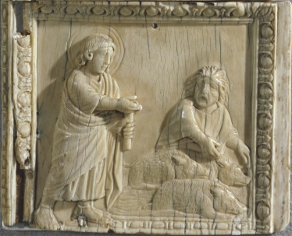
Leaving a Legacy
Mark 5:1-20
Notes:
My first morning is Israel, I heard a story about a Rabbi.
Rabbi Akiba ben Joseph, 50-135 AD. Akiba was imprisoned for transgressing Hadrian's edict forbidding the practice and teaching of the Jewish religion; he was subsequently flayed to death in the ancient Palestinian city of Caesarea. Akiba is one of the ten martyrs named in the penitential prayers of the Jews.
AKIBA and the ROMAN CENTURIAN -- WHO ARE YOU? WHAT ARE YOU DOING HERE?
Rabbi Akiba, born 50 AD. Meditating on Isaiah 43:10-13.
I, even I, am the Lord,
and apart from me there is no savior.
I have revealed and saved and proclaimed—
I, and not some foreign god among you.
You are my witnesses,” declares the Lord, “that I am God.
There was a Rabbi traveling the road from Bethsaida to Capernaum. Sun was setting. Going back to his family. He did what all rabbis did when they had few extra moments – he was reciting scriptures. He took the fork in the road the Roman fort instead of to Capernaum, since it was dark and he was reciting Scripture. Without realizing it, he came upon the fort and was startled when the Roman soldier on guard shouted down to him, “Who are you? What are you doing here?” Awakened from his intense concentration on Scripture, and not fully realizing where he was, the startled Rabbi reponded somewhat hesistantly, “What?” Again the soldier called down to him, now recognizing from he speech that he was Jewish, and said, “Hey there Jew, who are you? What are you doing here?”. Now, having regained his awareness, and with more confidence, the Rabbi replied, “How much do they pay you to ask me those questions?”. The soldier was taken aback by this questions, as he wasn’t expecting this kind of reply. He thought for a moment or two, then answered, “Three denarii a week, – what is that to you , Jew?” To this the Rabbi replied, I’ll gladly pay you double if you stand outside my house and ask those same questions every morning as I leave.

Slide 2
Who Are You?
What Are You Doing Here?
What will your Legacy Be?
Notes:
No 2 questions are more fundemental to our lives. We need to be reminded, daily, to think about them. So they guide our actions!
When you're gone, what will you have accomplished? Will you have fulfilled your purpose? What will you have left behind? What will your legacy be?

Slide 3
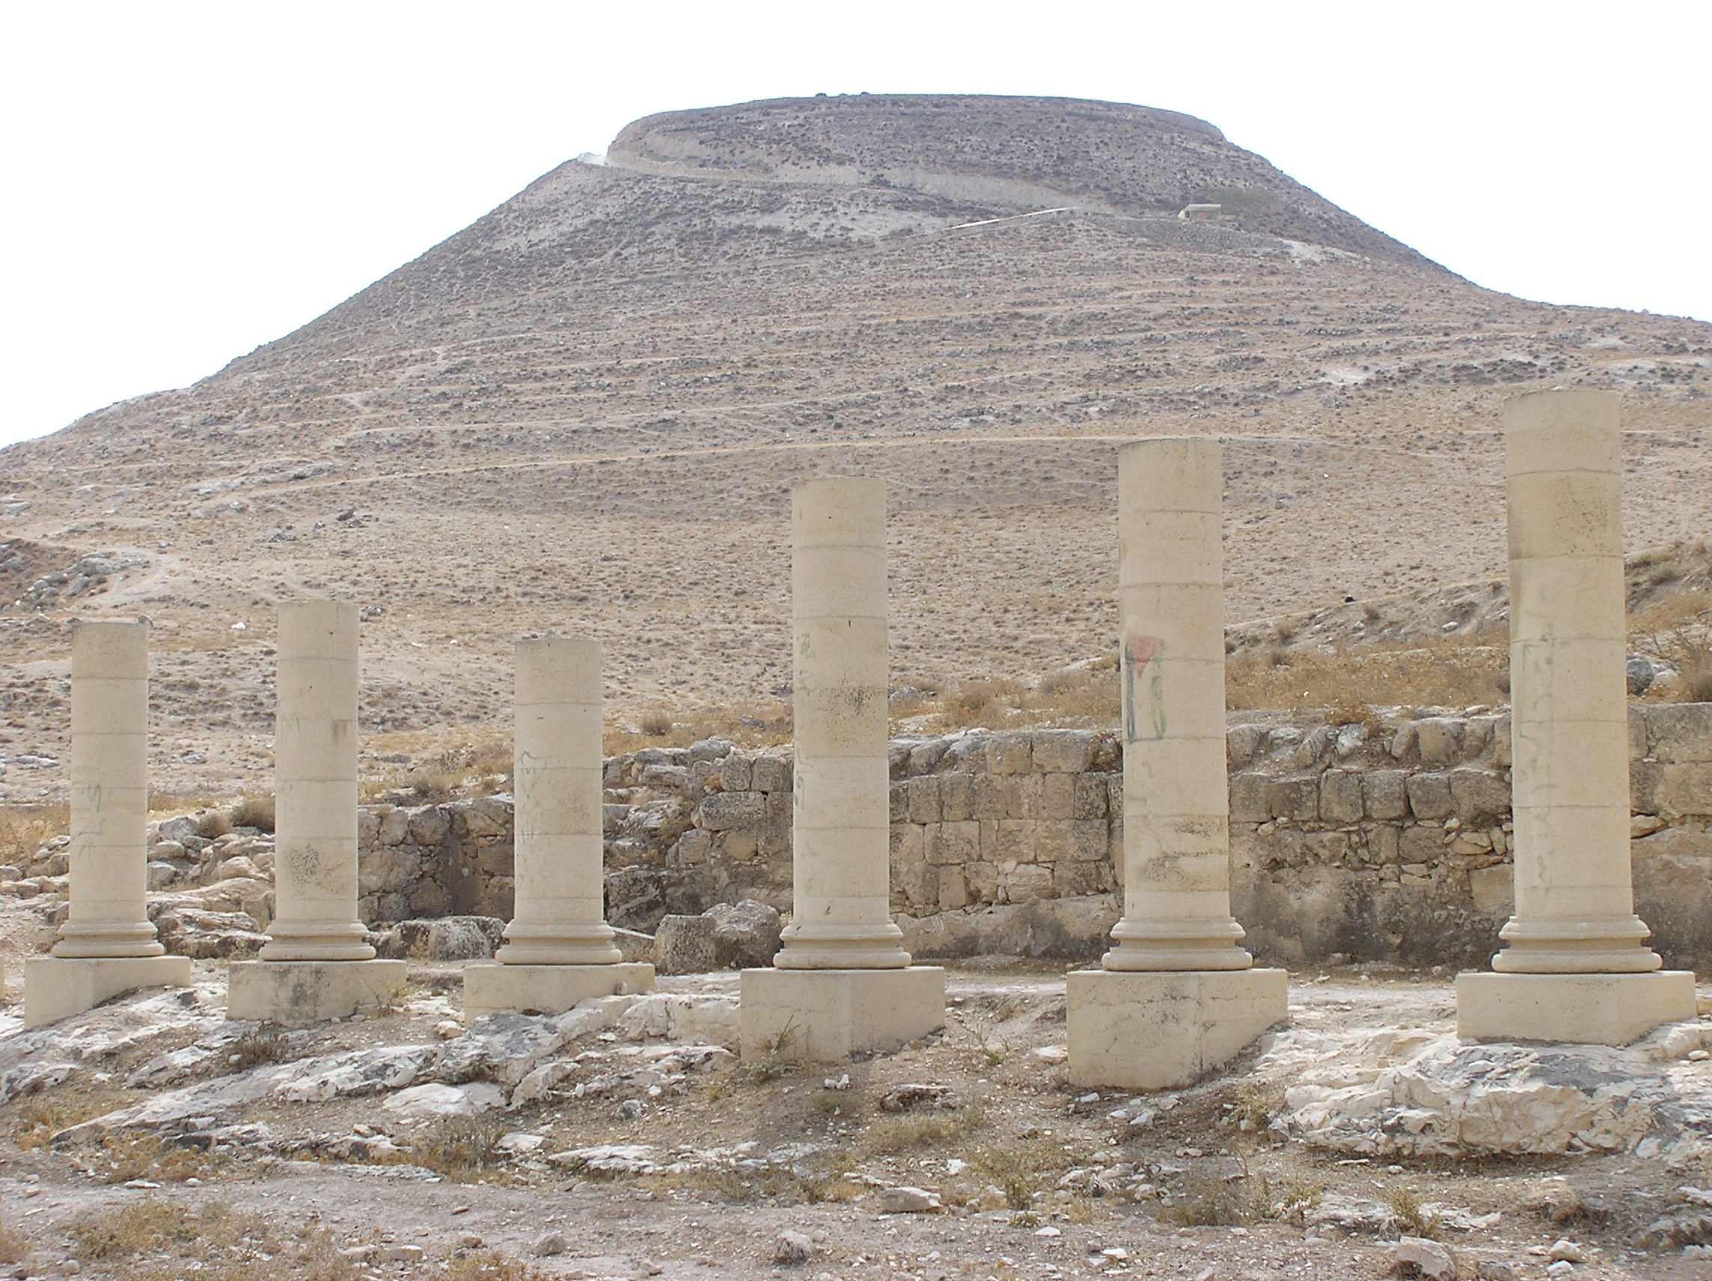
A Legacy of Stone Buildings.
- temporary beauty -
Built with cruelty & murder.
And it's all in ruins.
Notes:
Last week we talked about 2 the Two Kings of the Jews. Herod the Great and his legacy of stone. magnificant buildings, beautiful buildings… but they are all gone now. And in the process of building that legacy that didn't last, he was the model of cruelty and selfishness, killing many of his own family members.
Jesus the Messiah build a legacy of people, of changed lives, on a foundation of self sacrifice -- a legacy that really will last for all generations.
And we are commanded be like our Rabbi, Jesus.

Slide 4
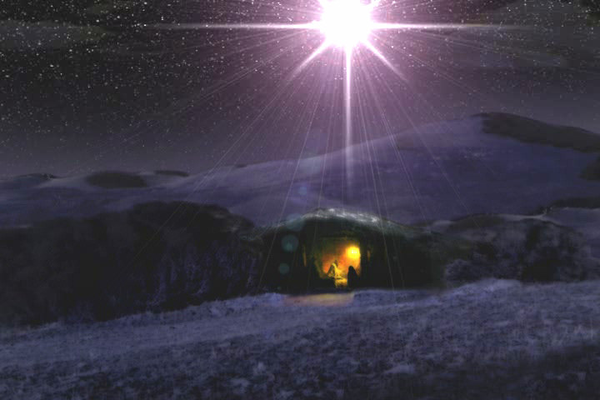
this is a test
A Legacy of People.
- changed lives -
Built through self-sacrifice.
Lasting for all generations.
Notes:
Jesus the Messiah build a legacy of people, of changed lives, on a foundation of self sacrifice -- a legacy that really will last for all generations.
And we are commanded be like our Rabbi, Jesus.

Slide 5

What kind of legacy
are you Building?
Notes:
Last week we talked about 2 the Two Kings of the Jews. Herod the Great and his legacy of stone. magnificant buildings, beautiful buildings… but they are all gone now. And in the process of building that legacy that didn't last, he was the model of cruelty and selfishness, killing many of his own family members.
Jesus the Messiah build a legacy of people, of changed lives, on a foundation of self sacrifice -- a legacy that really will last for all generations.
And we are commanded be like our Rabbi, Jesus.

Slide 6

Shema
Deut 5:9-10 (NIV)
For I, the Lord your God, am a jealous God, punishing the children for the sin of the fathers to the third and fourth generation of those who hate me, but showing love to a thousand generations of those who love me and keep my commandments.
Notes:
Herod' family killed each other - generations of hate, suspicion, and killing
Contrast with the legacy of Jesus the Messiah, the essence of God's LOVE for 1000 generations… that's the legacy I want to leave.

Slide 7
Shema
Deut 7:9 (NIV)
Know therefore that the Lord your God is God; he is the faithful God, keeping his covenant of love to a thousand generations of those who love him and keep his commands.

Slide 8
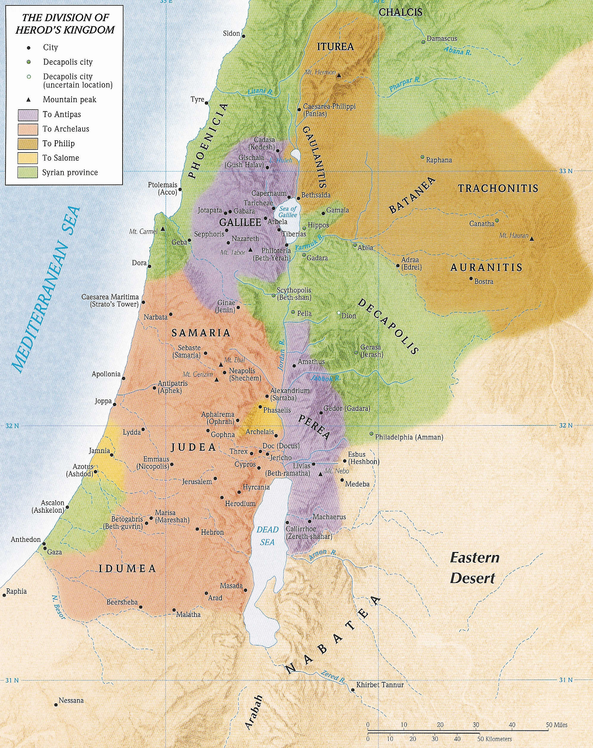
Herod
the
Great
=
King
of
Palestine
Galilee
Judea
Notes:
Decapolis Region - Autonomous Region - reported directly to Rome, not under Herod or anyone else really.
Decapolis mentioned twice in the Bible -- when Jesus went there twice, each time with his disciples, for just a very breif period.
Decapolis had been a PAGAN area since OT times. It was the traditionally seen as the land where the pagan people went after Joshua conquered the promised land.

Slide 9
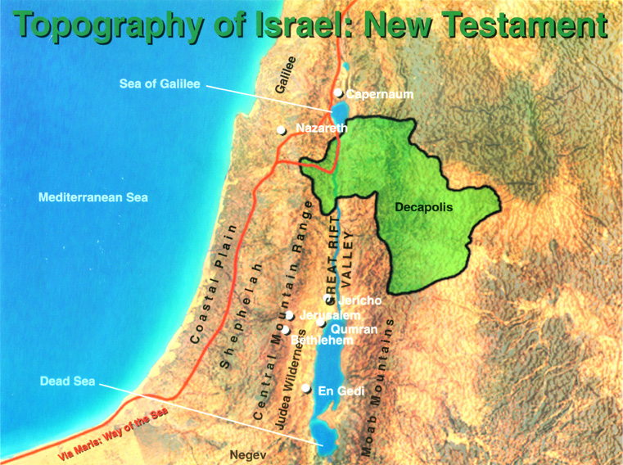
Notes:
Decapolis had been a PAGAN area since OT times. It was the traditionally seen as the land where the pagan people went after Joshua conquered the promised land.

Slide 10
Shema
Joshua 3:10 (NIV)
This is how you will know that the living God is among you and that he will certainly drive out before you the Canaanites, Hittites, Hivites, Perizzites, Girgashites, Amorites and Jebusites.
Seven Pagan Nations Driven Out
Decapolis area was called
"The Land of the Seven"
"The Other Side"

Slide 11
Herod
the
Great
=
King
of
Palestine
Galilee
Judea
Notes:
Pagan tradition here continued when Alexander the Great ruled this part of the world.
Alexander the Great - planted 10 cities in the Decapolis region. deca "ten" + polis "city". He was a missionary, planting ciites with his Greek philosophy and world view. He knew if he control 4 things - Religion, Education, Media, and Entertainment, he could control what people believed and how they would be behave. He could plant his philosophy in their minds.

Slide 12
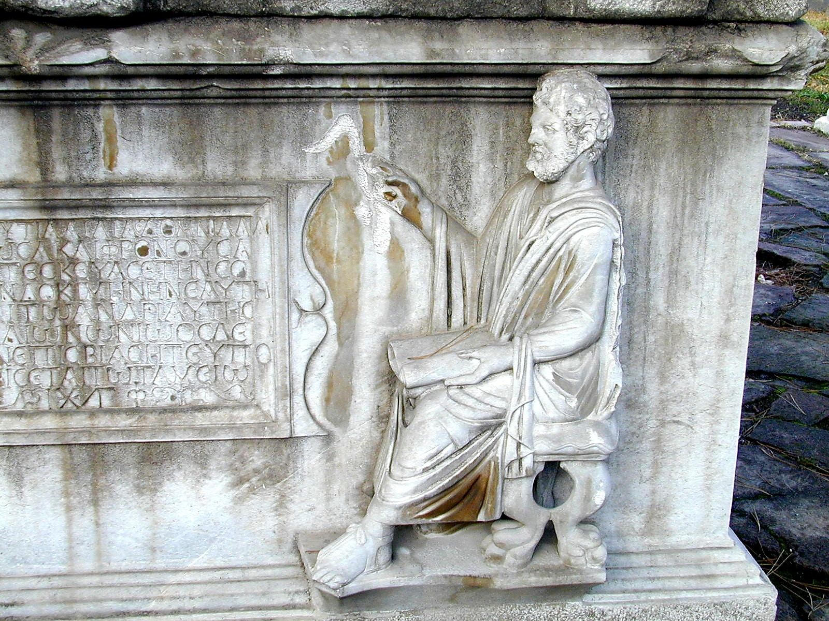
"Man is the ultimate source of truth"
Hellenism
Hellenism
Notes:
Hellenism = humanism = new age. Nothing new about it. It came from the Greeks, and later the Romans.
Hellenism as a worldview is based on a belief that human beings are the ultimate source of truth and authority in the universe. “Man is the measure of all things of what is and what is not,” said the Greek philosopher Protagoras (481-411 BC). This was a culture devoted to the supremacy of human beings and human accomplishment. Human accomplishments in athletics, the arts, and architecture became the motivating drive of society. The human body was considered the ultimate in beauty so nudity in art, in the baths, and in sports was acceptable and even expected. Accumulation of the greatest of material things to provide luxury and comfort for ones self - the ultimate in the universe - was considered the normal pursuit of ones life. Anything to improve the quality of human life. Since humans are the ultimate reality, the ultimate human was the greatest of all. To be the best, better than all others at any pursuit was life’s great goal. What could be more natural than to get the most out of life for one’s self?

Slide 13
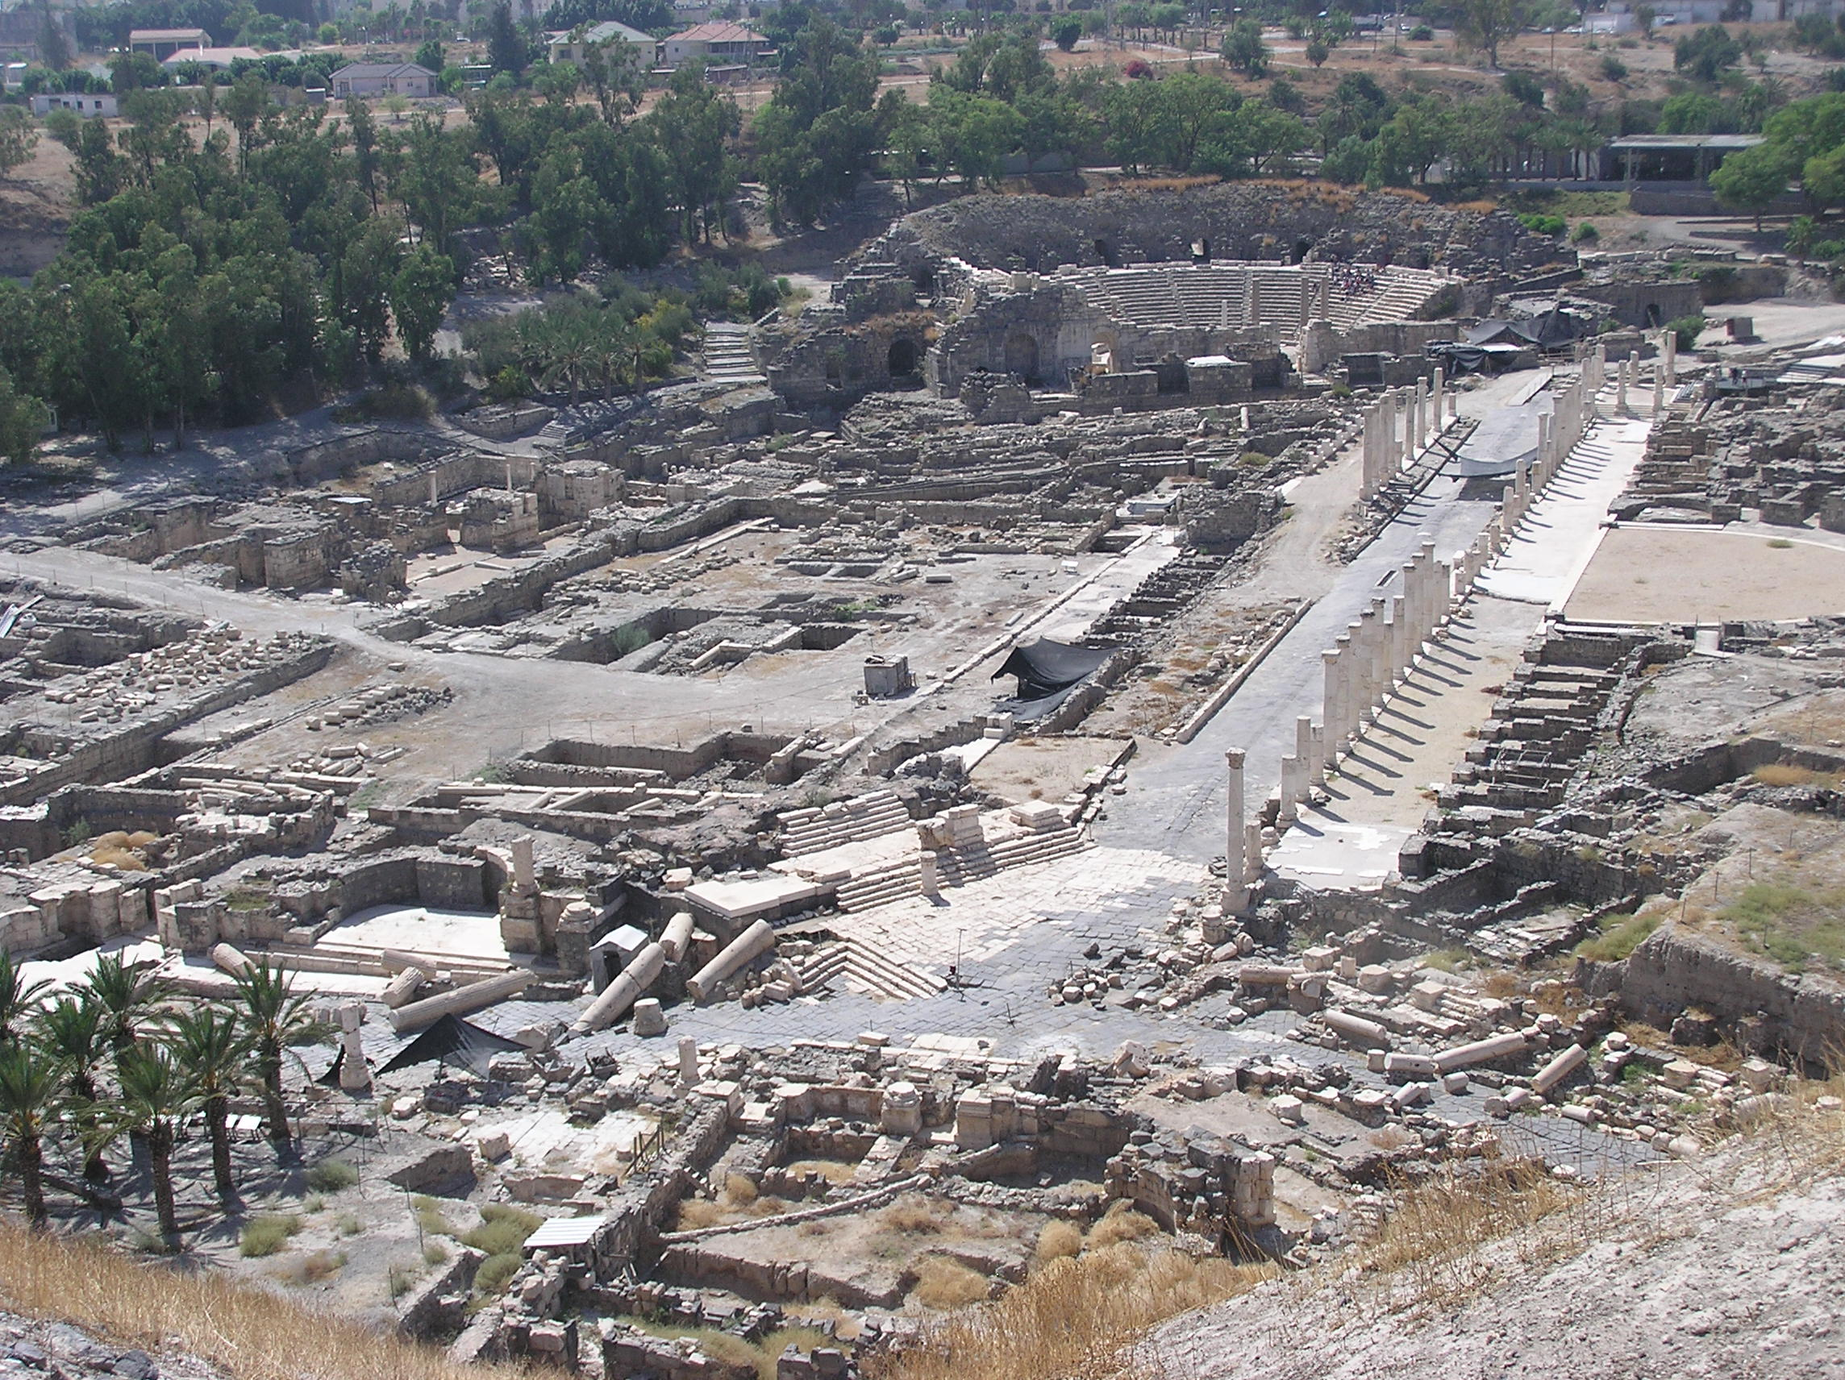
Beth Shan
Population ~100,000+
Notes:
Decapolis had 10 Model cities built to communicate the Hellenistic philosophy that "Man is the Ultimate Source of Truth".

Slide 14
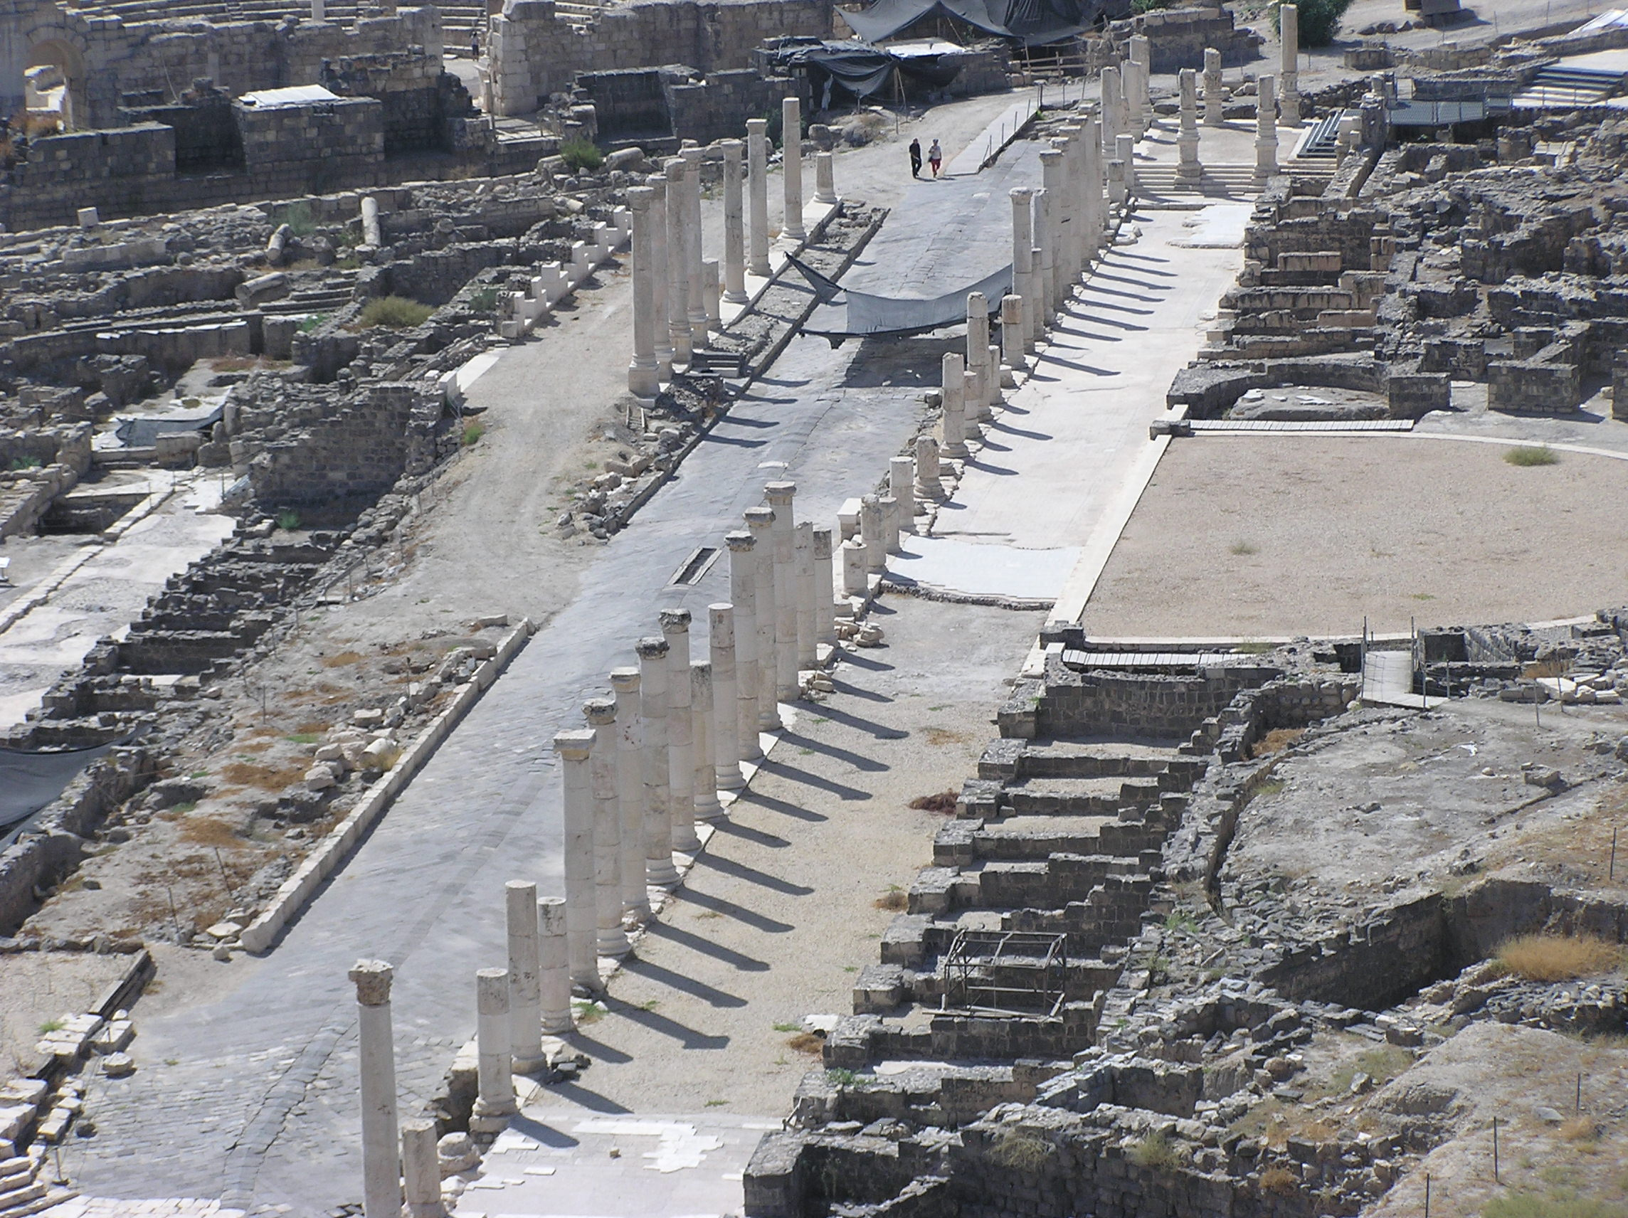
Colonade
Main Street Shopping
Notes:
Beautiful cities - full of wealth and materialism, making all those on the outside envious of what it had to offer.

Slide 15
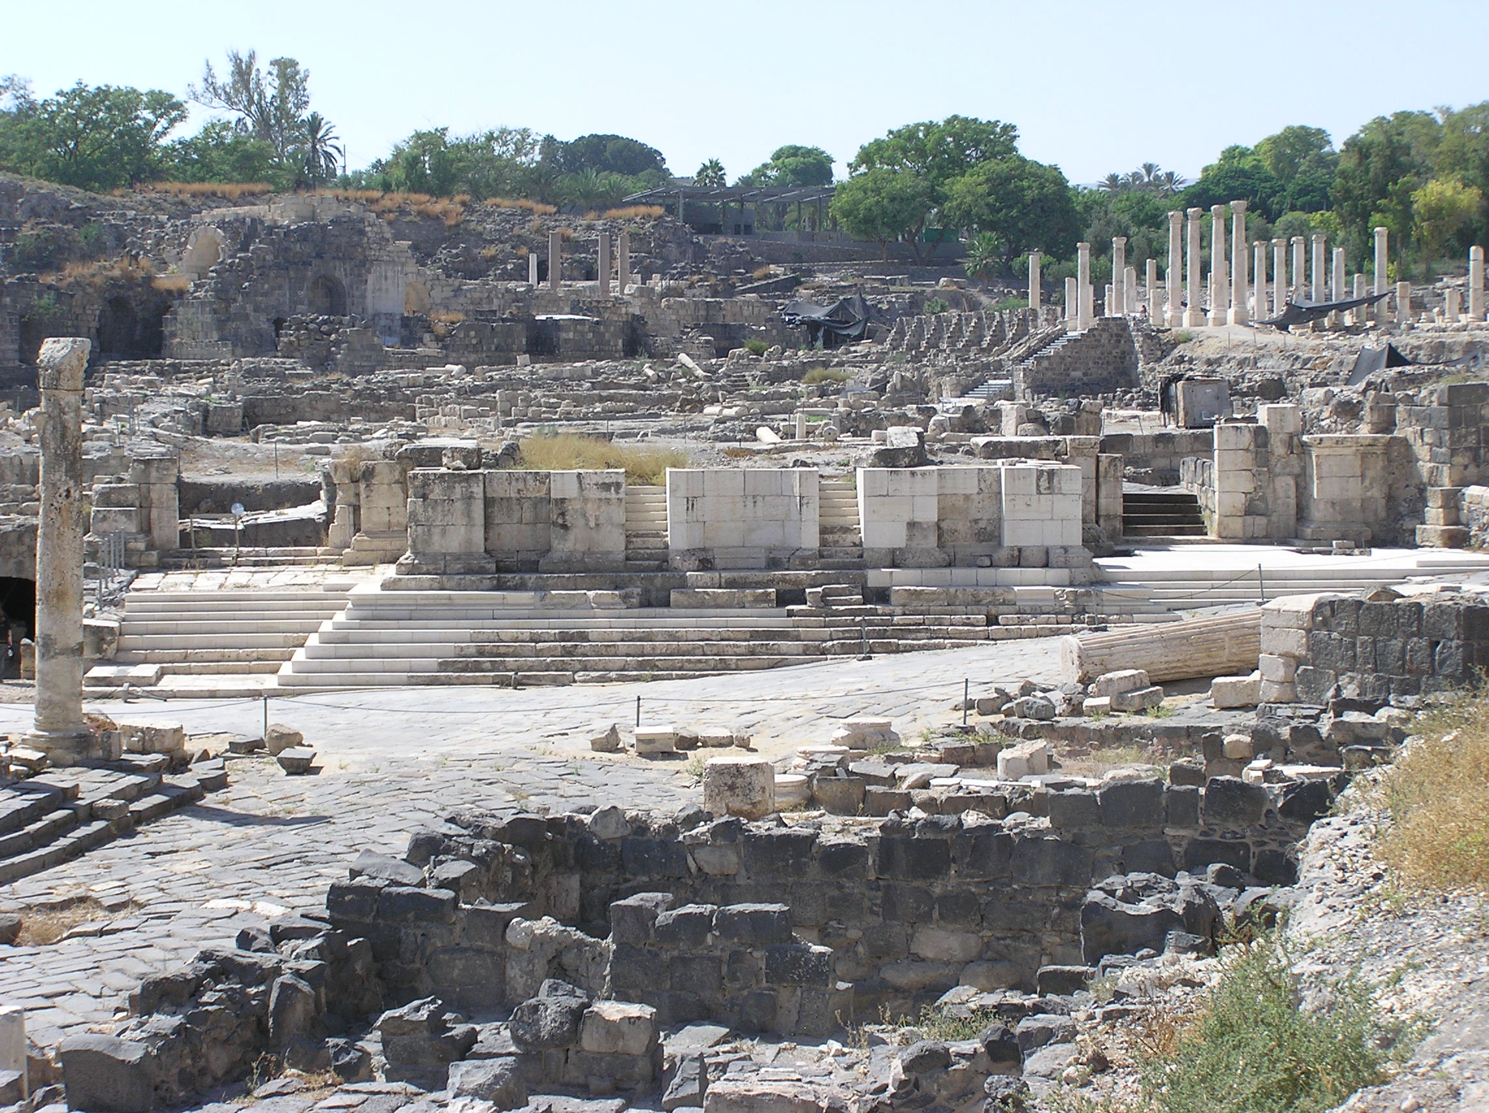
Temples
Religion
Notes:
Ascelopius - god of healing, symbol is snake.
He knew if he control 4 things - Religion, Education, Media, and Entertainment, he could control what people believed and how they would be behave. He could plant his philosophy in their minds.

Slide 16
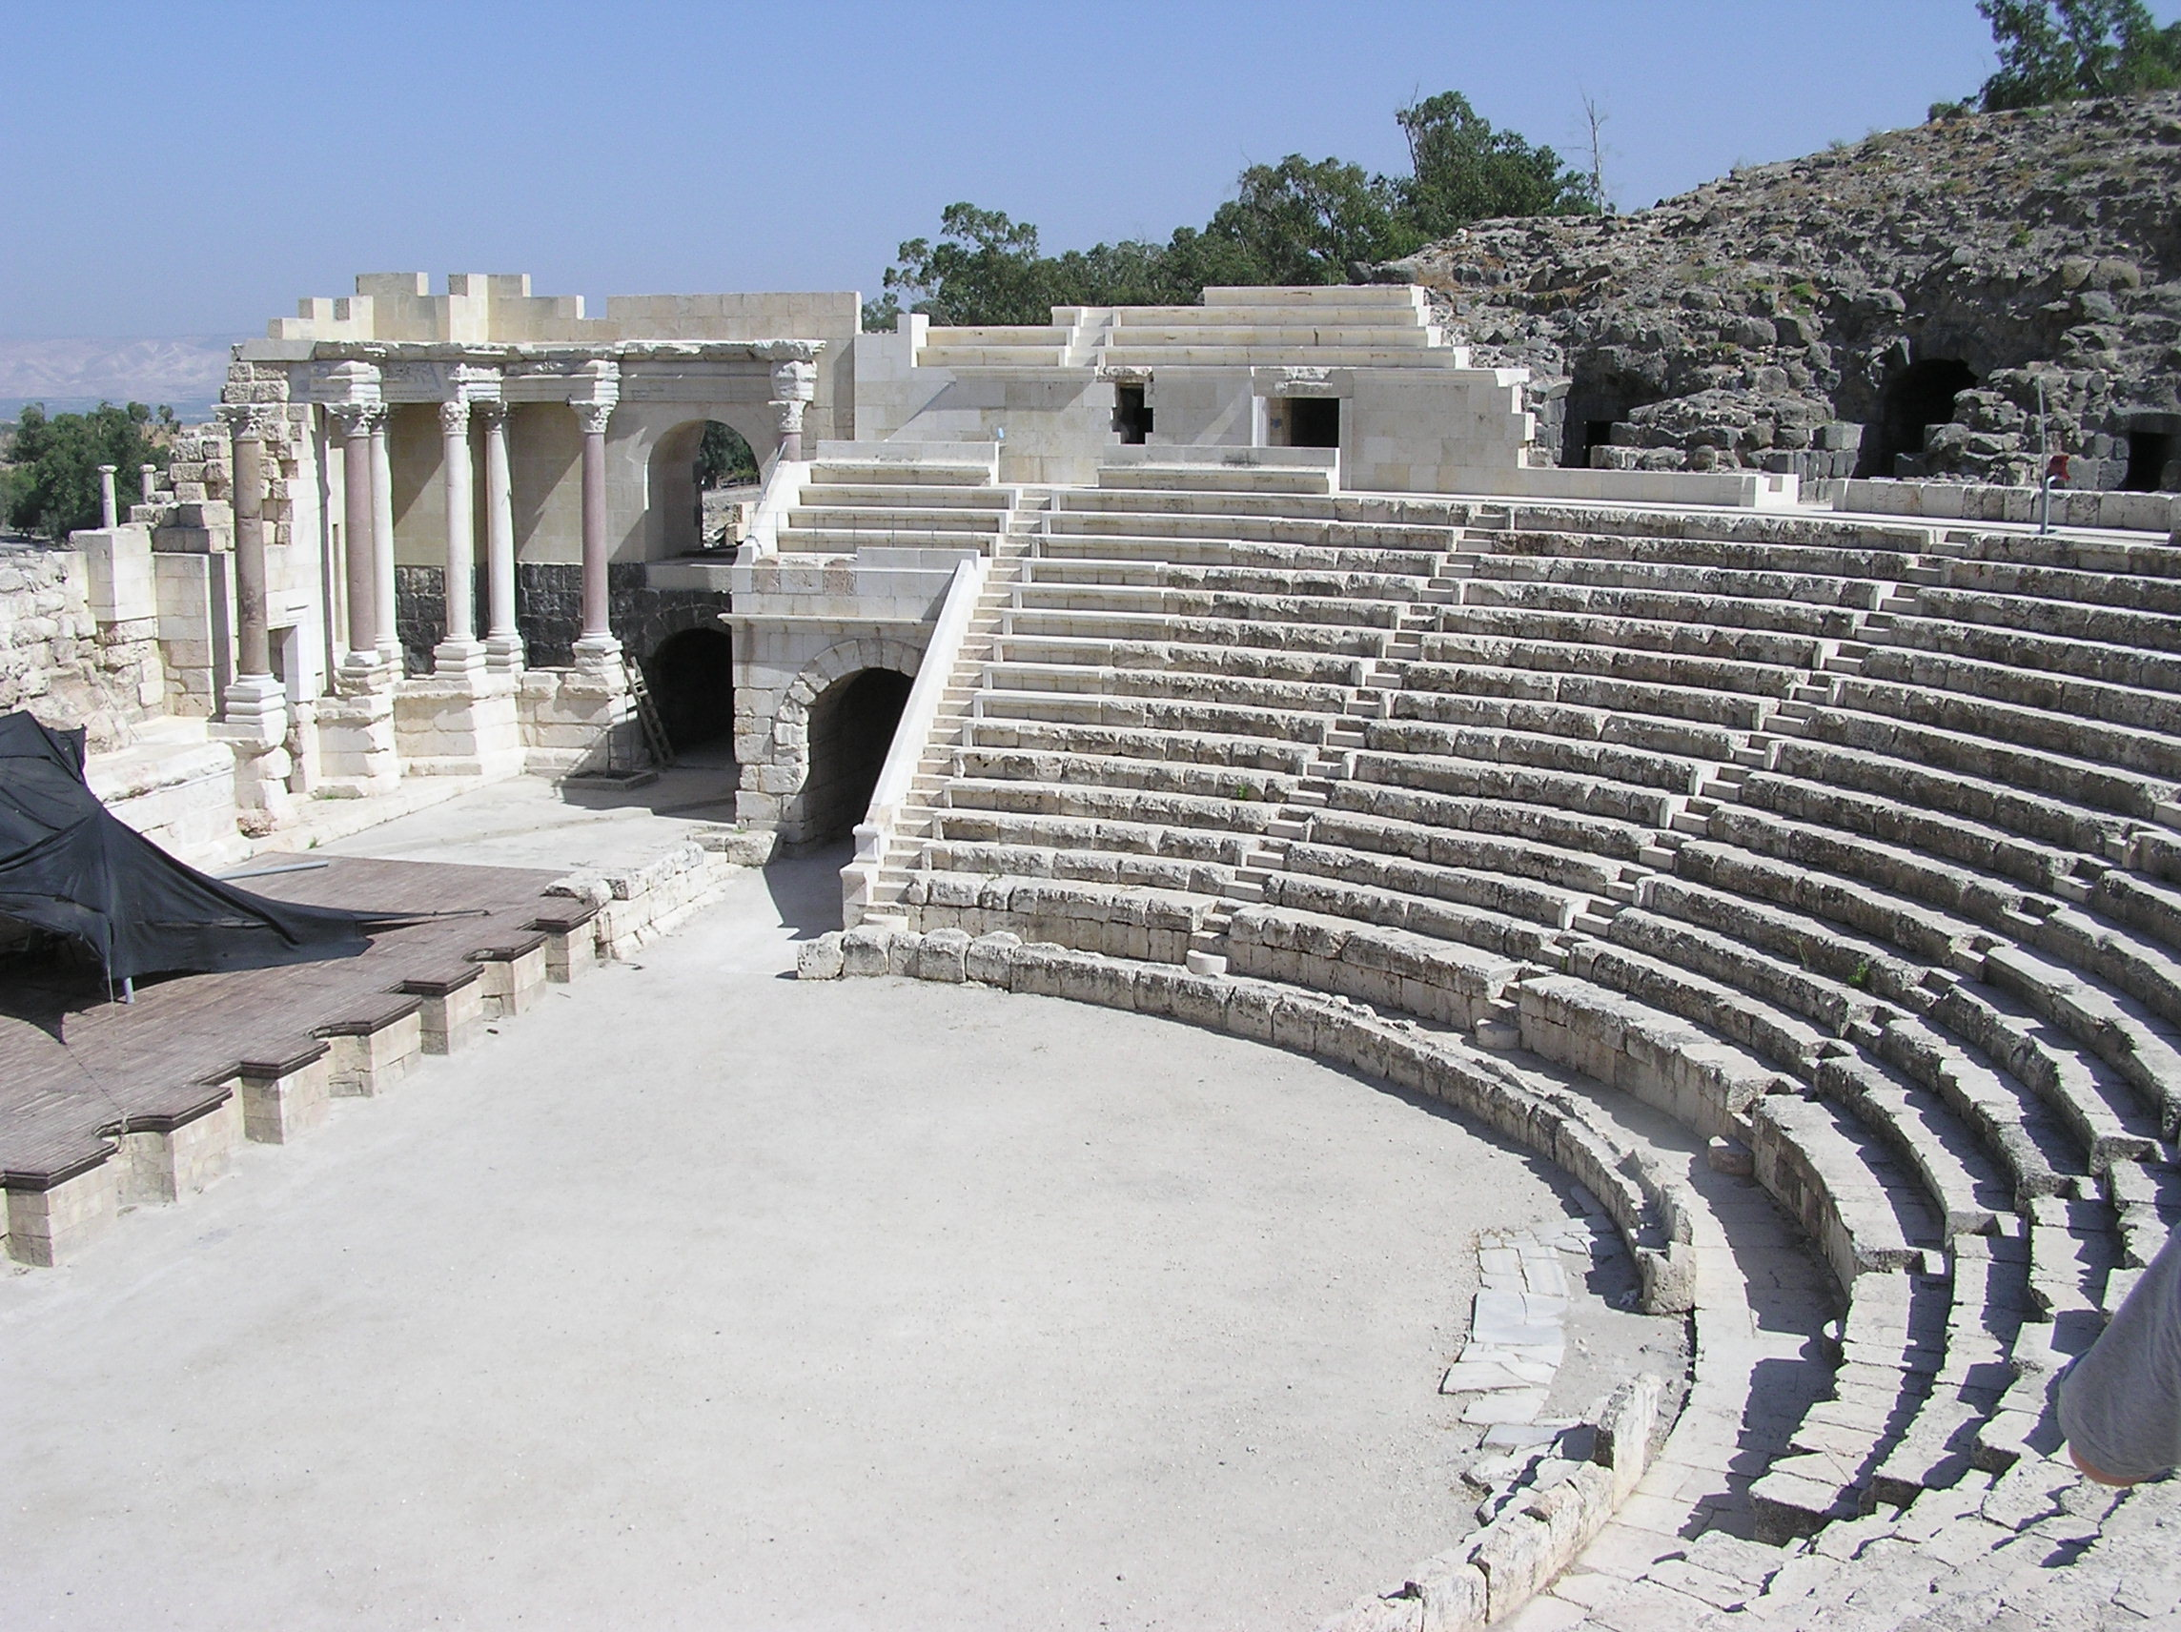
Theater
Arts / Media
Notes:
He knew if he control 4 things - Religion, Education, Media, and Entertainment, he could control what people believed and how they would be behave. He could plant his philosophy in their minds.

Slide 17
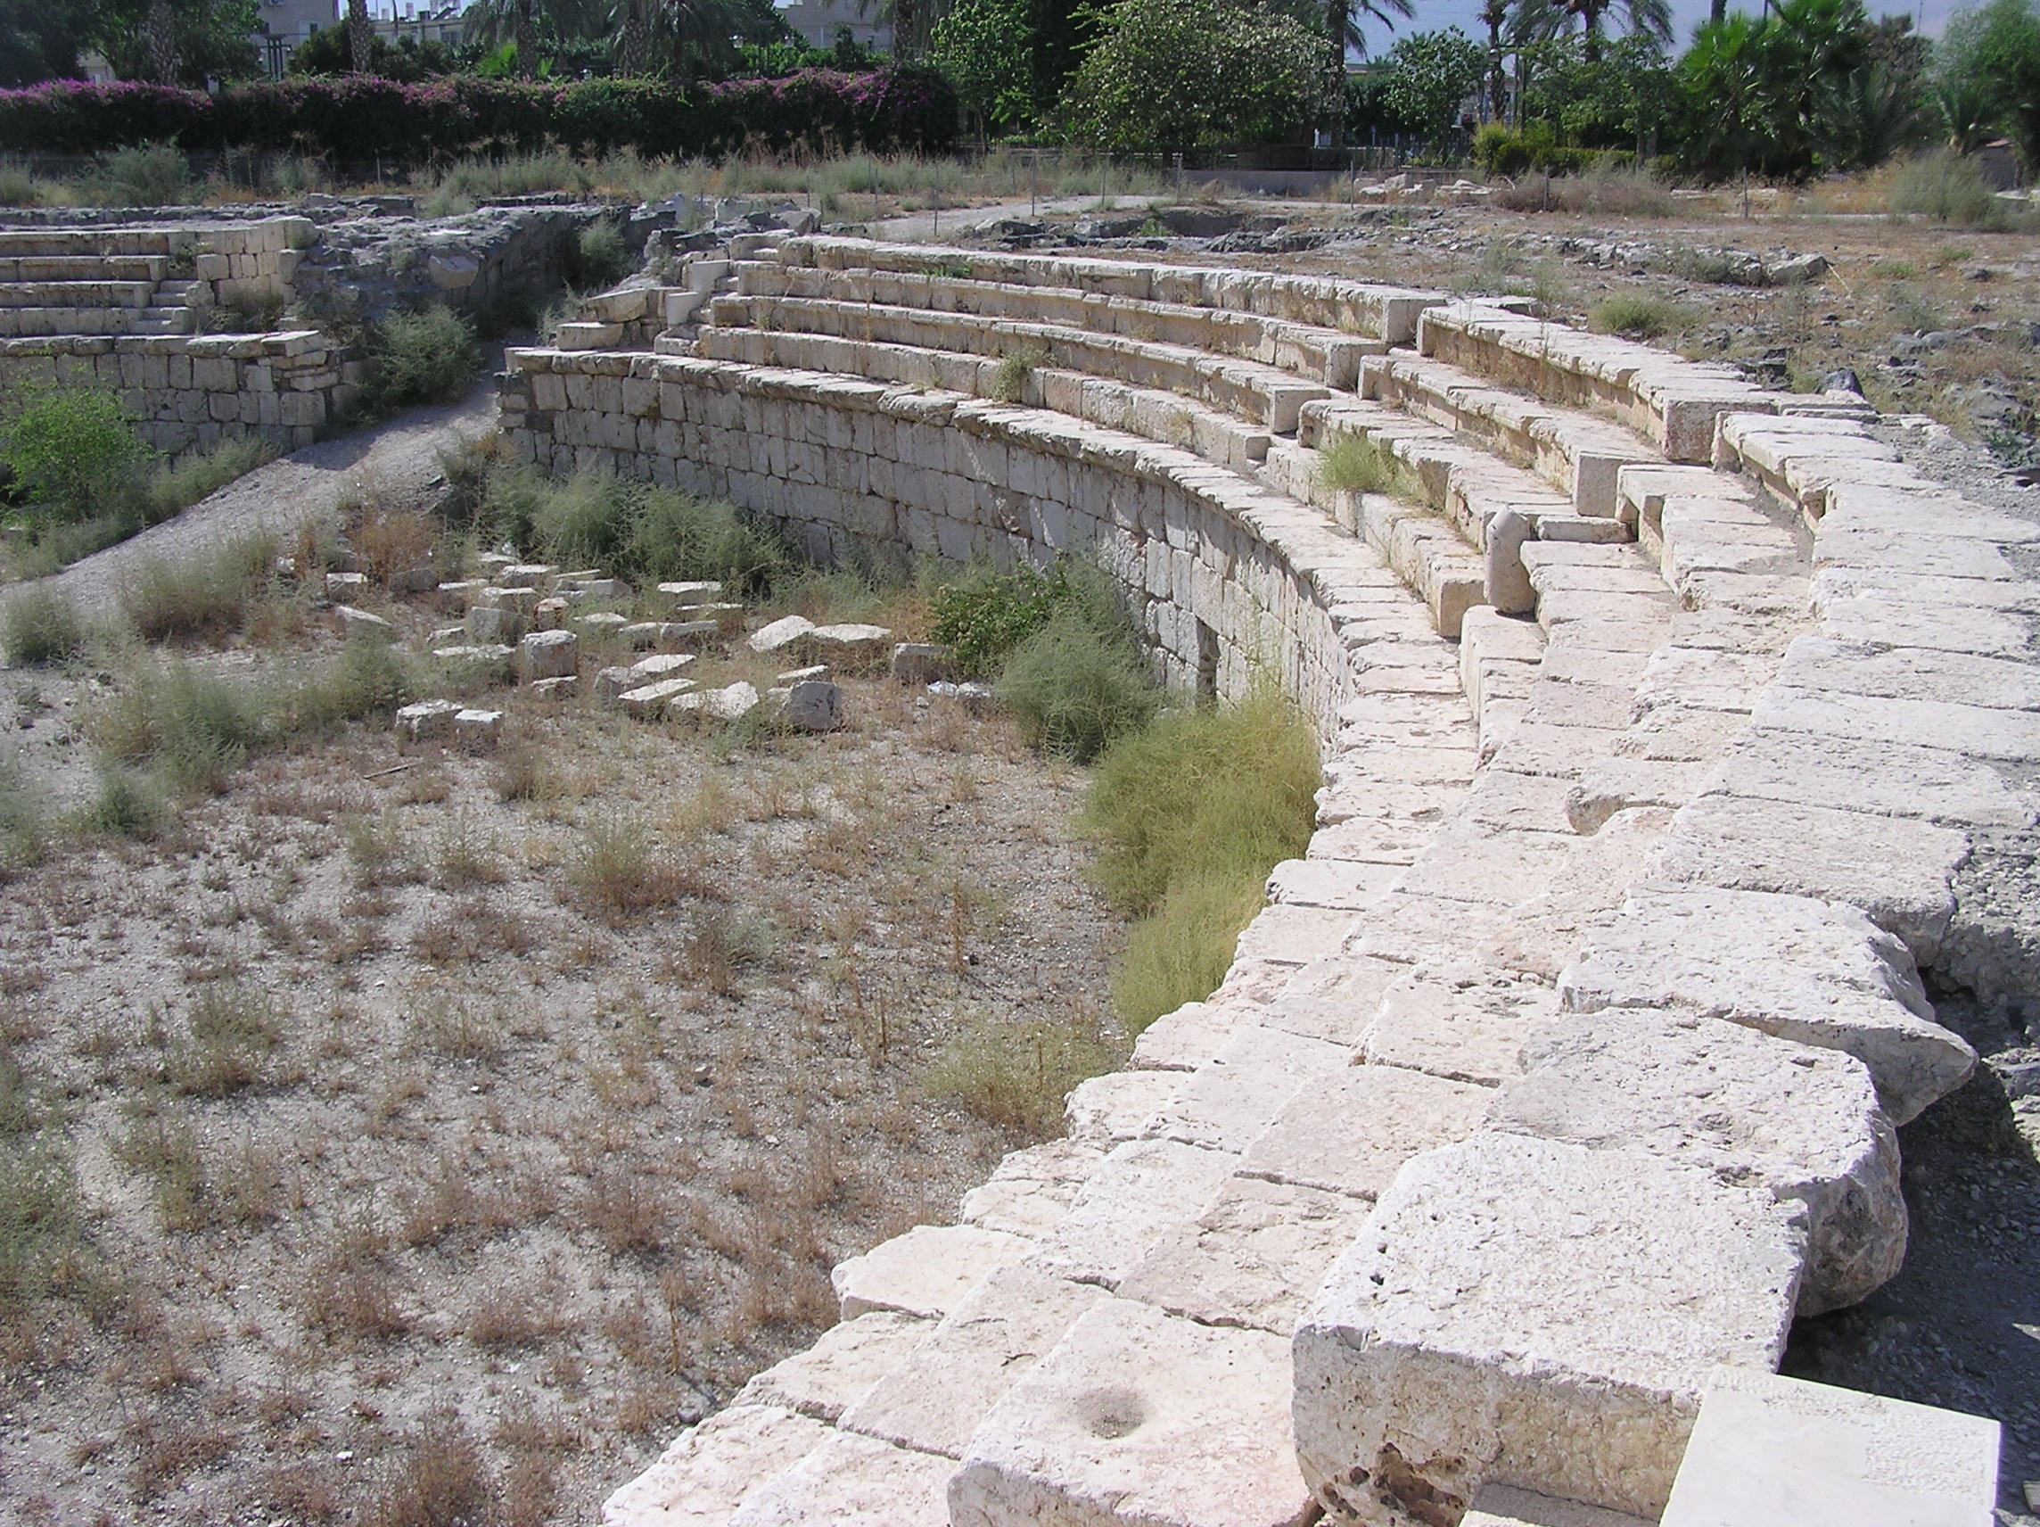
Arena
Sports
Notes:
Competition - man against man, which one is Best? Which one has more value?

Slide 18
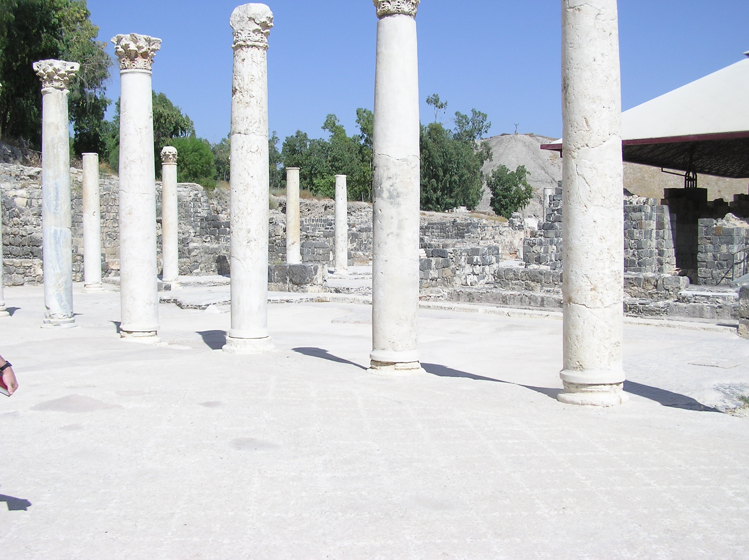
Gymnasium
Education
Notes:
gymnas = nude;
He knew if he control 4 things - Religion, Education, Media, and Entertainment, he could control what people believed and how they would be behave. He could plant his philosophy in their minds.

Slide 19

Clash of Cultures
Greek
ISRAEL
vs.
Roman
Jewish
Pagan
YHWH
Notes:
CLASH of Culture -- CLASH of Values
Jewish - extreme modesty in dress and behavior; Greek displaying public nudity, coed education and sports in the nude.
And offering all the materialistic trappings that lure a person away from focus on the things of God, at least according the Rabbis.

Slide 20
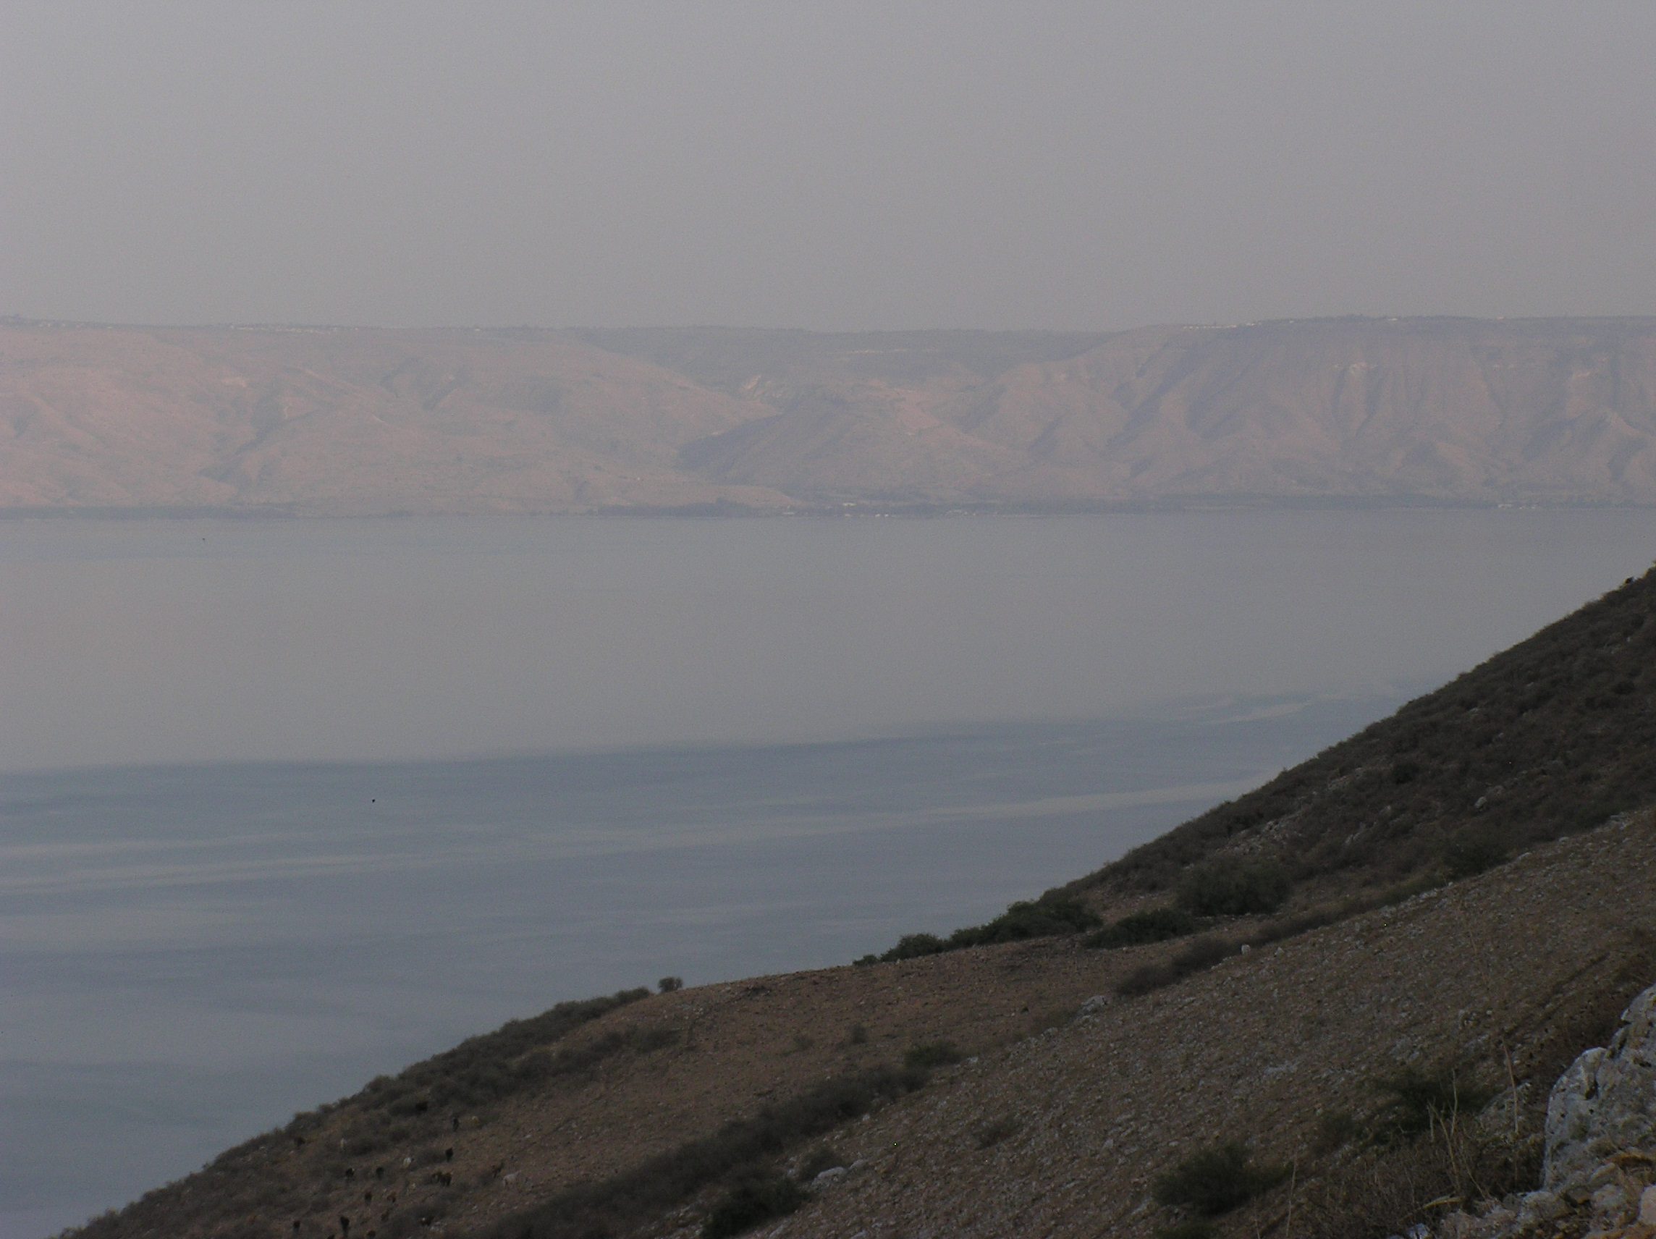
Decapolis
"Pagan Country"
Susita
Notes:
Like AMISH vs Las VEGAS at Lake of the Weeds
There was one decapolis city - the one where our story takes place today - that is on the edge of the Sea of Galilee. Small sea, so it's visible from nearly everywhere around the sea.
This picture is taken from Mt Arbel - the mt with the caves where King Herod started his reign of killing and death as the new King of Palestine.

Slide 21
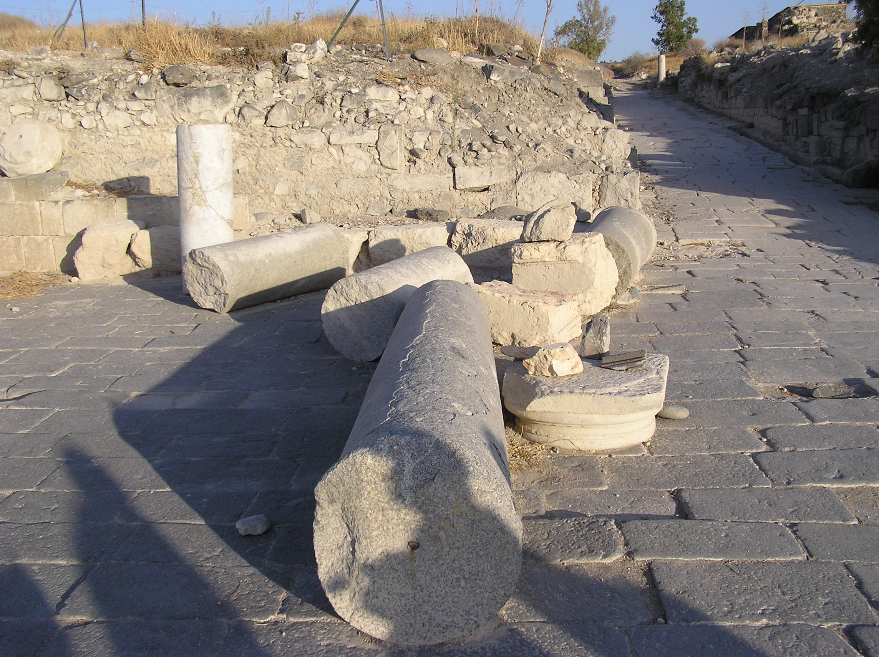
Susita
Pop. ~12,000
Notes:
Susita was the smallest city of the decapolis cities.
It hasn't really been excavated very much yet - so you have to imagine a place like Beth Shan, just smaller.

Slide 22
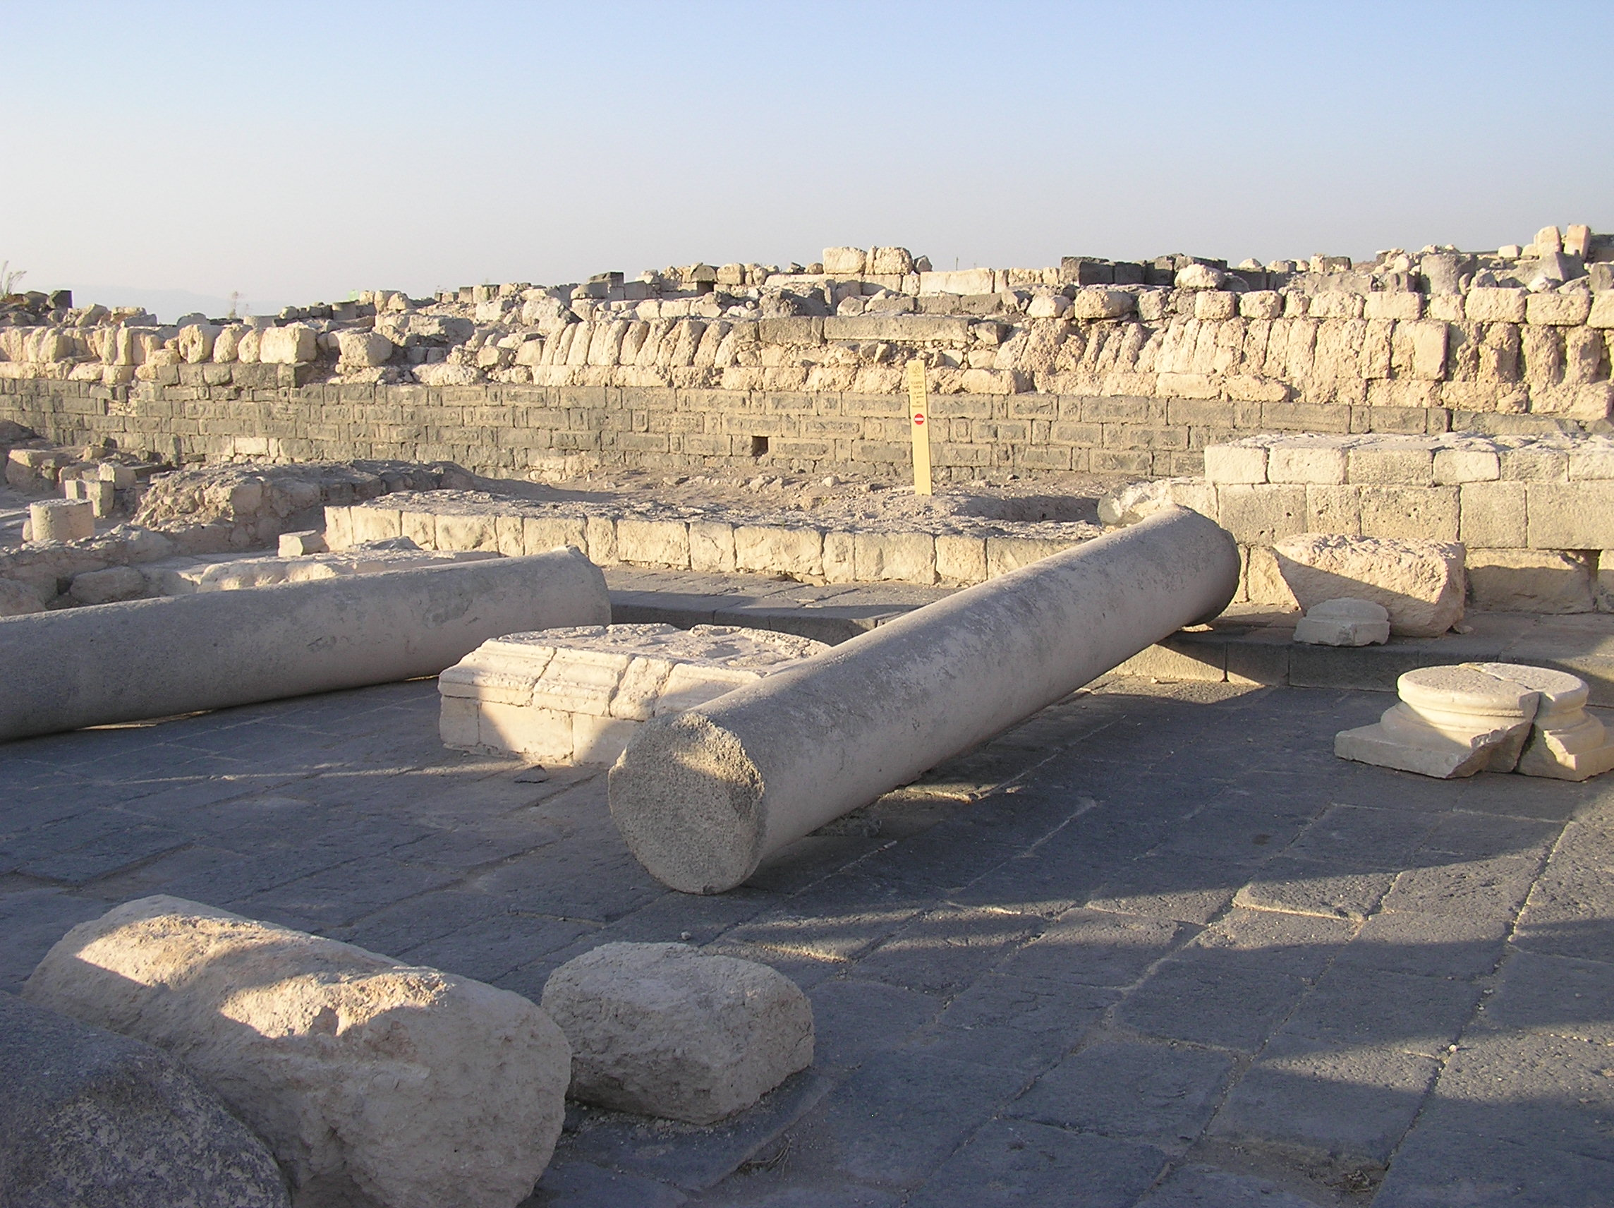
Susita
Town Square
Notes:
It would have had a theater, a gymnasium, and pagan temples.

Slide 23
Decapolis
"Pagan Country"
Susita
Kursi
Tombs
Cliffs
Notes:
But it was visible from all around the Sea of Galilee - like a beacon or lighthouse proclaiming it's hellenistic, ungodly philosophy.
Jesus took his disciples here -- probably landing at the tiny fishing village of Kursi, under the jurisdiction of the city of Susita.
There were some cliffs close by -- the only place around the entire Sea of Galilee where cliffs would have come right to the edge of the sea.
And in the hills behind the cliffs there have been found some caves, used as tombs long ago.

Slide 24
Shema
Mark 5:2-5 (NIV)
When Jesus got out of the boat, a man with an evil spirit came from the tombs to meet him. This man lived in the tombs, and no one could bind him any more, not even with a chain. For he had often been chained hand and foot, but he tore the chains apart and broke the irons on his feet. No one was strong enough to subdue him. Night and day among the tombs and in the hills he would cry out and cut himself with stones.

Slide 25
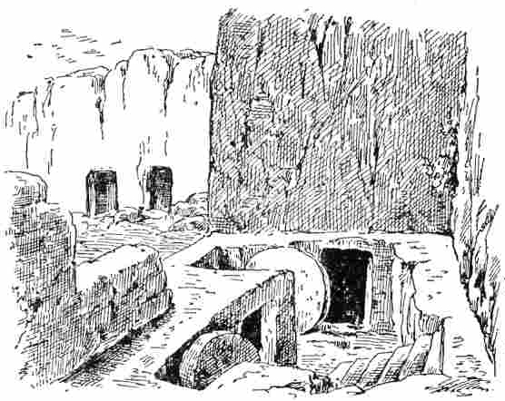
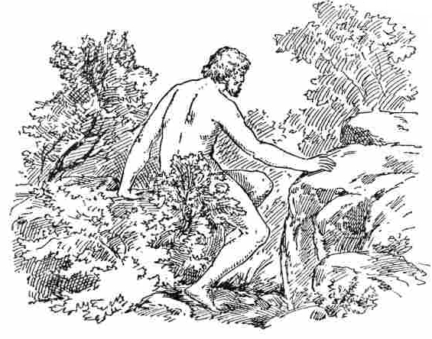
Naked
Filthy, Stinky
Bloody, Scabby
Strong Dangerous
Uncontrollable
Notes:
Picture him - naked, dirty, smelly, bloody, scabby
Strong, dangerous, uncontrolable

Slide 26
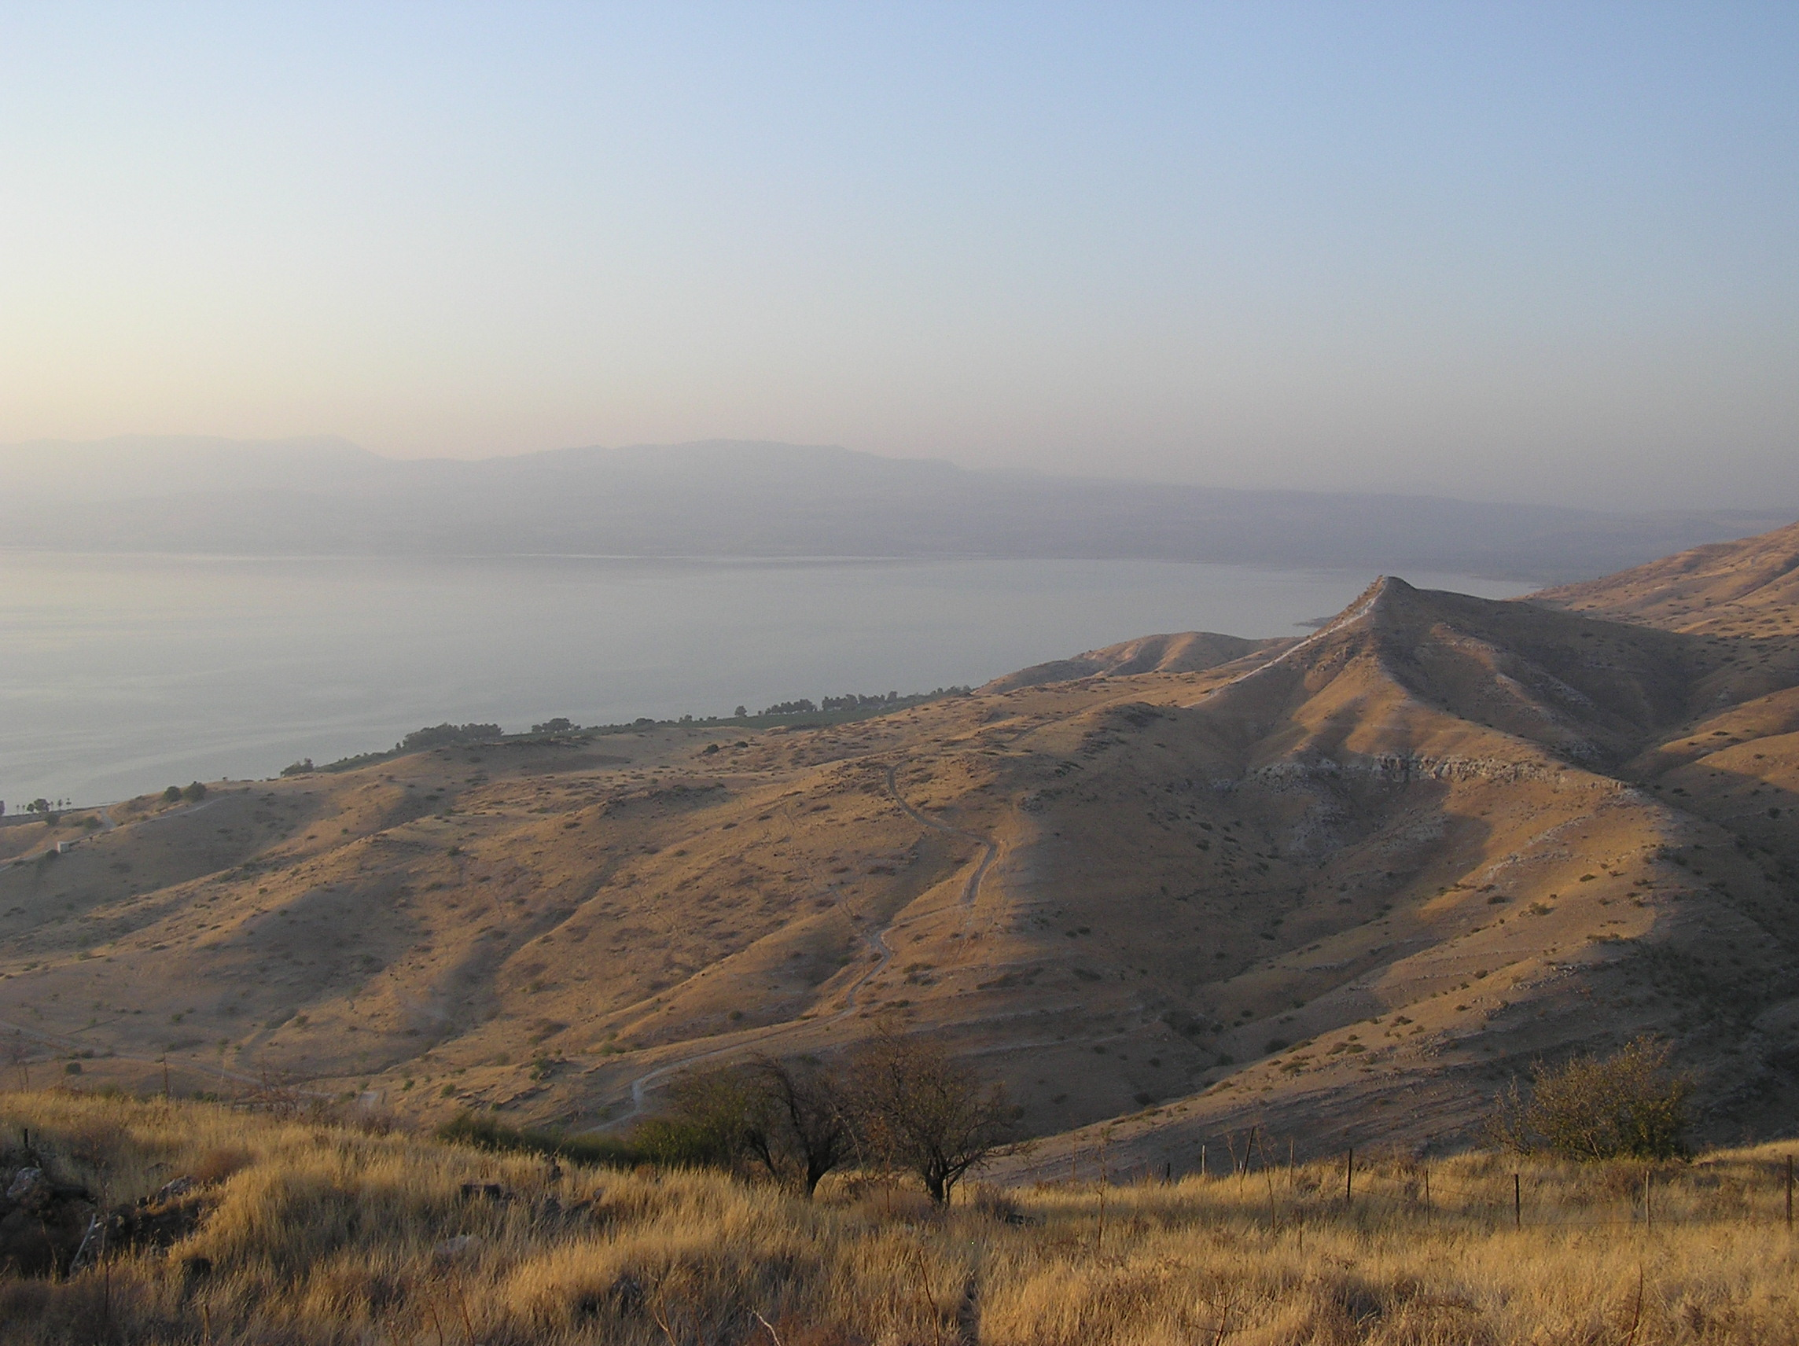
View from Susita
Tombs
Cliffs
Notes:
Imagine him in the middle of the night, on the peak of the hill above the tombs, screaming and wailing at the top of his lungs. You could hear him all over the countryside. On a still quiet night, perhaps you could even hear him here in the city of Susuta.

Slide 27
Shema
Mark 5:6-10 (NIV)
When he saw Jesus from a distance, he ran and fell on his knees in front of him. He shouted at the top of his voice, “What do you want with me, Jesus, Son of the Most High God? Swear to God that you won’t torture me!” For Jesus had said to him, “Come out of this man, you evil spirit!”
Then Jesus asked him, “What is your name?”
“My name is Legion,” he replied, “for we are many.” And he begged Jesus again and again not to send them out of the area.
Notes:
Legion "a large number" - interesting that he used this word for his name. Perhaps there is a link here to the fact that there was a Roman legion stationed right here in Susita. It was the 12th legion, one of Rome's most elite legions. The marines, the best of the best. Because of the great threat to Rome coming from the Zealots headquartered in Gamla, just a couple miles away.

Slide 28
Shema
Mark 5:11-13 (NIV)
A large herd of pigs was feeding on the nearby hillside. The demons begged Jesus, “Send us among the pigs; allow us to go into them.” He gave them permission, and the evil spirits came out and went into the pigs. The herd, about two thousand in number, rushed down the steep bank into the lake and were drowned.
Notes:
In a way it makes sense to go into the pigs. The sacred animal sacrificed to Baal & Zeus. This was where they belonged.

Slide 29
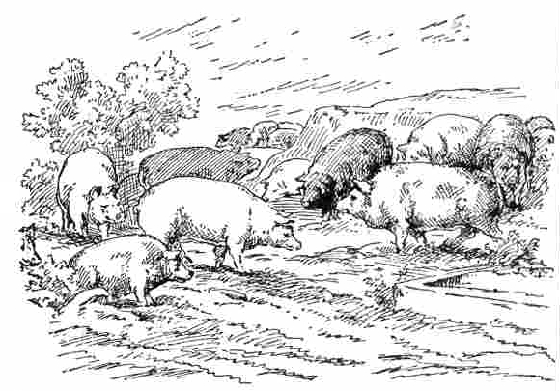
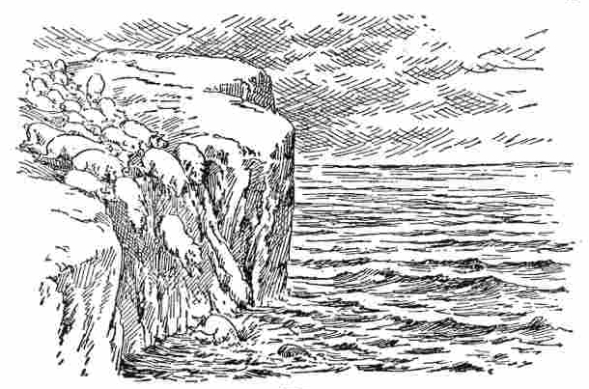
2000 Pigs
"Sacred Animals"
Mascot of 12th Legion
The Sea
The Abyss
The Underworld
Notes:
The pigs were the sarifical animal for the pagan god.
It had special meaning for Susita because of the 15th Legion
The Sea was the underworld, the domain of Baal, of the evil one.
It made sense for the evil spirits to want to go into the Pigs
And for the pigs to rush into the sea - to go to where they belong - the abyss is their home!

Slide 30
Shema
Mark 5:14-17 (NIV)
Those tending the pigs ran off and reported this in the town and countryside, and the people went out to see what had happened. When they came to Jesus, they saw the man who had been possessed by the legion of demons, sitting there, dressed and in his right mind; and they were afraid. Those who had seen it told the people what had happened to the demon-possessed man—and told about the pigs as well. Then the people began to plead with Jesus to leave their region.
Notes:
the town = Susita
countryside - everyone along the way to Susita
dressed - somebody had given him clothes to wear, treated him as a human

Slide 31
Why did the Decapolis people
want Jesus to leave?
Valuable pigs were destroyed
The gods would be angered
Peace & order were threatened
Jesus challenged their view of life
    He gave value to the "worthless"
    He turned their world upside down
    They didn't understand & didn't want to

Slide 32
Shema
Mark 5:18-20 (NIV)
As Jesus was getting into the boat, the man who had been demon-possessed begged to go with him. Jesus did not let him, but said, “Go home to your family and tell them how much the Lord has done for you, and how he has had mercy on you.” So the man went away and began to tell in the Decapolis how much Jesus had done for him. And all the people were amazed.
Notes:
begged to go with him -- imagine the LOVE he had for Jesus!
He had been given real value. He was a person. He had been saved.

Slide 33
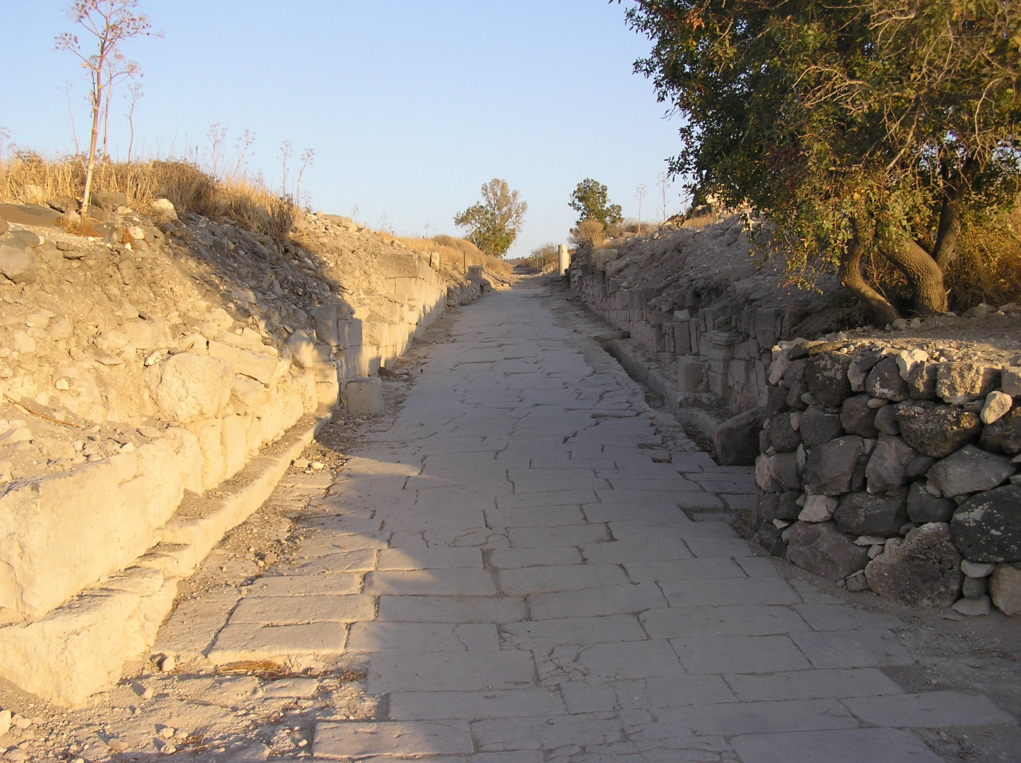
Susita
Roman Road
Notes:
Can you see the man running into Susita, along this very road?

Slide 34
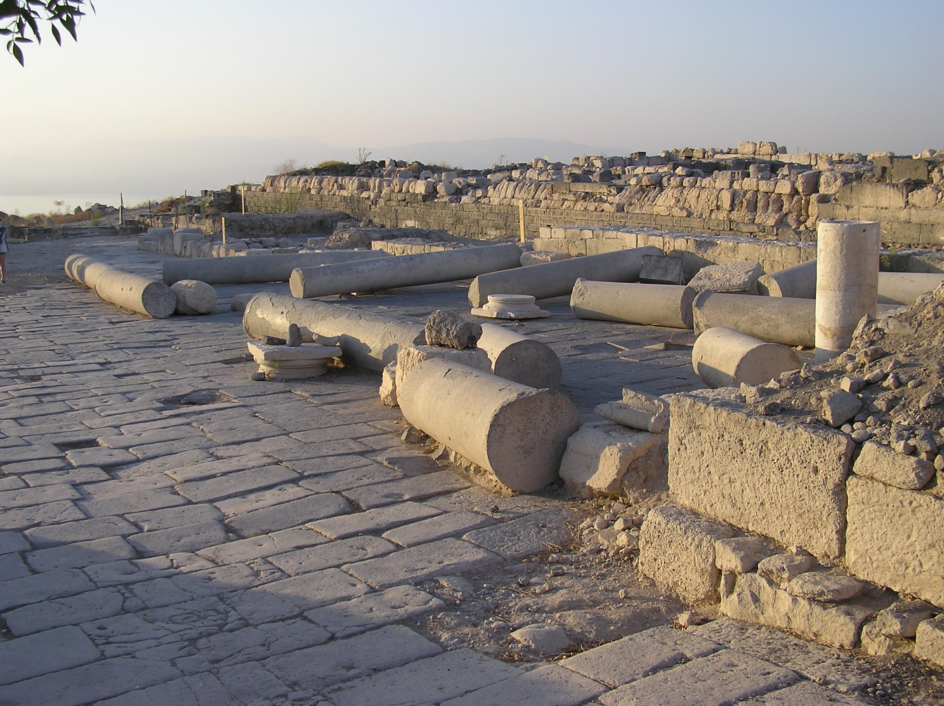
Susita
Town Square

Slide 35
Colonade
Main Street Shopping
Notes:
He probably walked the main street of Beth Shan, right here, and stood under the colonade and with excitement told his story.

Slide 36
Shema
Mark 7:31 (NIV)
Then Jesus left the vicinity of Tyre and went through Sidon, down to the Sea of Galilee and into the region of the Decapolis…
Mark 8:1 (NIV)
During those days another large crowd gathered…
Notes:
Scripture mention the Decapolis only one other time, again when Jesus goes there, some time after the event we just read about.

Slide 37
Shema
Matthew 15:29-31 (NIV)
Jesus left there and went along the Sea of Galilee. Then he went up on a mountainside and sat down. Great crowds came to him, bringing the lame, the blind, the crippled, the mute and many others, and laid them at his feet; and he healed them. The people were amazed when they saw the mute speaking, the crippled made well, the lame walking and the blind seeing. And they praised the God of Israel.

Slide 38
Where did the crowds come from?
Was it because of the "crazy man"?
Did he really do what Jesus commanded?
If so, he left quite a legacy.
"They praised the God of Israel"
Notes:
How did they know about Jesus in that pagan land?
His legacy -- they praised the God of Israel !!

Slide 39
The legacy of a demon-possessed crazy man, touched by Jesus
He Loved Jesus
He Obeyed Him
He Told his Story
and God's purpose was accomplished
Notes:
I'd be happy if the story ended right there. But there a wonderful little bit of extra, that we get from looking back at history.

Slide 40
Over the next decades, churches were formed in Susita
and throughout the Decapolis.
The church at Susita became the leading church in the region.
Eventually the church placed a
Bishop in Susita

Slide 41
In 325, the original draft of the
Nicene Creed was penned
by the Bishop of Susita
along with two other Bishops
Many generations
throughout history to this day
are blessed through the Nicene Creed.

Slide 42
Shema
Deut 7:9 (NIV)
Know therefore that the Lord your God is God; he is the faithful God, keeping his covenant of love to a thousand generations of those who love him and keep his commands.

Slide 43
Imagine leaving a legacy of God's love to your children, grandchildren
and theirs after them.
Love Me !
Keep My Commands !
Tell Your Story !
Notes:
The lesson of the demon-possessed man in the Decapolis, is that if God can use him in such a mighty way, he can use you too! But first we have to recognize that we need him. We have to see ourselves in as dirty and filthy in His eyes as the demon-possessed man would have looked to us.

